Slide 1
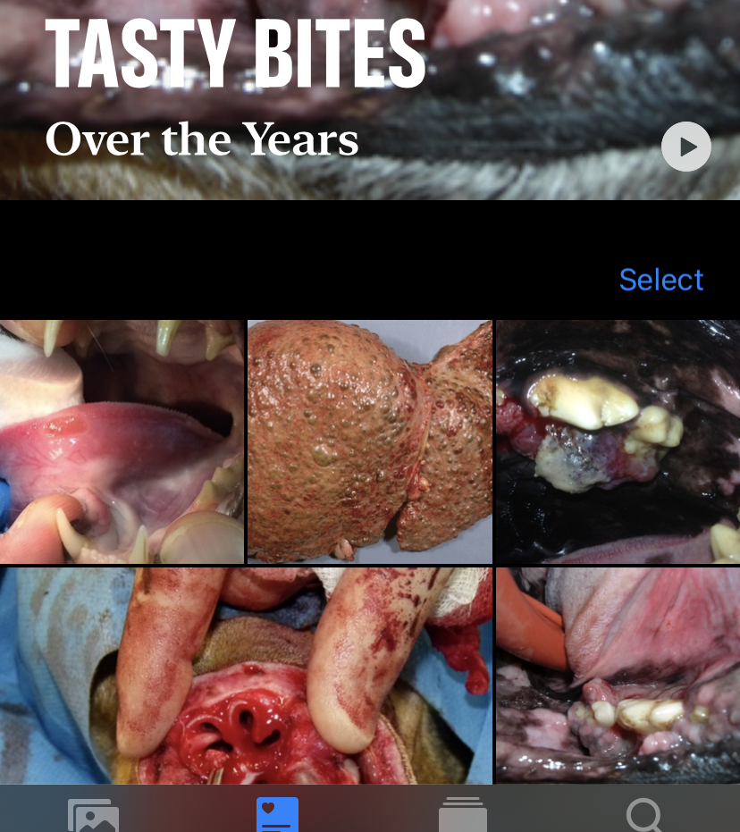
Veterinary oncology
Prof. David Killick DipECVIM-CA FRCVS
drk@liverpool.ac.uk
Perhaps not well understood outside the field
Spontaneous cancers
Dogs, cats (and horses)

Slide 2
Veterinary cancers
Spontaneous cancers
More recapitulation of the evolutionary process of cancer development in people
Similar range of cancers as suffered by humans
But incidences vary
‘Lifestyle’ cancers (drinking, smoking, sexually transmitted viruses) are less common

Slide 3
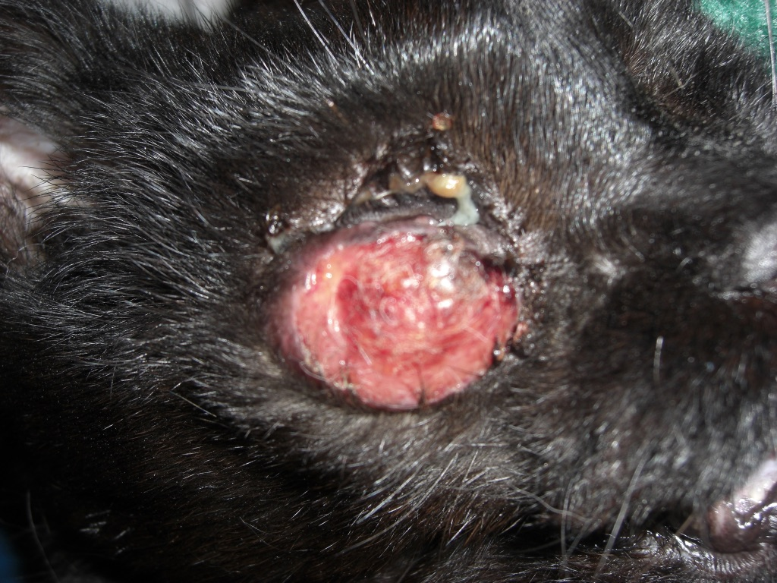
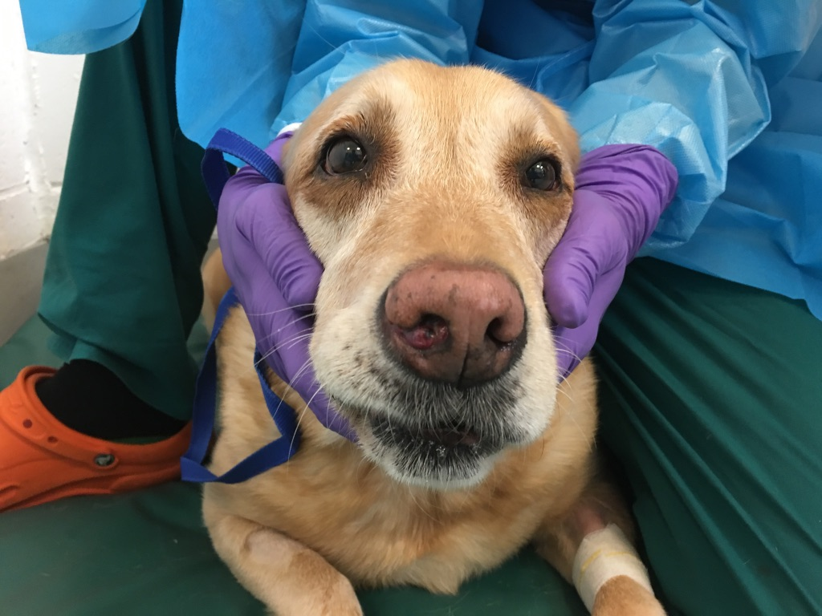
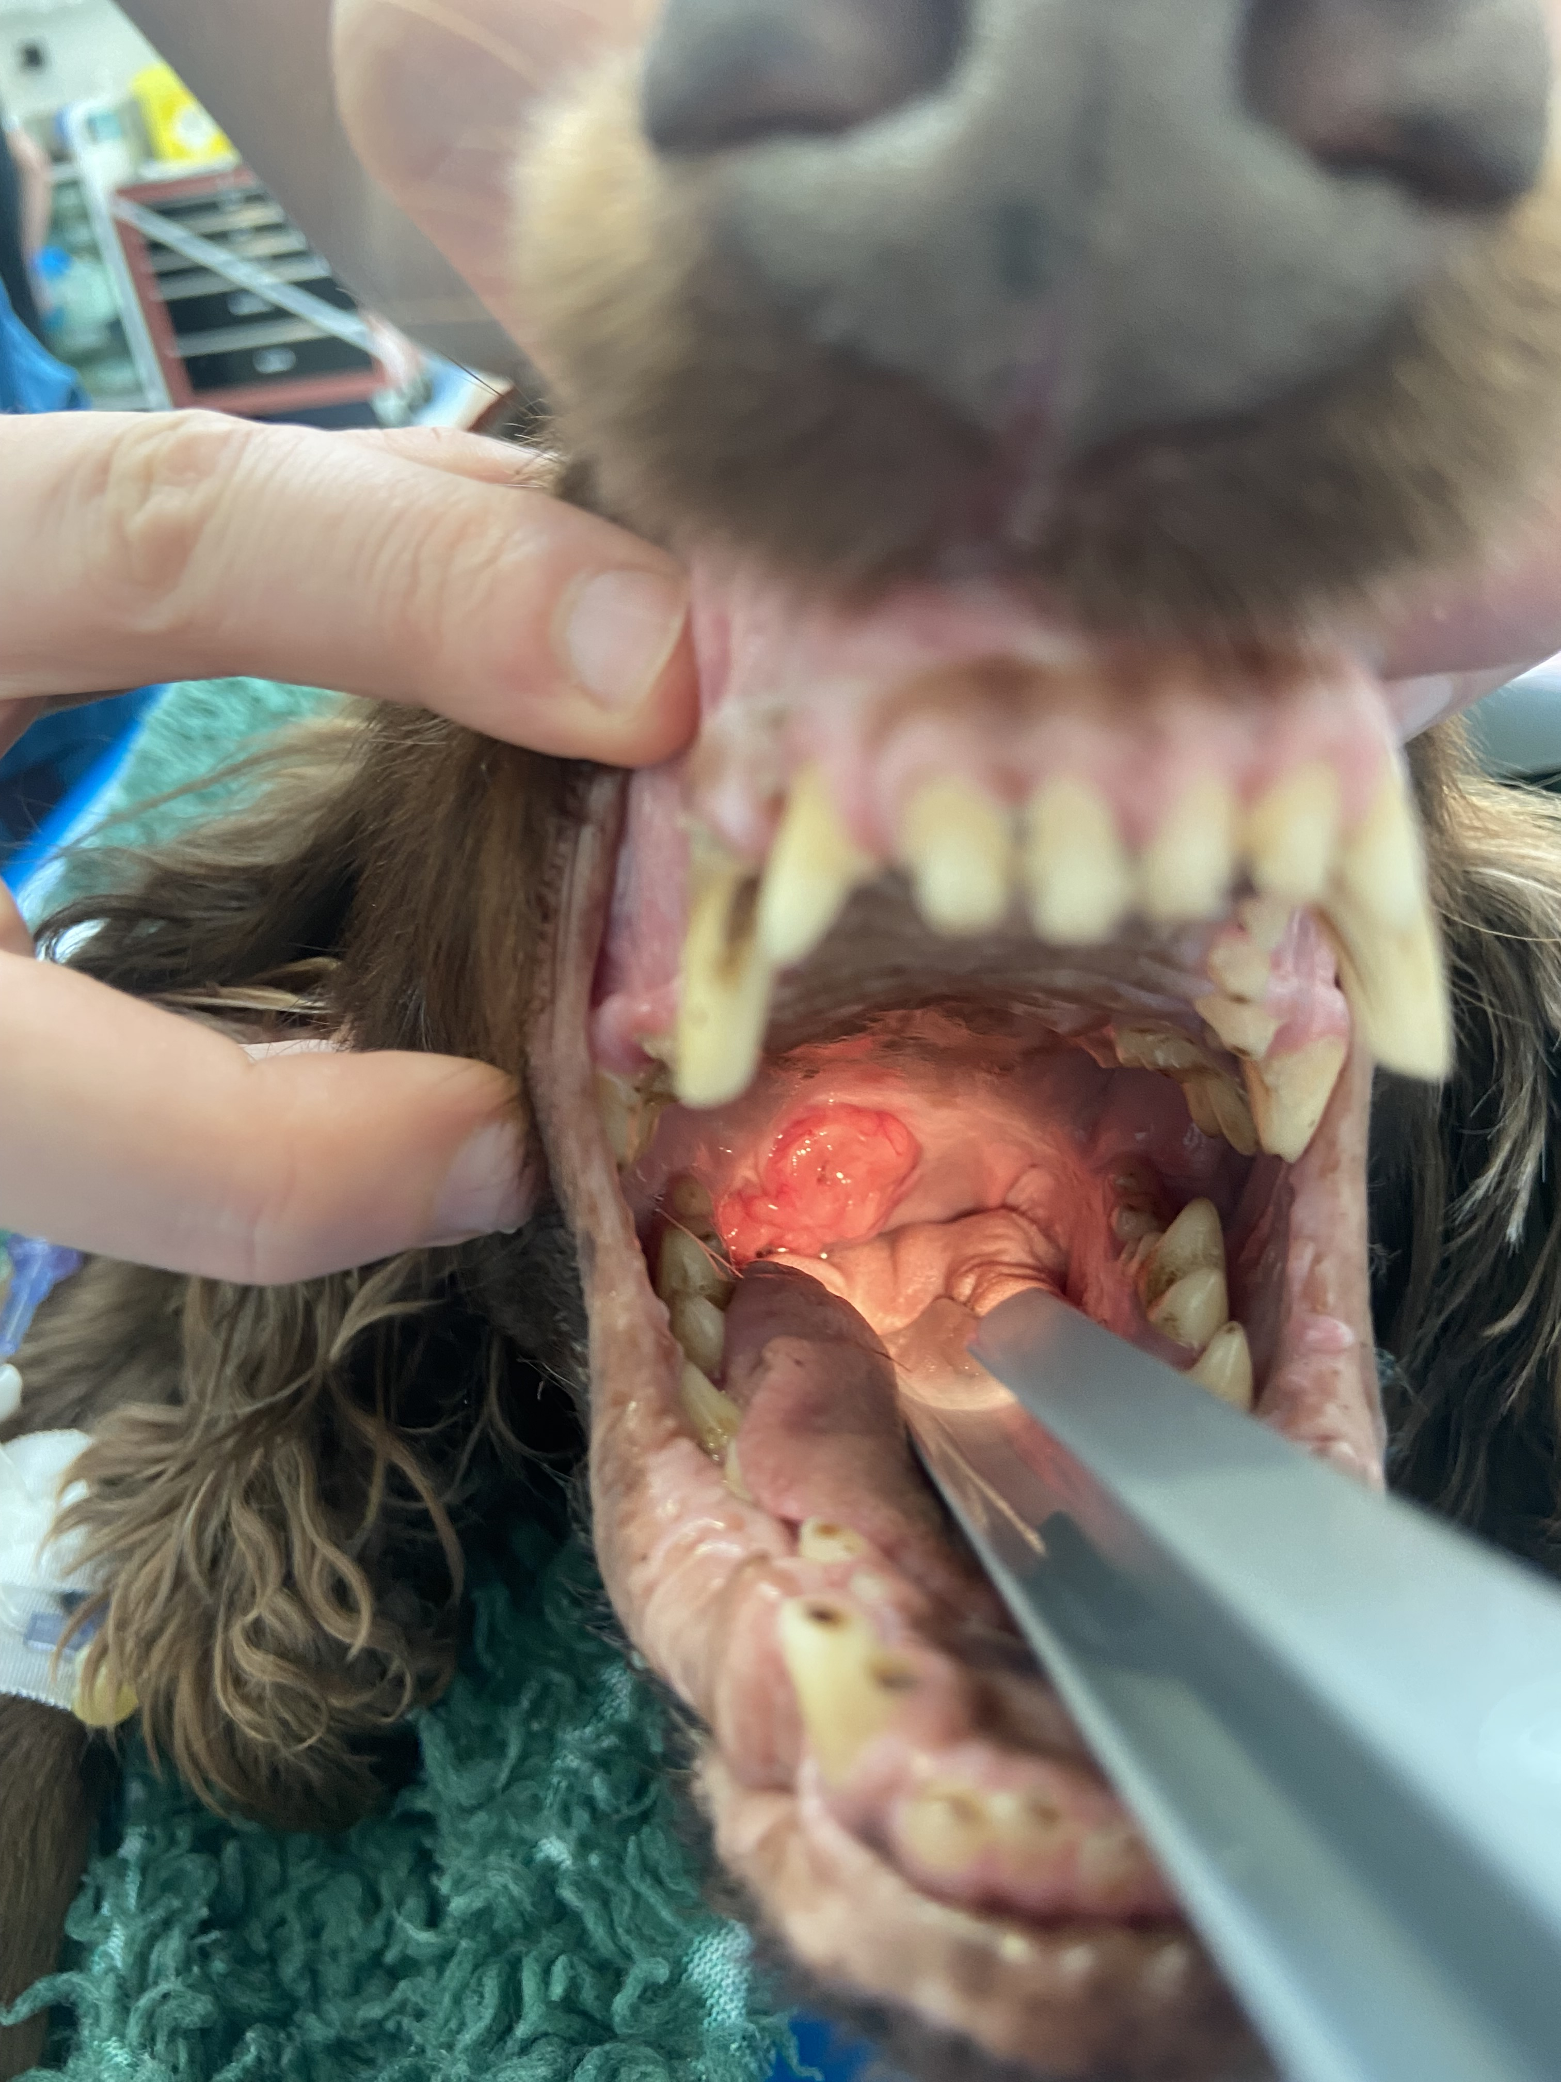
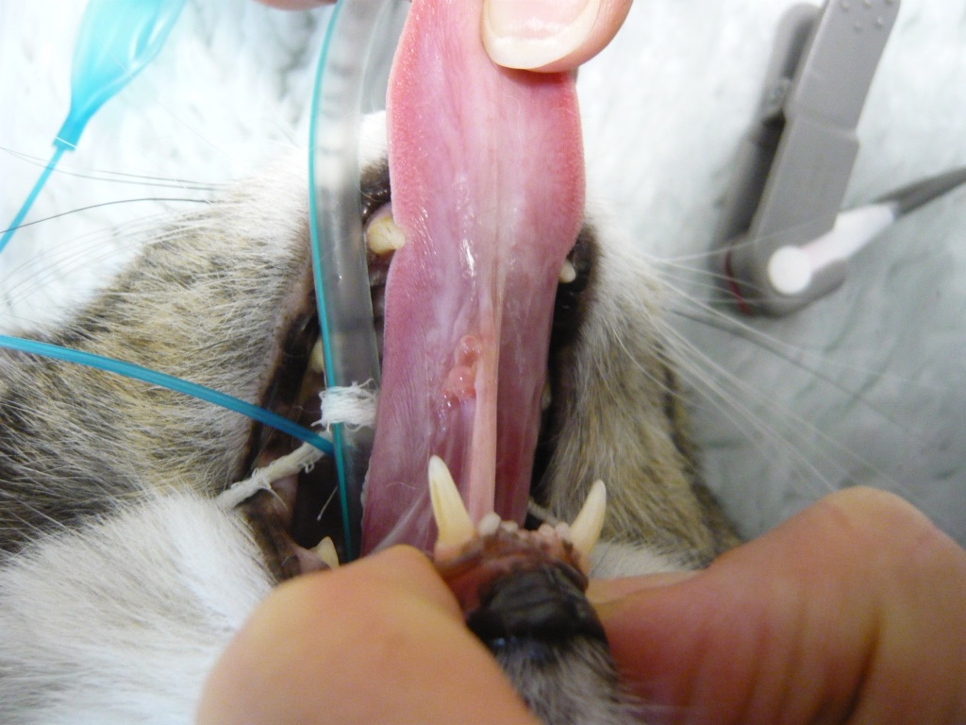
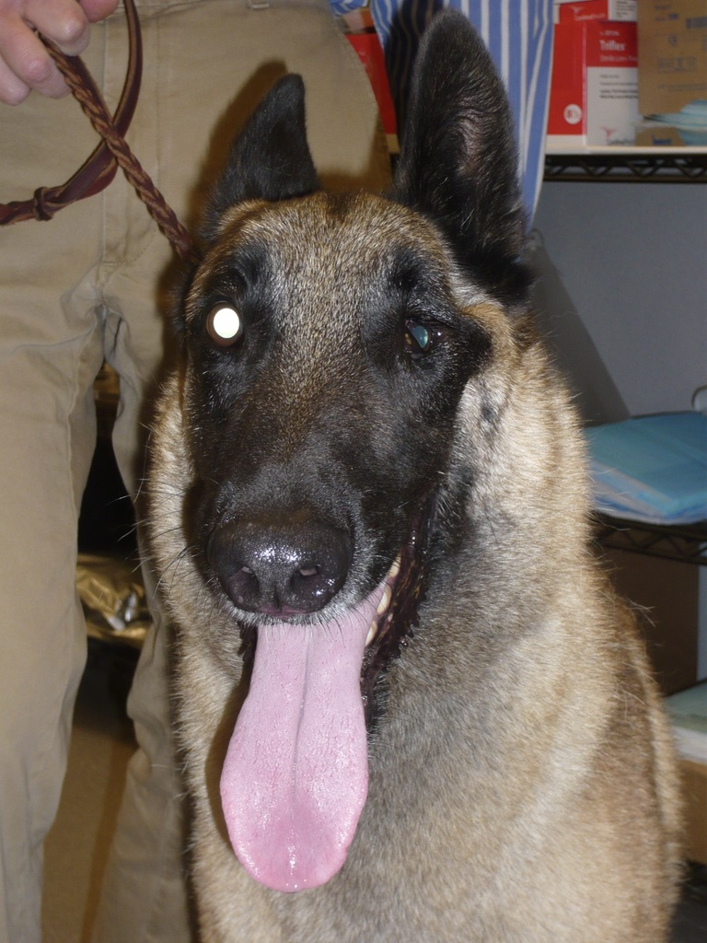
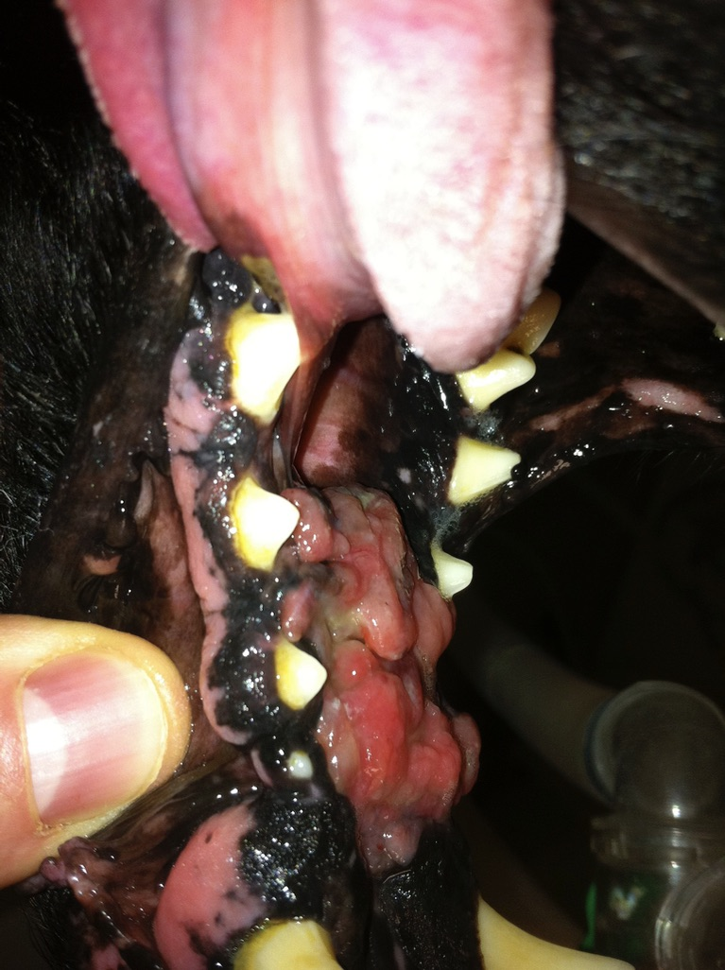

Slide 4
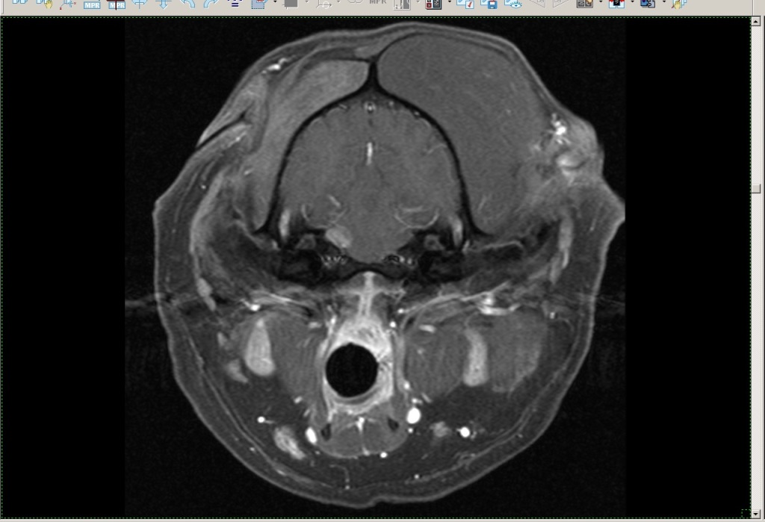
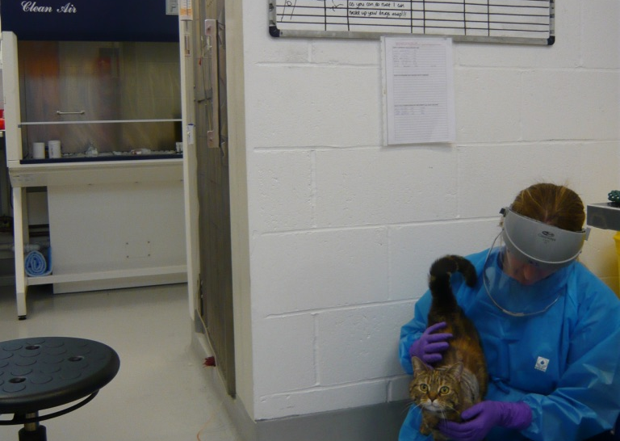
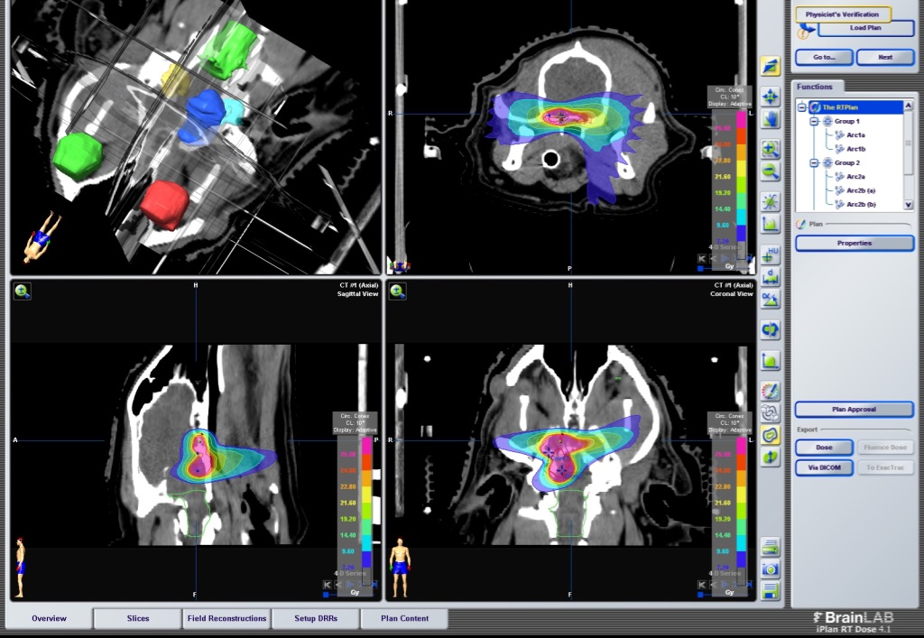
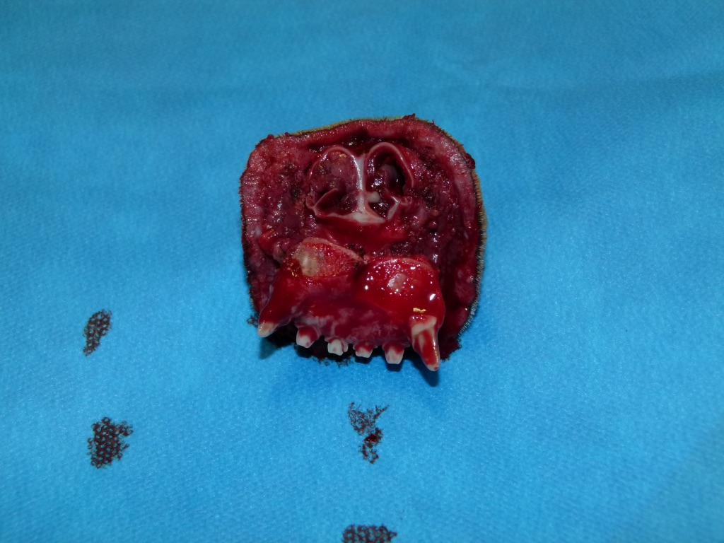
Veterinary Clinical Oncology
Diagnosis
Cytology, histopathology, IHC, flow, molecular pathology (developing)
Staging with imaging (XR, US, CT, MRI)
Treatment
Surgery
Radiation
LINACC based photons and electrons
3d conformal, IMRT, VMAT etc
Chemotherapy
Immunotherapy (basic compared to modern human oncology but developing)

Slide 5
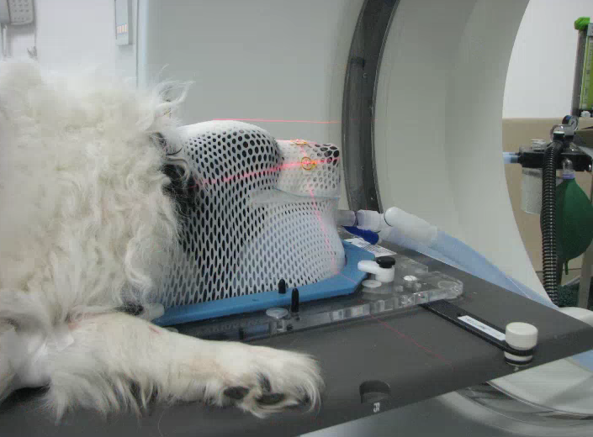
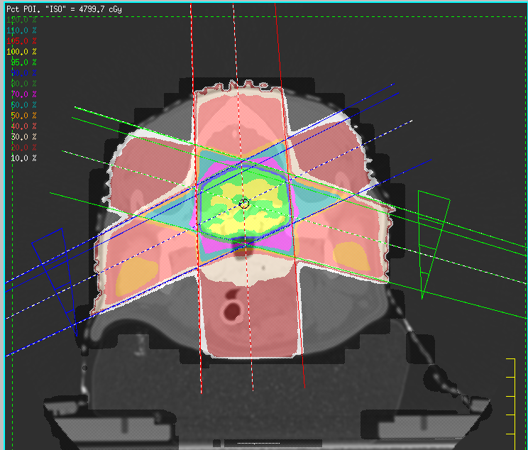
Veterinary radiation
Patients staged
Imaged in the treatment position to plan 3D radiation
Dose and fractionation prescribed
Patients treated under GA with port imaging as required

Slide 6
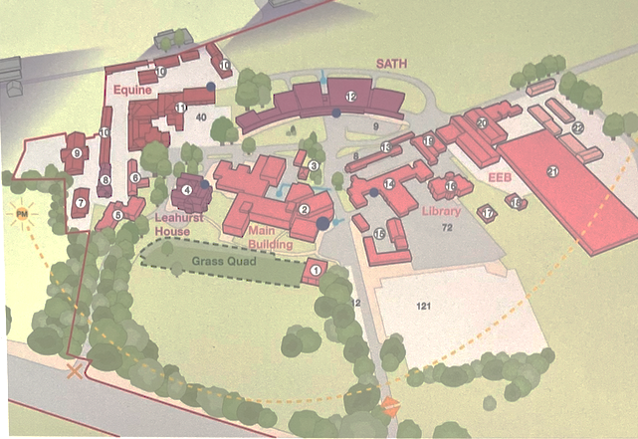
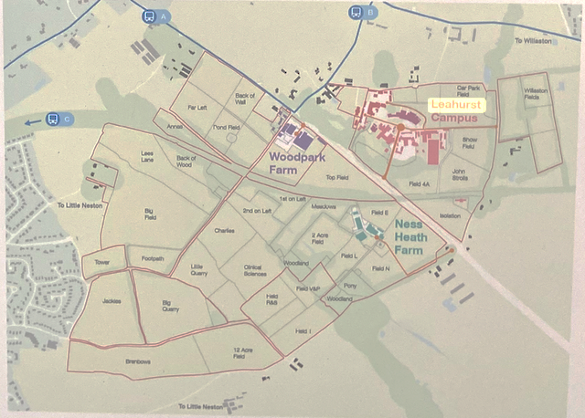
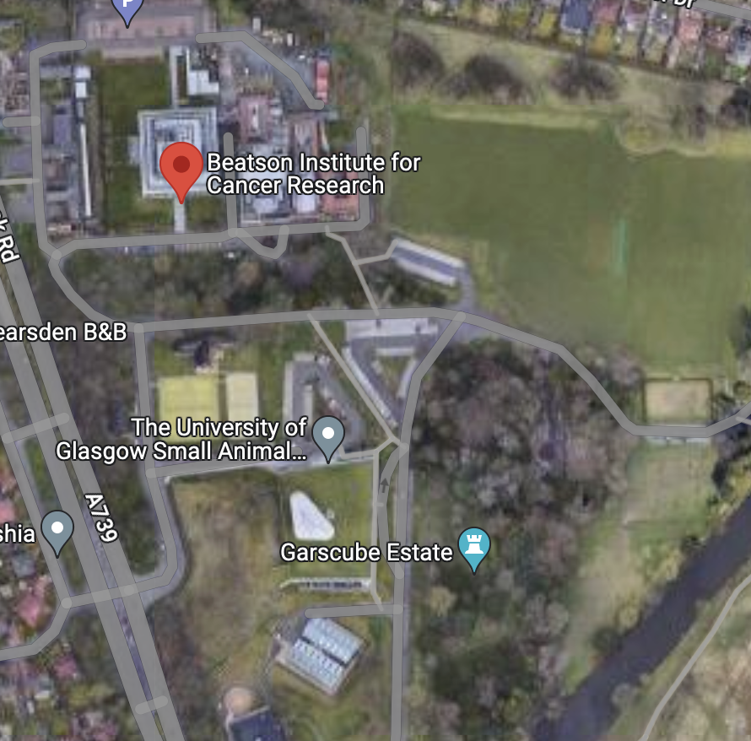
Typical university veterinary site
Leahurst
Neston nr Clatterbridge
University oncology services
Liverpool, Glasgow, Edinburgh, Cambridge, Bristol, RVC
Veterinary hospital
Patients
Veterinary specialists
Equipment
Experimental animal facilities
AWERB and ethics committees
Space for development (generally keen to get biotech partners on site)

Slide 7
Veterinary clinical research Basis - Veterinary Surgeons Act
Routine veterinary practice
Investigation and management involving procedures and techniques likely to be of direct benefit to the individual animal(s) – allows interventions which otherwise would be regulated
Clinical veterinary research
RVP plus work concurrently has an intention to generate new knowledge that benefits animals
Home Office license under ASPA
Planned work is not CVR AND involves procedures that breach the lower threshold outlined in ASPA. ASPA work can in principle be done on veterinary patients, but bureaucracy quite high
See FAQ
https://www.rcvs.org.uk/setting-standards/advice-and-guidance/faqs--routine-veterinary-practice-and-clinical-veterinary/

Slide 8
RCVS clinical veterinary research guidance
Ethical review is required for CVR
Client informed consent is required for CVR
An option to withdraw without penalty (to client or animal) is mandatory and should be explicit in consent information
Rarely exercised

Slide 9
RCVS clinical veterinary research guidance
Novel procedures require a thorough harm / benefit analysis
Is there evidence that likely benefits outweigh likely harms?
Is procedure of equivalent benefit and likely to cause less harm than that currently available?
Will the procedure improve overall animal welfare?
Is there a rescue plan in place?
Is the context appropriate (staffing, facilities, institutional support, insurance)?
This is a general consideration for RVP.

Slide 10
Some things to consider
Patients come with a client
Clinical Veterinary Research considerations
Generally interested in novel treatment
Quite a few diseases without optimal treatment
Keen on radiation treatments with lower numbers of fractionations (if treatment effect can be maintained)
Concerned about costs
Concerned about adverse effect severity
Want a functional (ideally better!) pet back
Reduces housing / feeding costs etc
Need some client facing facilities
CVR requires a vet to be recommending treatment
Reasonable expectation of beneficial effect
Flow of spontaneous diseases is variable
Can be increased through paid for trials
Anaesthesia of patients would need to be done by a veterinary surgeon
Procedures outside those clinically indicated would come under ASPA
No further regulatory training or reporting considerations for CVR

Slide 11
Conclusions regarding clinical veterinary research
Fewer barriers to entry
Limitations on what can be done with veterinary animals
Additional PR – clients etc
Disease models may be more relevant
Potential to have experimental and spontaneous animals on same site

