Slide 1
3D modelling of FETS-FFA main magnet
10/01/24
Ta-Jen Kuo
Supervisor: Jaroslaw Pasternak, Jean-Baptiste Lagrange
Imperial College London, STFC

Slide 2
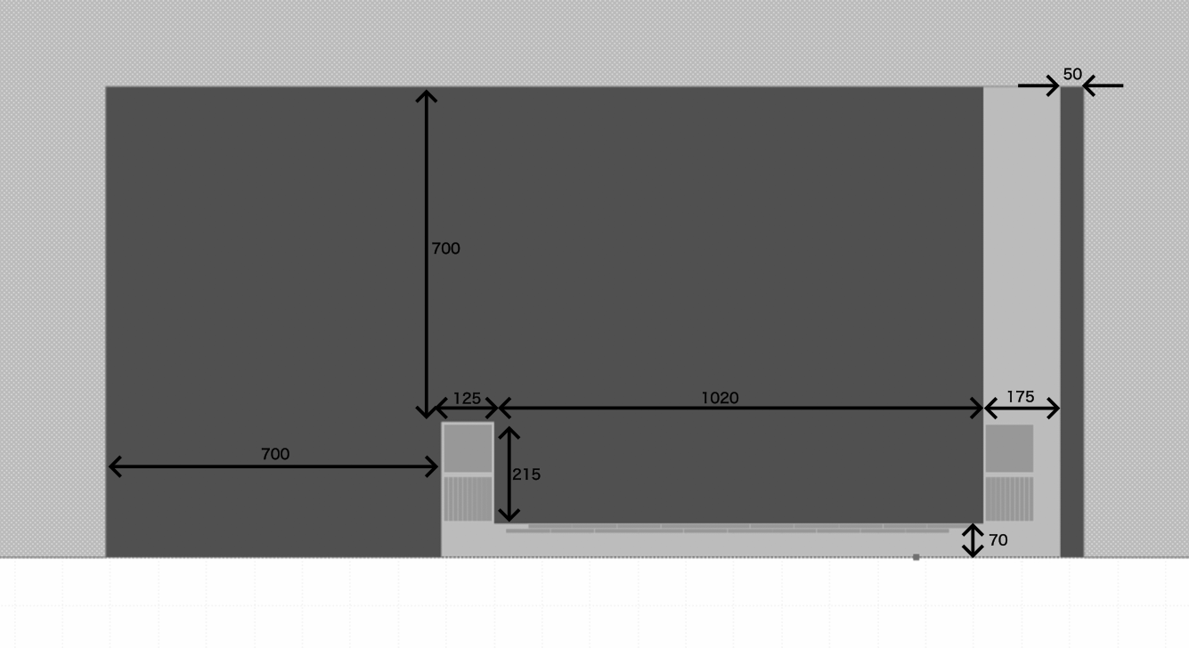
Cross section view of the magnets with coils
5 trim coils (each layer) returning at inner side of magnet and 5 on the outer side
main coil: 100mm x 100mm trim coil: 92.5mm x 10mm
Modified from image produced by Jean-Baptiste Lagrange

Slide 3
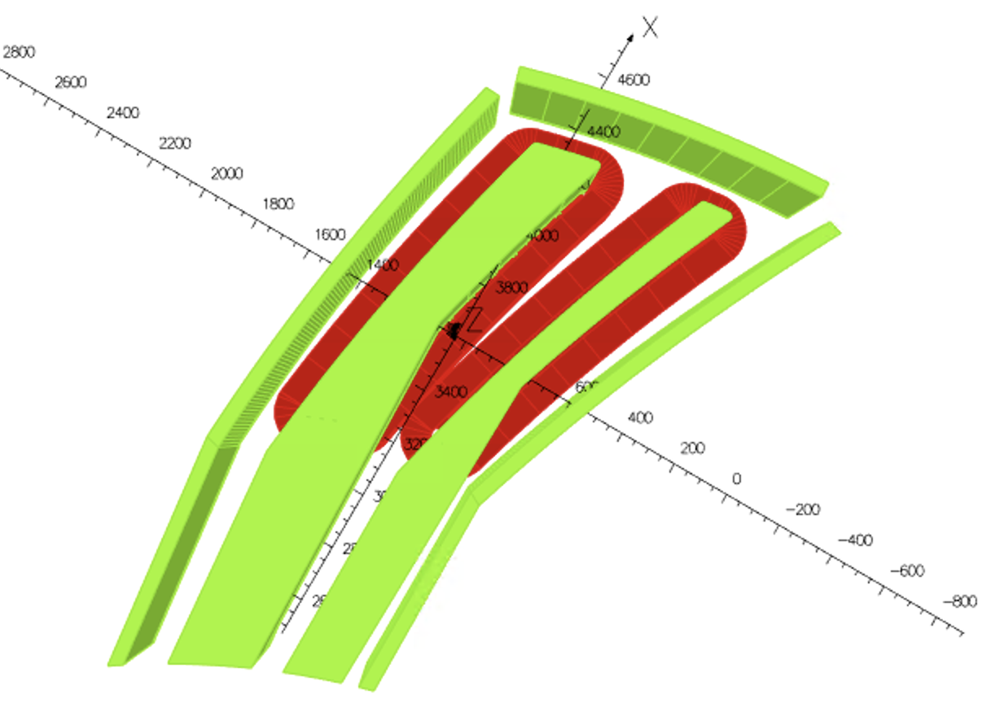
Configuration of doublet magnet (Top view)
Radial clamps
F magnet and clamp
D magnet and clamp
Coils (Red)

Slide 4
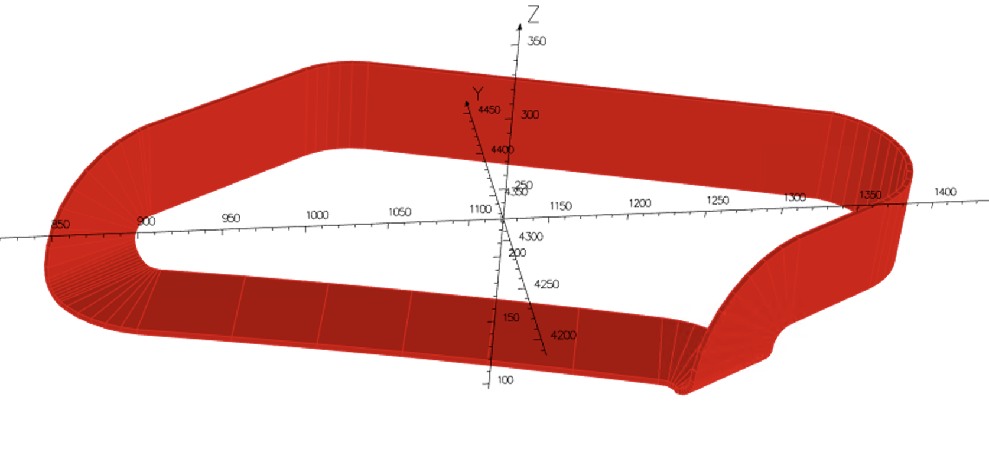
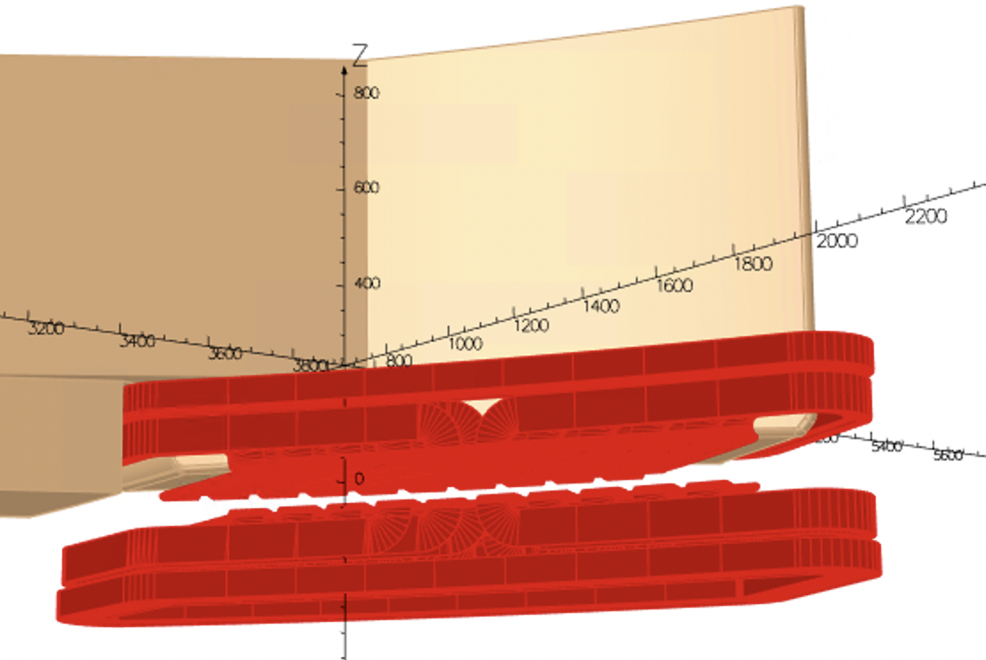
Shape of the trim coil
The circular arc becomes too small if the opening angle is smaller than 2.5 degrees
Hence opening angle of D magnet set to 2.5 degrees

Slide 5
Opening angles including clamps
Need at least 10 mm margin between each components
Opening angle between F pole and the clamp: 2.13 degrees
F pole: 3.47 degrees
F/D opening angle: 4.03 degrees
D pole: 2.50 degrees
Opening angle between D pole and the clamp: 2.13 degrees
Clamps are 50 mm thick each

Slide 6
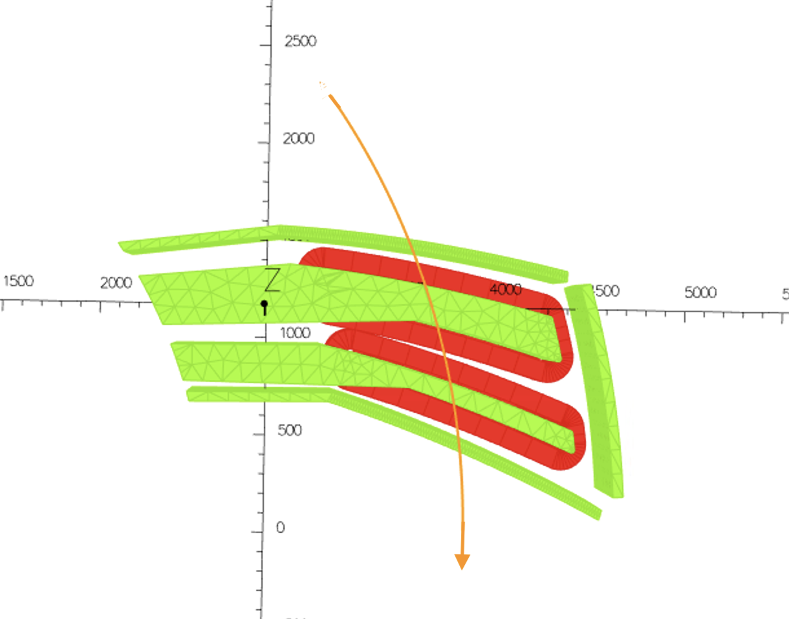
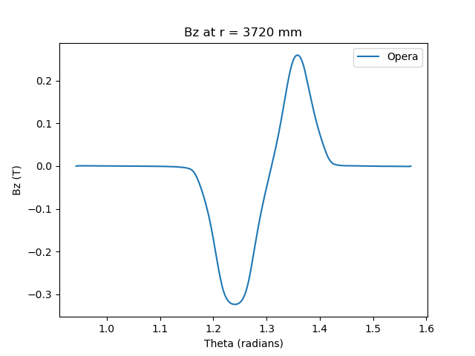
At each radii vary theta and obtain Bz
Separate into negative component (F magnet) and positive component (D magnet)

Slide 7
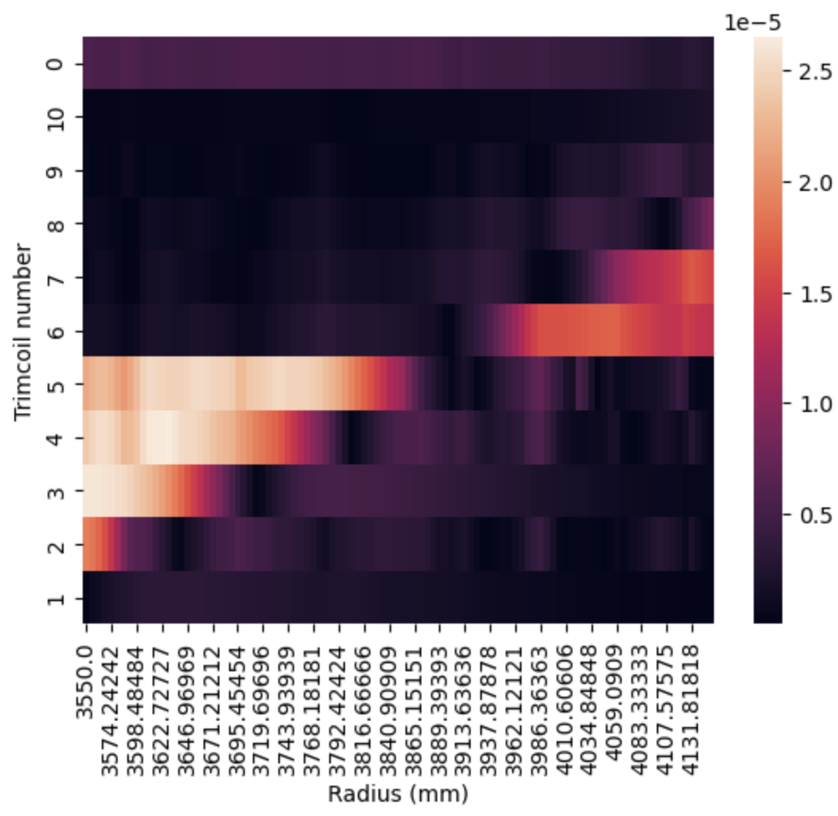
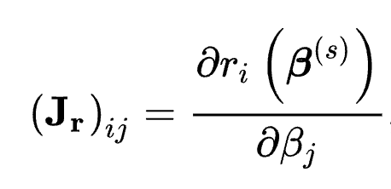
Current optimization
Match maximum Bz of F magnet with the analytic scaling law
Jacobian Matrix
Effect of maximum Bz with varying current
Number 0: Main coil
Number 1-10: Trimcoils with increasing radii
GFR ( 3580-4150 mm)

Slide 8
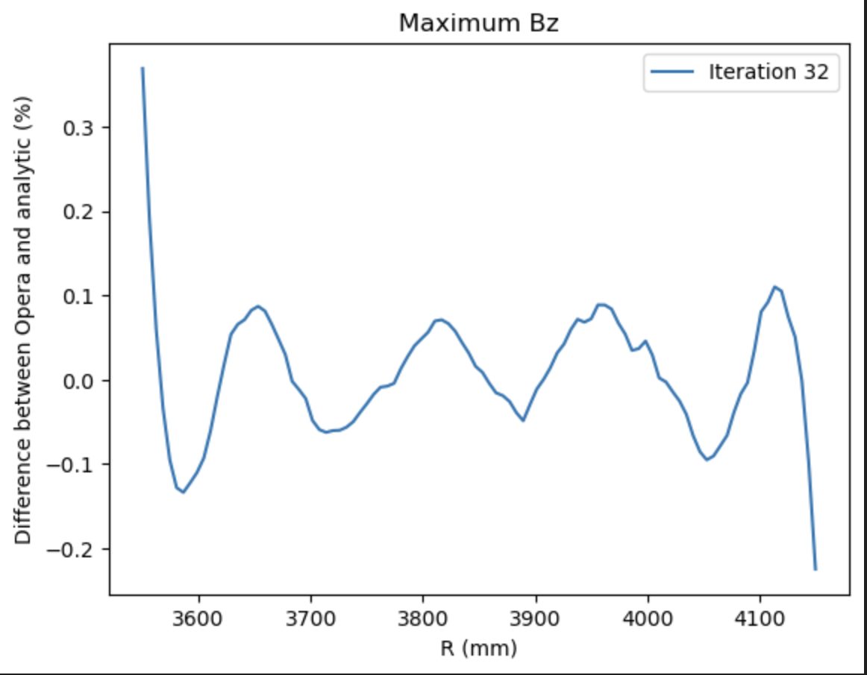

Central scenario: B₀ : -1.344690T, r₀ : 4.147222m, k : 7.716500
$$B=B_{0} {(\frac{r}{r_{0}})}^{k}$$
Current Values in F magnet
Coil Number | Current Values (Ampere turn)
0 | 64948.68
10 | 1439.04
9 | 4991.75
8 | 12849.20
7 | 10057.83
6 | 7839.84
5 | 5259.40
4 | 4162.98
3 | 2988.36
2 | 2695.18
1 | 459.00
Current optimization for F magnet

Slide 9
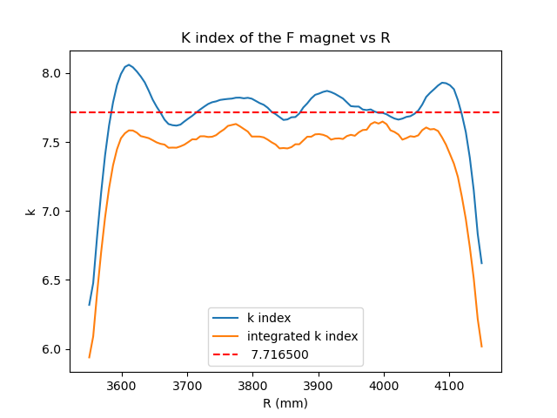
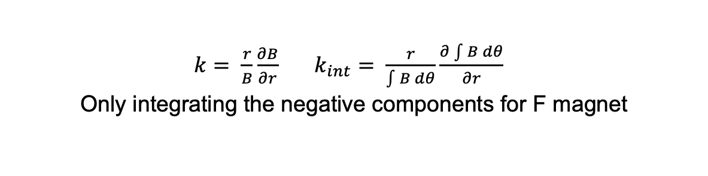
$k= \frac{r}{B}\frac{∂B}{∂r}$ $k_{int}= \frac{r}{\int{B} dθ}\frac{∂\int{B dθ}}{∂r}$
Only integrating the negative components for F magnet

Slide 10
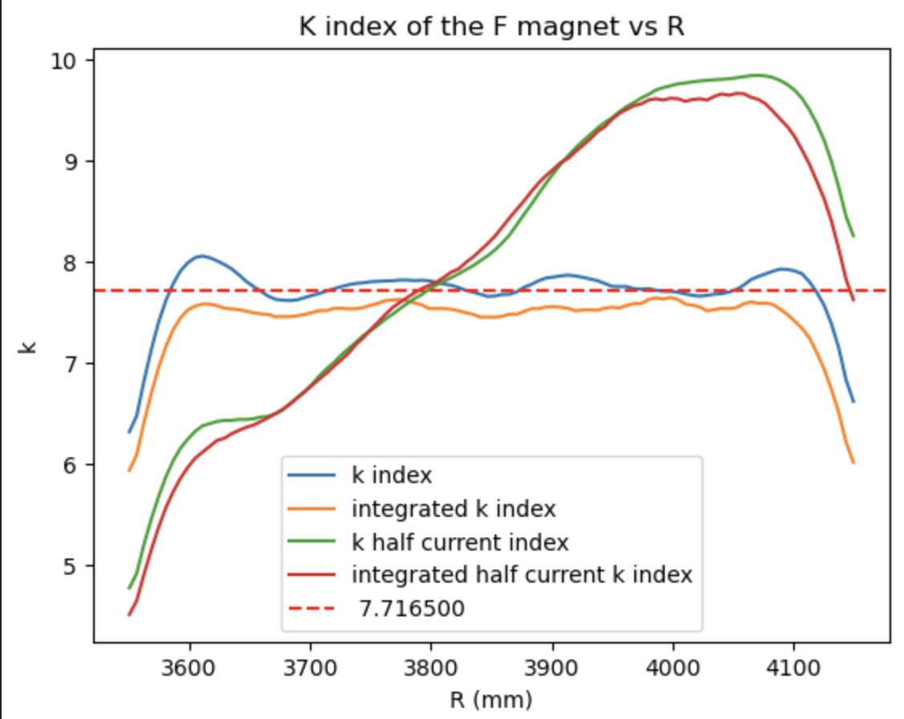
Effect of halving the currents
Each working point may need to be separately optimized

Slide 11
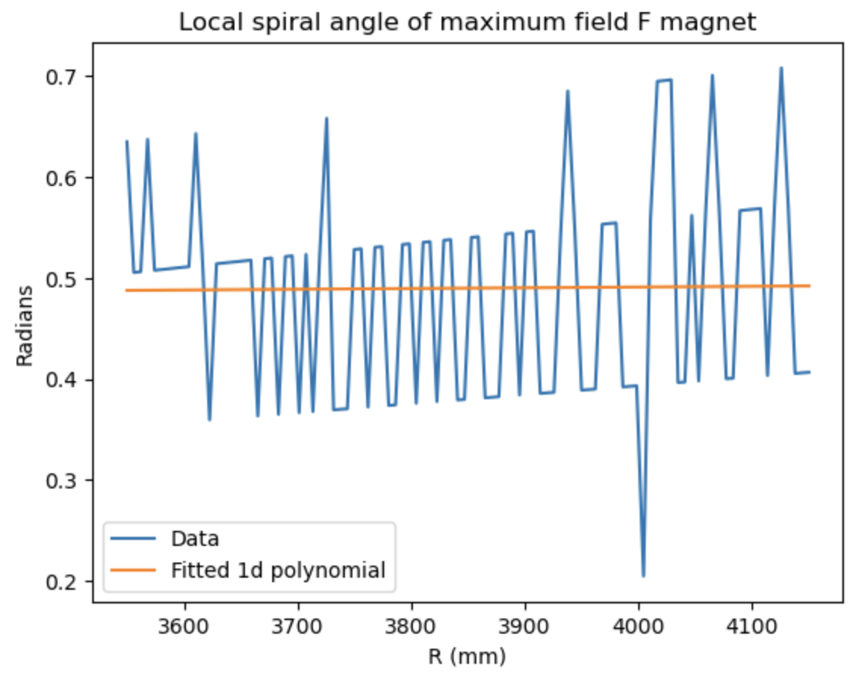


Spiral angle of the Field
$r\frac{dθ_{max}}{dr}=\tan\left(z\right)$ where z is the spiral angle
Looking at $θ_{max}$ directly produces
Results with a lot of noise

Slide 12
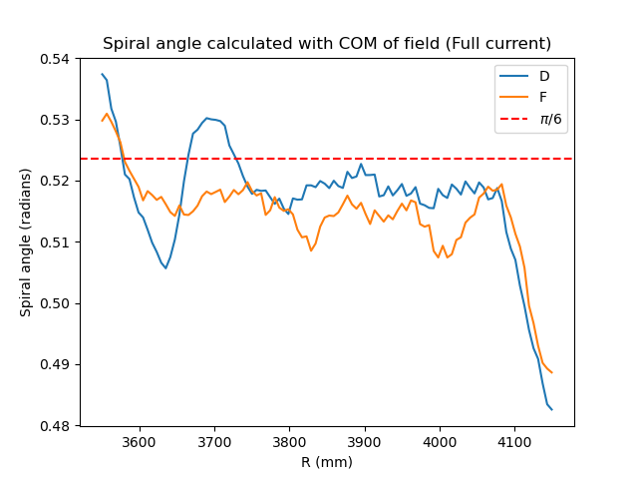
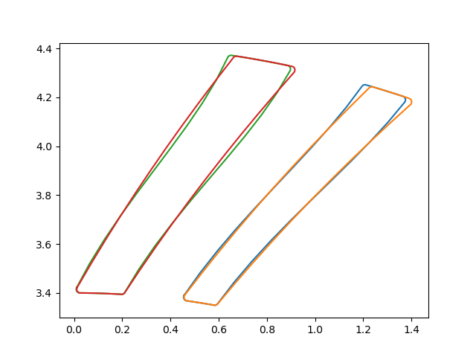
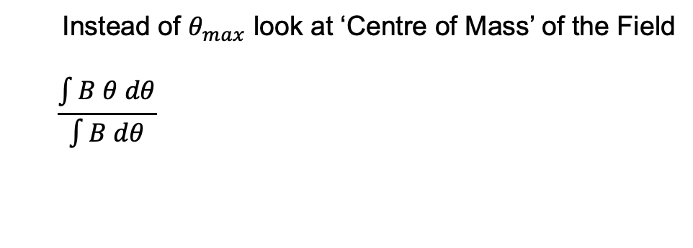
Instead of $θ_{max}$ look at ‘Centre of Mass’ of the Field
$$\frac{\int{B θ dθ}}{\int{B dθ}}$$
Adjusting the pole to correct the spiral
angle of the field?

Slide 13
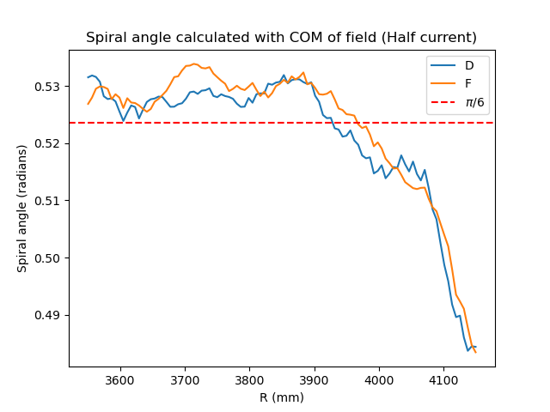
Effect of halving the currents
Value of spiral angle changes with the current
Decided not to vary the shape of the pole

Slide 14
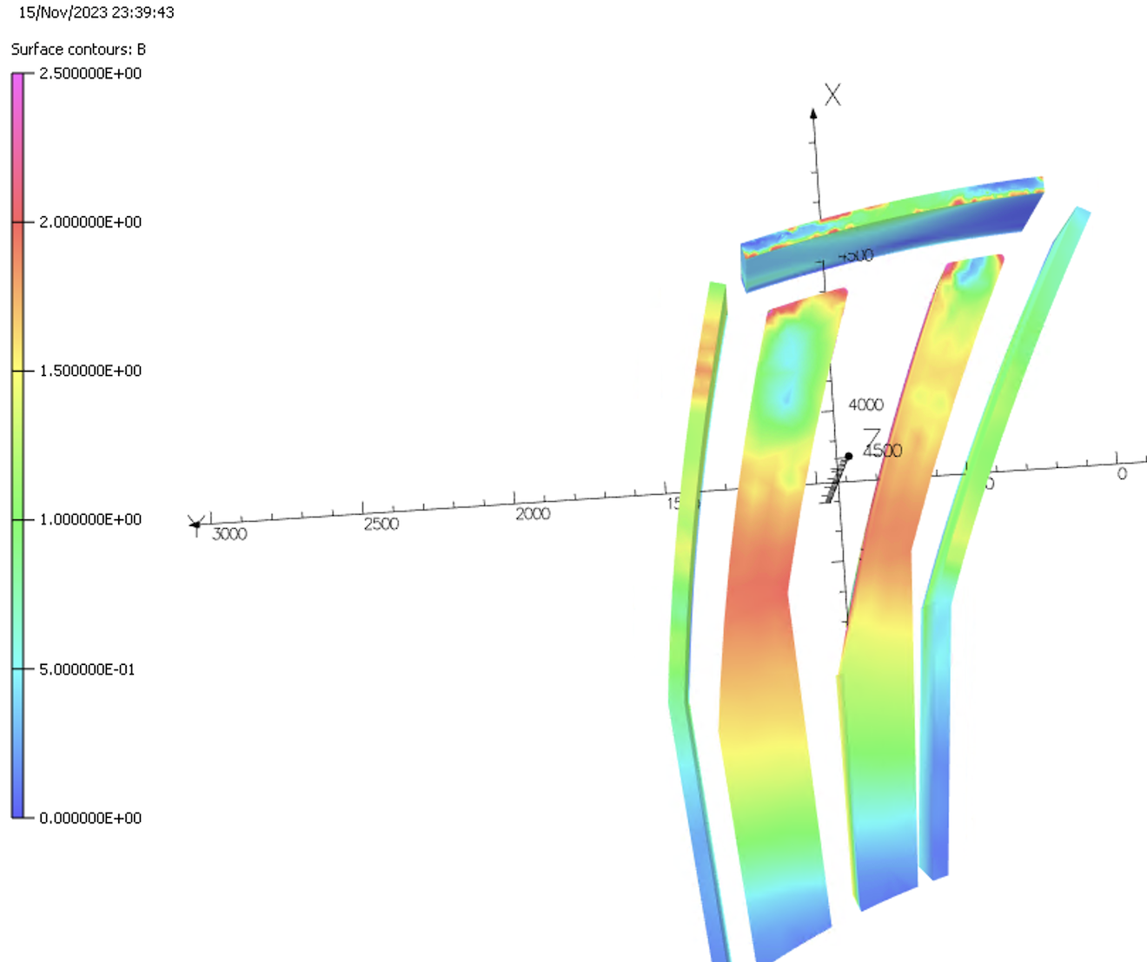
Saturation of the return yoke is along 2T at the thinnest part of the spiral
Top view

Slide 15
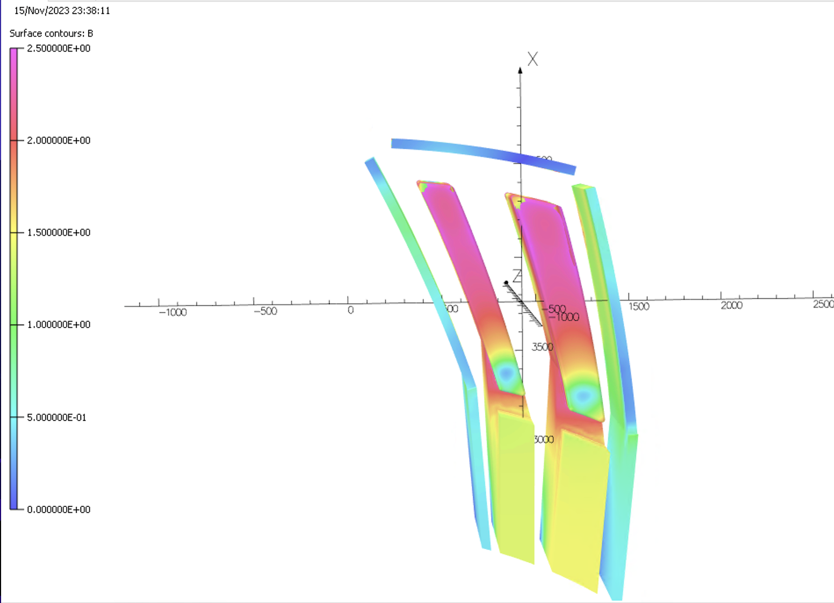
Saturation of the pole is higher than 2.5 T
Bottom view

Slide 16
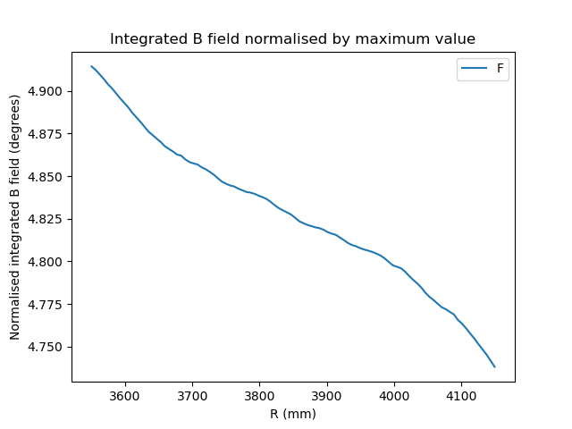
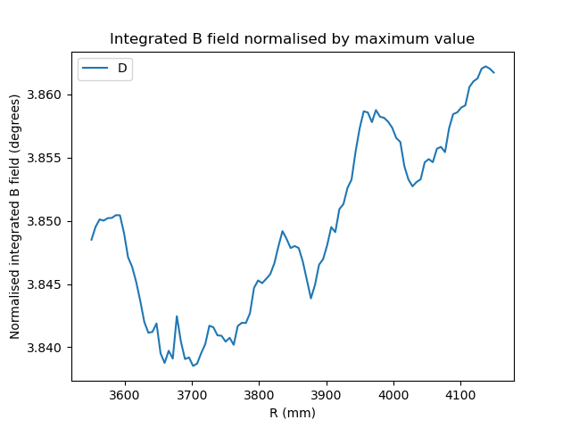
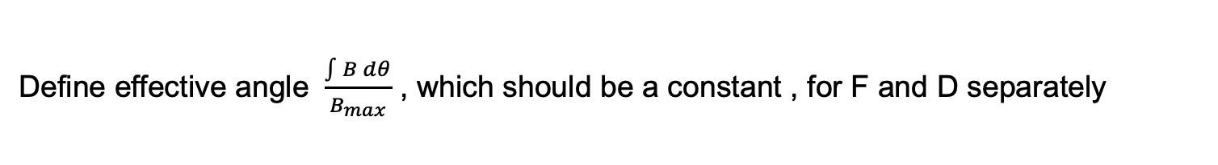
Clamp Optimization
Define effective angle $\frac{\int{B dθ}}{B_{max}}$ , which should be a constant , for F and D separately
(The results were produced before current optimization)

Slide 17
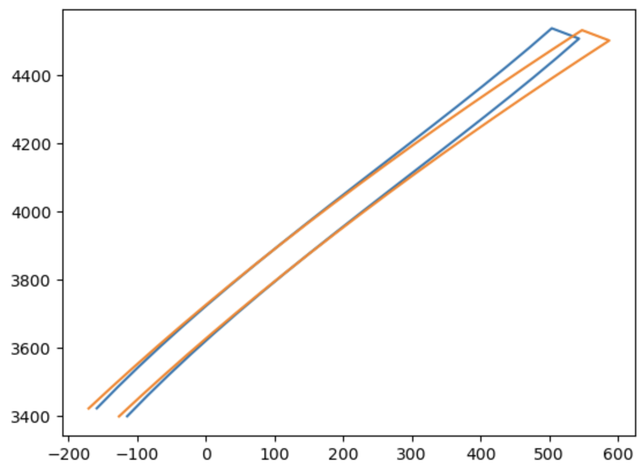
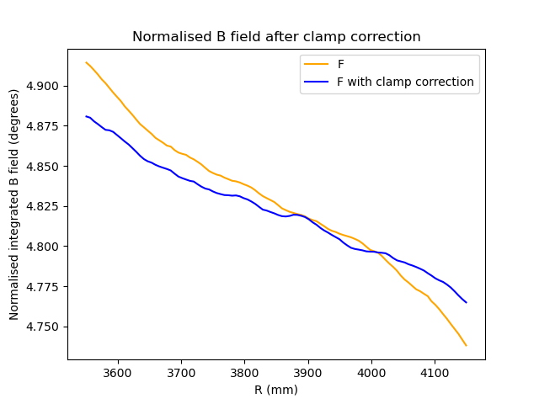
Focusing on the F magnet for now
Adjusting the clamps improves the results with the magnitude of this correction to be
investigated

Slide 18
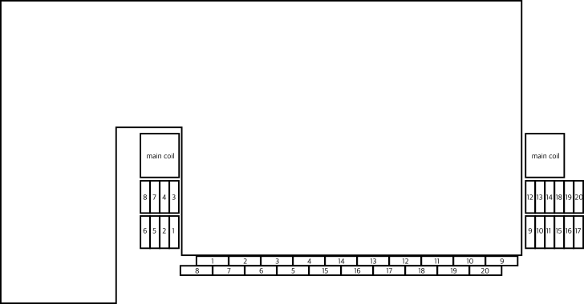
Wrapping the trim coils at two different height layers can reduce the opening angles
4 trim coils (each layer) returning at inner side of magnet and 6 on the outer side
1 mm margin
between coils and pole
700 mm
125 mm
700 mm
1020mm
430 mm
Gap height 70.5 mm
Main coil: 50mm x 200mm Trim coil: 10mm x 92.5 mm
Modified from image produced by Jean-Baptiste Lagrange

Slide 19
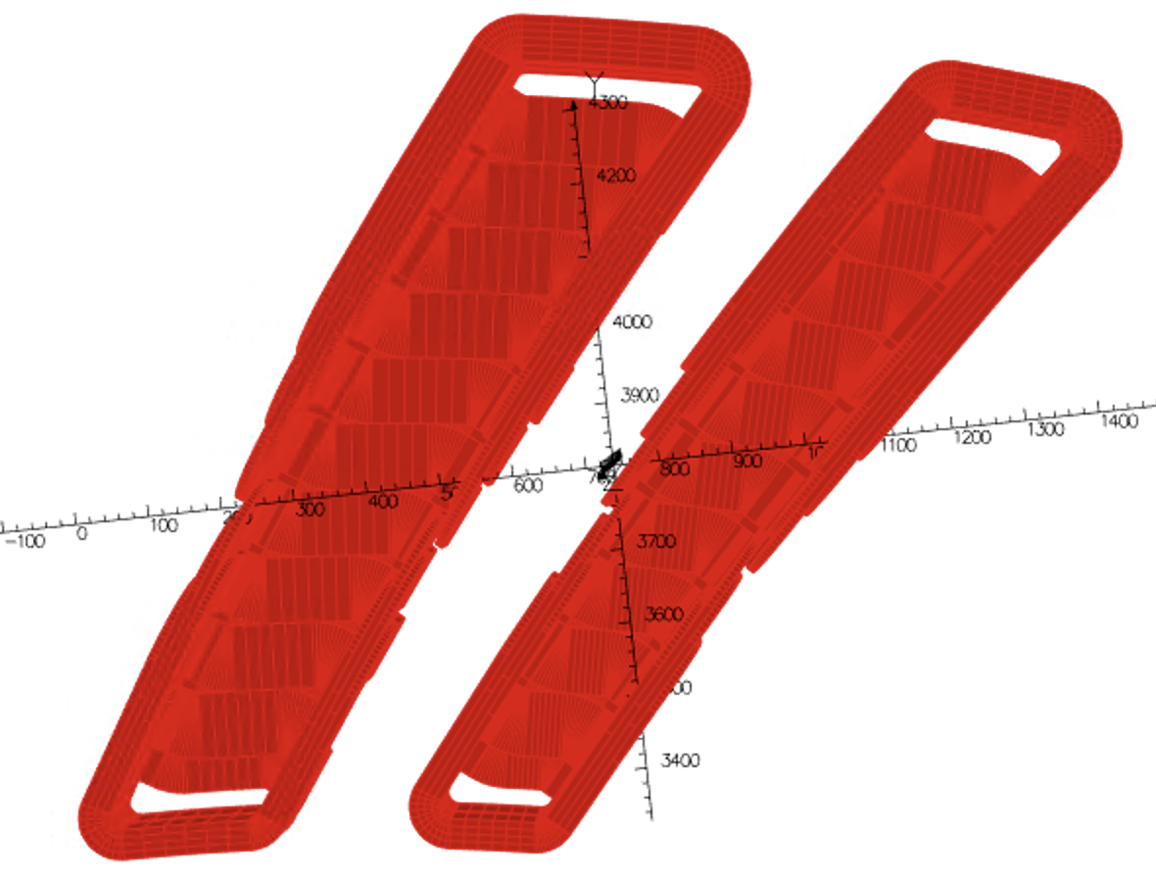
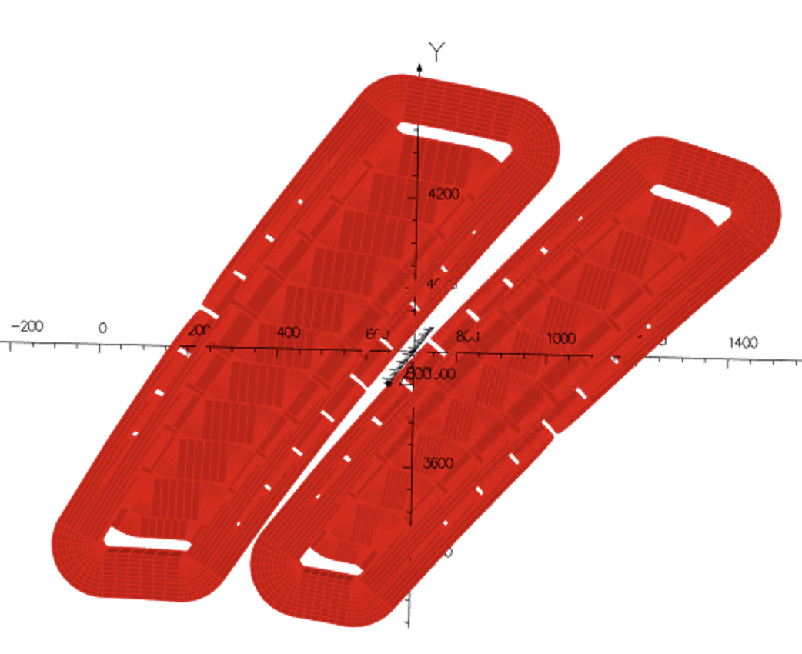
Top view of trim coils in Opera3D
New configuration
Old configuration

Slide 20
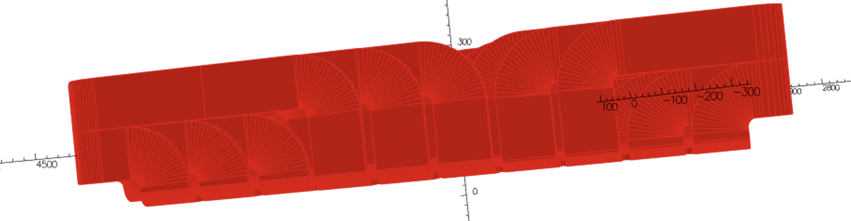
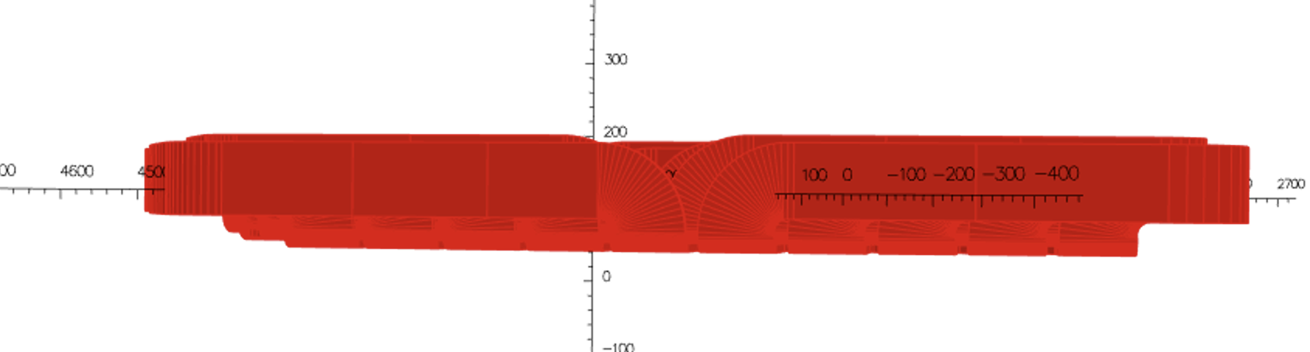
Side view of trim coils in Opera3D
New configuration
Old configuration

Slide 21
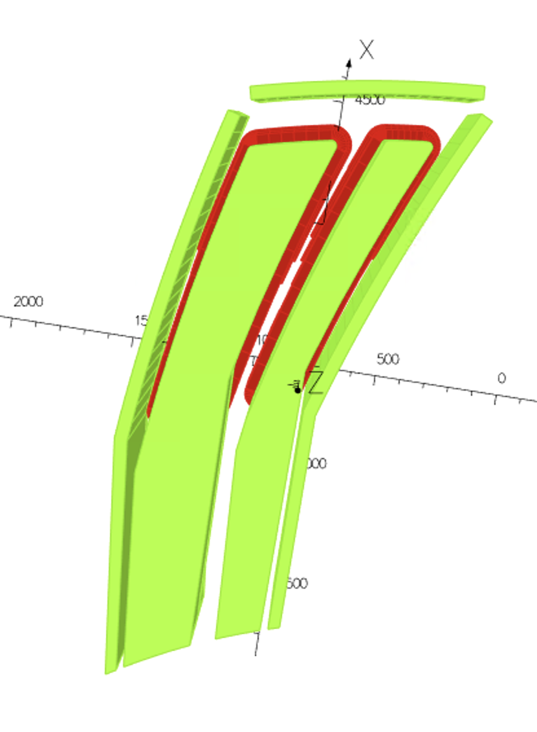
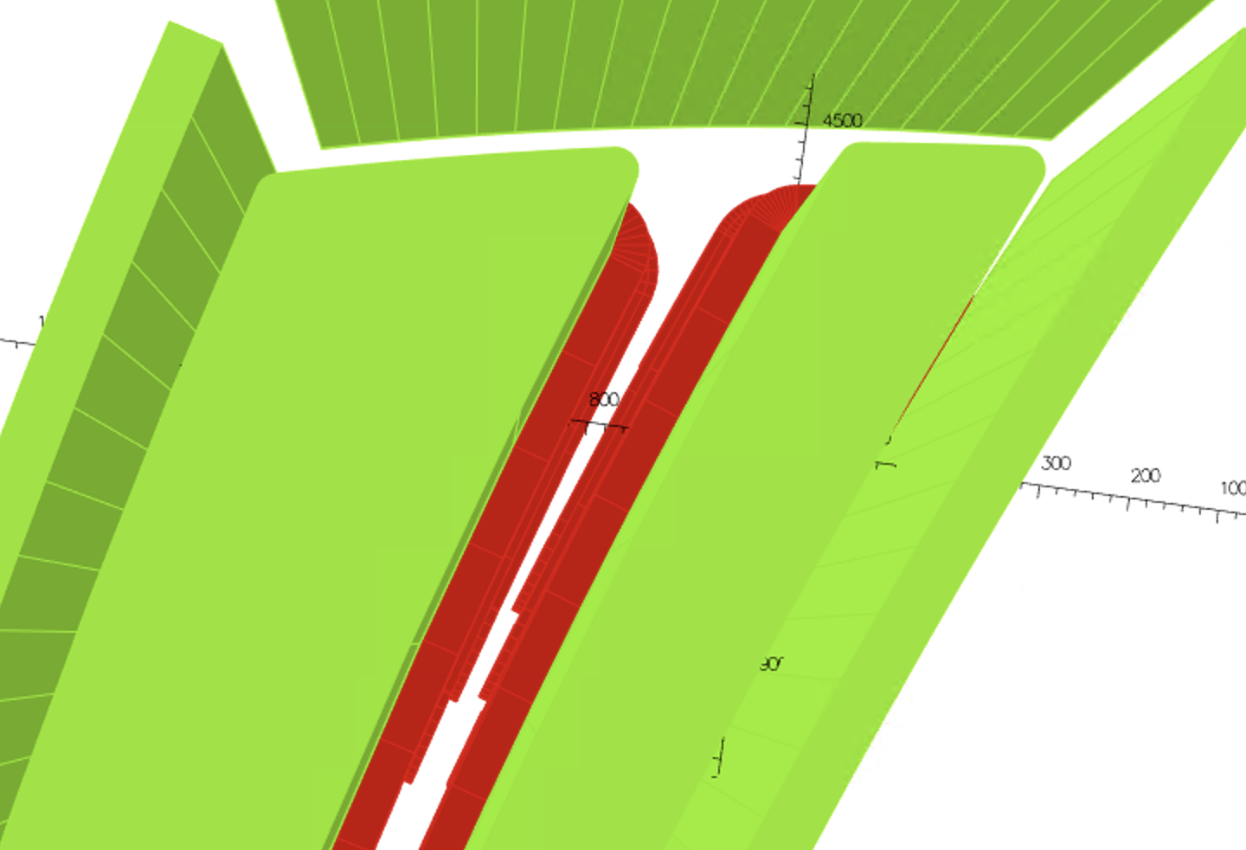
Model in Opera 3D
About 17 mm separation between coils
Of F and D magnet

Slide 22
New opening angles for the two layers trim coil design
Opening angle between F pole and clamp: 1.2 degrees
F pole: 4.5 degrees
F/D opening angle: 2.25 degrees
D pole: 2.5 degrees
Opening angle between D pole and clamp: 1.2 degrees

Slide 23
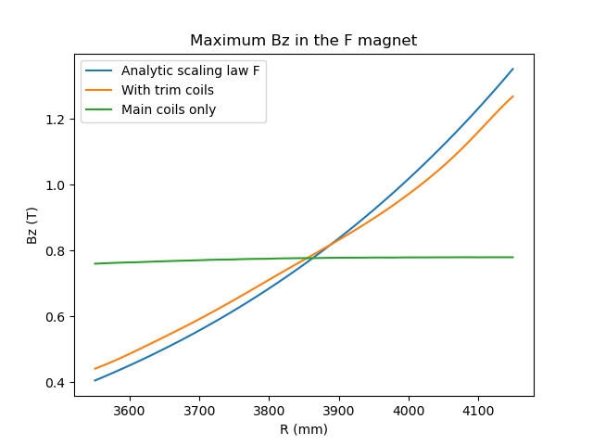
Initial investigation suggests 140,000 Ampere turn required
for main coil

Slide 24
Further work include:
Simultaneously optimize current for F and D magnet
Adjust clamps to get fringe field extent at each radii as constant
as possible
Produce Enge coefficients for optimized results

Slide 25
Extra Slides

Slide 26
To keep the total tune shift within 0.01
• d(k-value) < 0.04
d(spiral angle) < 0.2 degree.
To keep the total tune shift within 0.001
• d(k-value) < 0.004
d(spiral angle) < 0.02 degree.

Slide 27
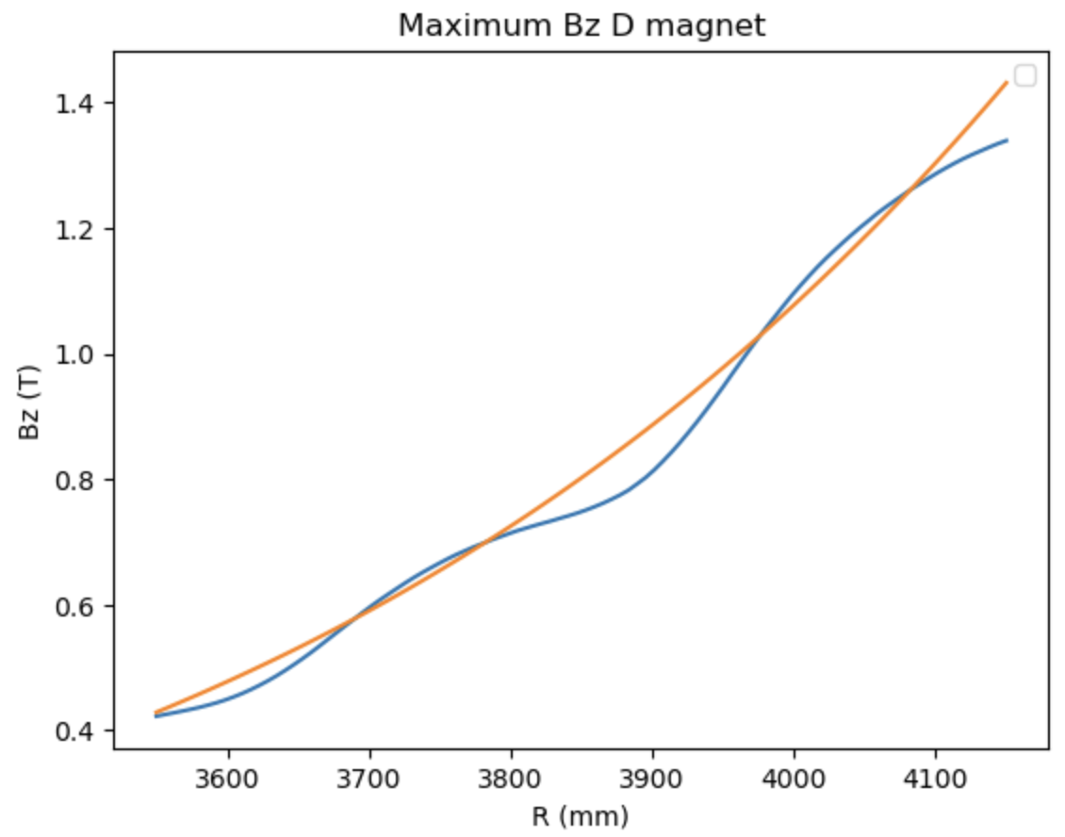
Large oscillation in the optimized Bz
Maybe adjust the main coil current first
before starting optimization
Current Values in D magnet
Coil Number | Current Values (Ampere turn)
0 | 99298
10 | 12771
9 | 3096
8 | 8697
7 | 11691
6 | 18181
5 | 4399
4 | 4256
3 | 6436
2 | 701
1 | 1407
Notes:
99298.767827 12771.138507 3096.098208 8697.240151 11691.664170 18181.589041 4399.723572 4256.792730 6436.484317 701.919086 1407.878705 0.12692

Slide 28
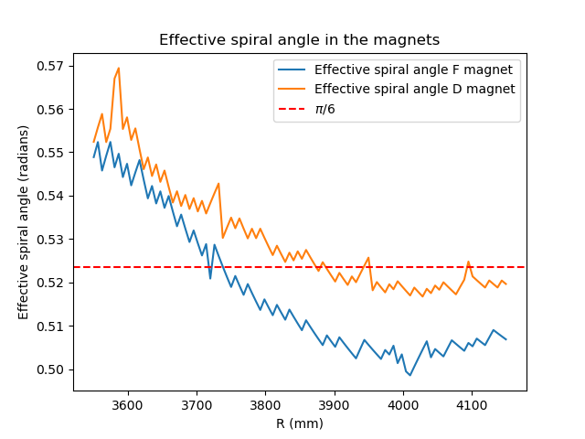
$tan⁡(z_{eff})= {(θ}_{max} −θ_{0}) / (ln⁡\frac{r}{r_{0}}$) ${with θ}_{max} found in simulation$
Plotting Z_{eff} at different radii

Slide 29
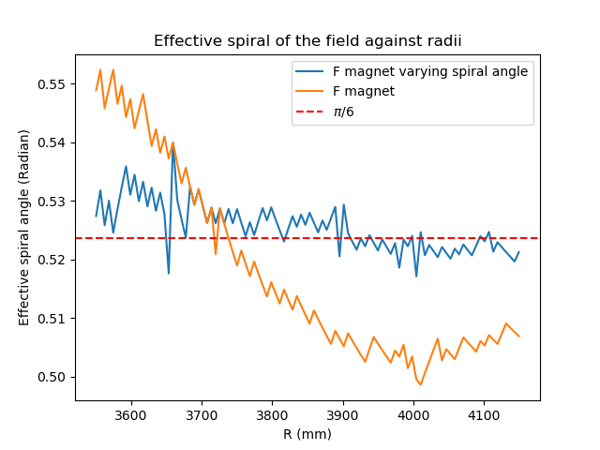
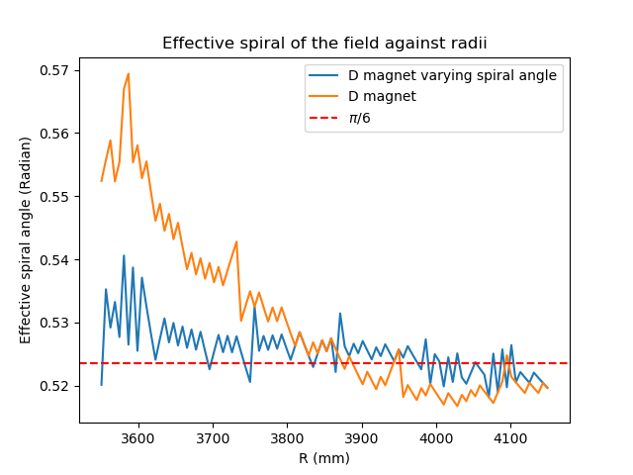
At the current values optimized for the central scenario, the effective spiral angle of the field seems to be corrected

Slide 30
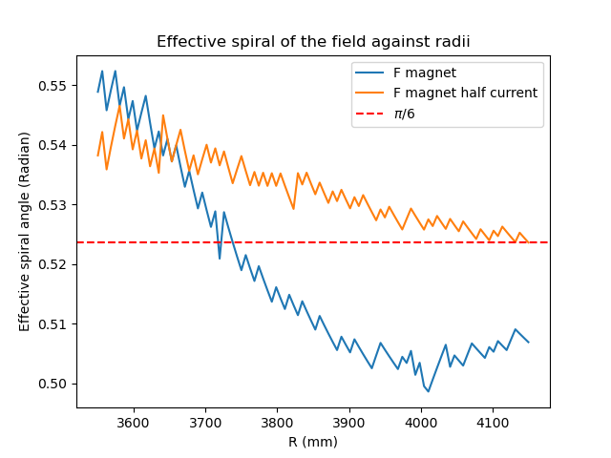
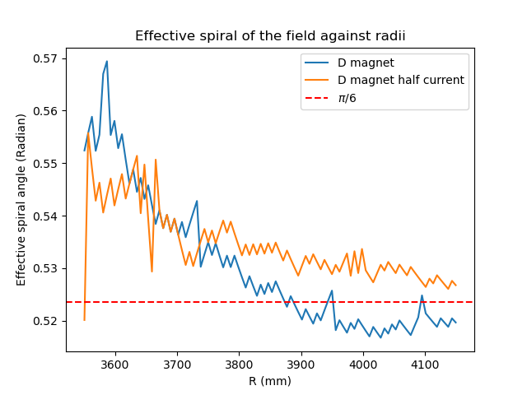
However, the effective spiral angle is affected by the current values
Halving all the current values changes the effective spiral angle even with
the pole having a constant spiral angle (30 degrees)

Slide 31
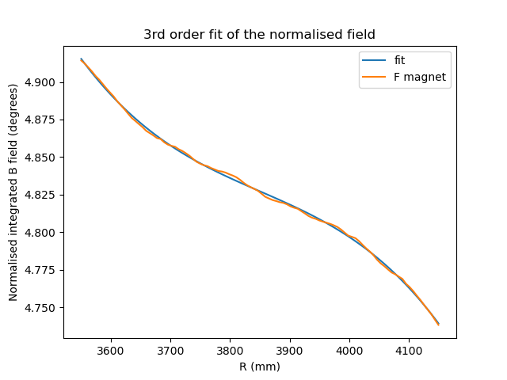
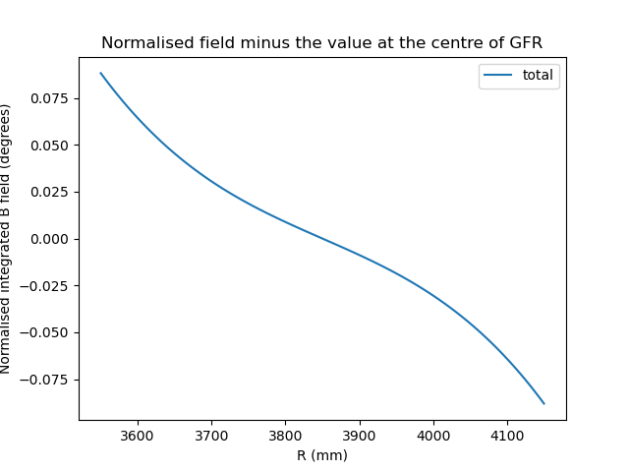
Focusing on the F magnet for now
Fit a third order polynomial and minus the value at the centre of the GFR
Add the angles to the clamps

Slide 32
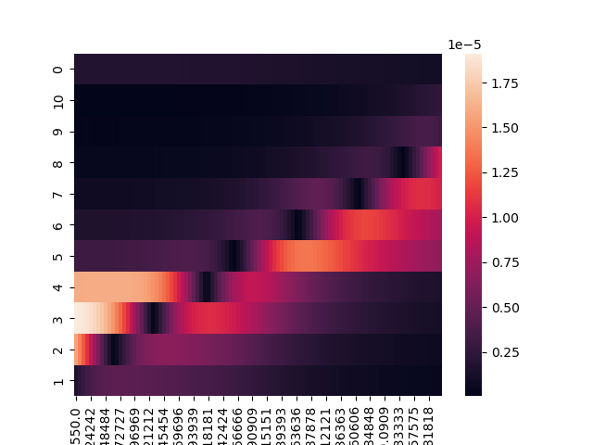
Jacobian Matrix for the k index with the two layer design

Slide 33
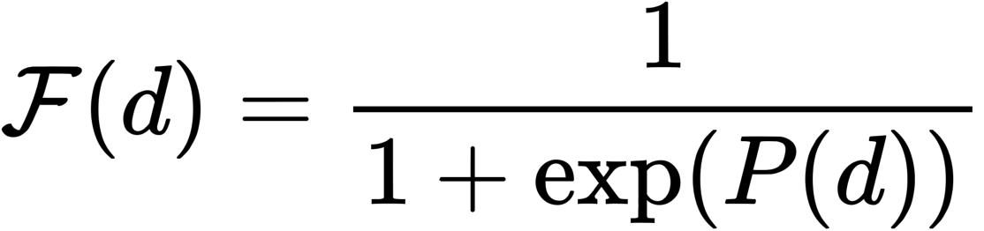
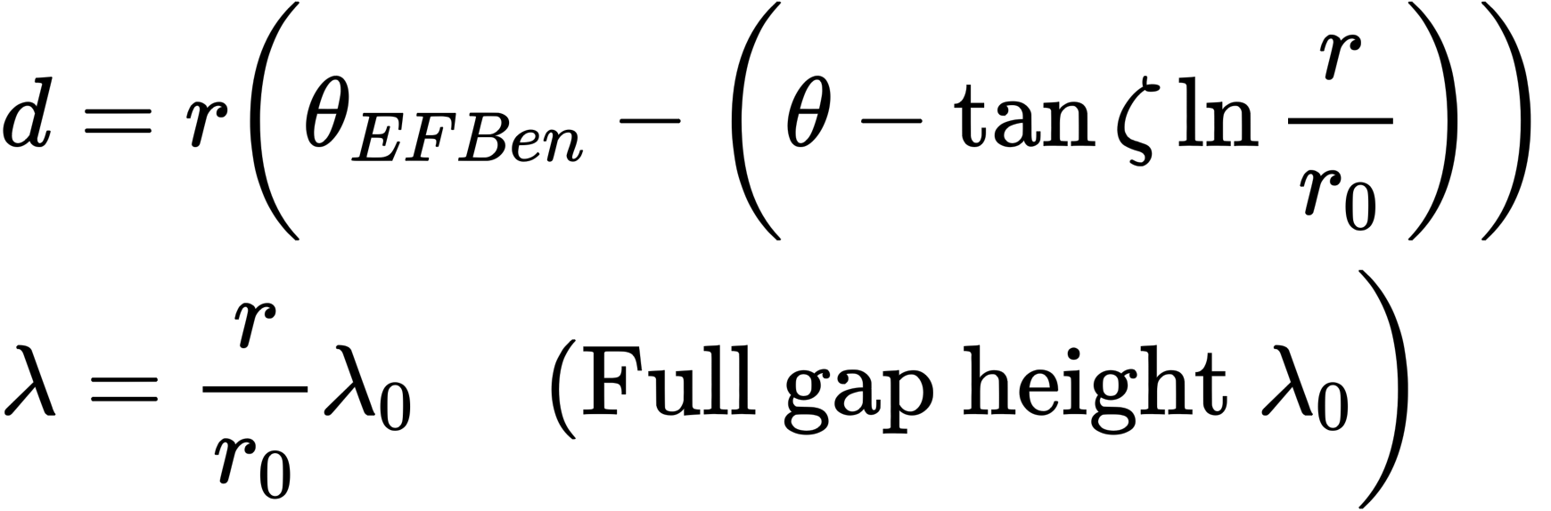
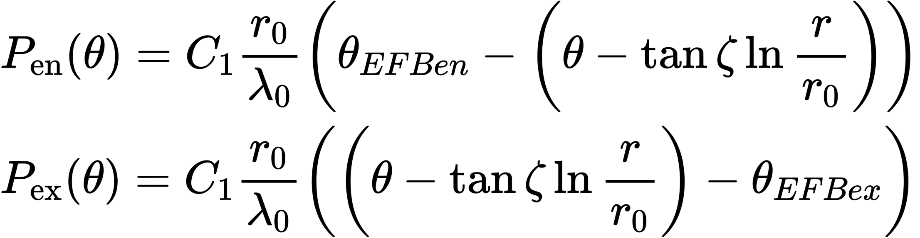
Enge fringe field
For the Simplest case: $P(d)=C_{1}\frac{d}{λ}$
Effective Field Boundaries (EFB) chosen at the edge of the pole

Slide 34
Enge fringe field with higher coefficients
$$P(d)=C_{0}+C_{1}\frac{d}{λ}+{C_{2}(\frac{d}{λ})}^{2}+C_{3}({\frac{d}{λ})}^{3}+…$$
To model the doublet together
$B= \frac{B_{0_F}}{(1+e^{P_en_F})(1+e^{P_ex_F})}$ + $\frac{B_{0_D}}{(1+e^{P_en_D})(1+e^{P_ex_D})}$
As two separatable functions of each magnet superpositioned on top of each other

Slide 35
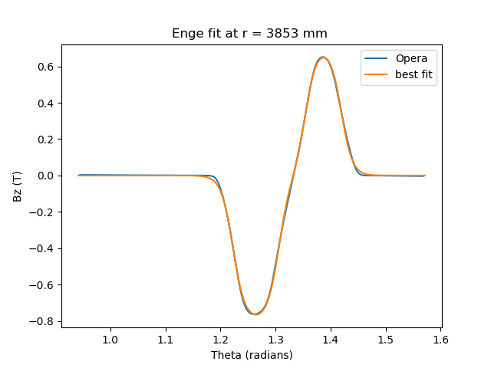

Enge fringe field fit
Considering only the C1 coefficient
$θ_{F_{en}}=\text{1.15067703}\text{ (}\text{1.160644}$)
$θ_{F_{ex}}=\text{1.23398973}$ (1.221207)
$θ_{D_{en}} =\text{1.28218508}$ (1.291544)
$θ_{D_{ex}}=\text{1.34751288}$ (1.335177)
C1_{F} = 38.2184742
C1_{D} = 41.3568124
B_{0 F} = -0.79728663 (-0.76257)
B_{0 D} = 0.69796035 (0.65133)

Slide 36
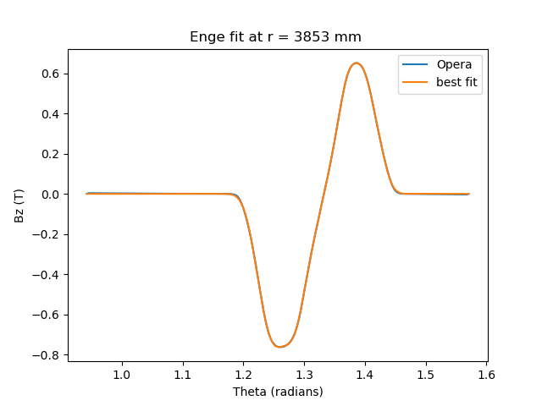
Enge fringe field fit
Considering up to C3 coefficients

