Slide 1
Joint LhARA FETS FFA Meeting
Mechanical Design
Clive Hill with contributions from Neil Bliss and Mitchell Kane
16/01/24

Slide 2
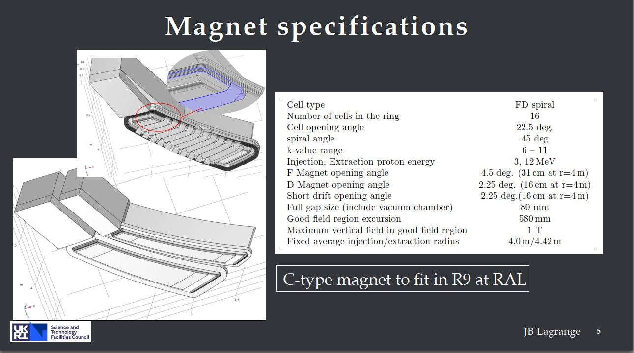
Taken from 230503_magnet_lagrange 07/02/2023

Slide 3
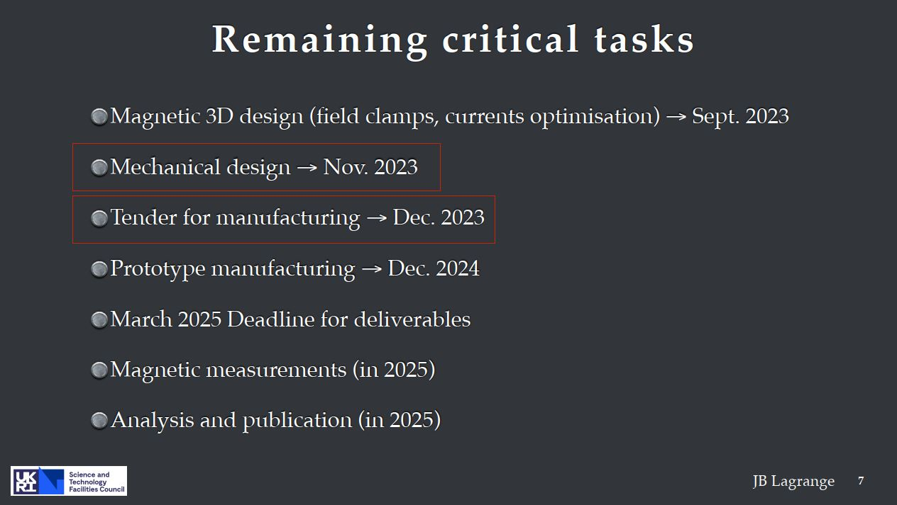
Taken from 230503_magnet_lagrange 07/02/2023

Slide 4
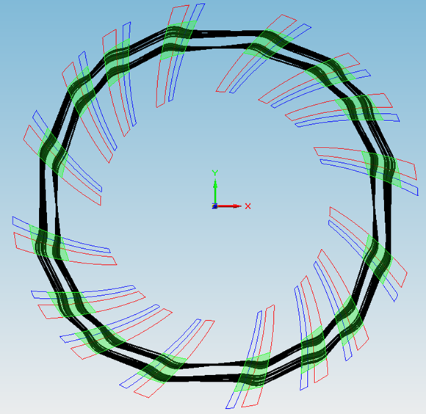
Taken from Neil Bliss presentation 28/06/23
FETS FFA
4 – fold symmetry lattice
Bf1, Bd1
Bf2, Bd2
Injection
Diagnostics
Bf3, Bd3
Diagnostics
Diagnostics
Bf4, Bd4
RF Cavity
Step file received from FETS FFA team

Slide 5
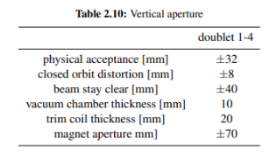
Taken from Neil Bliss presentation 28/06/23
Simplified Vacuum Chamber
Bf1, Bd1
Full penetration e-beam weld
Ribs
Full rib
Chamber 1
Vacuum chamber cross-section
Bf2, Bd2
Injection
~= 4 places
Chamber 2**
Half rib
Diagnostics
Vacuum chamber cross-section
Diagnostics
Bf3, Bd3
Diagnostics
Chamber 3
Bf4, Bd4
RF Cavity

Slide 6
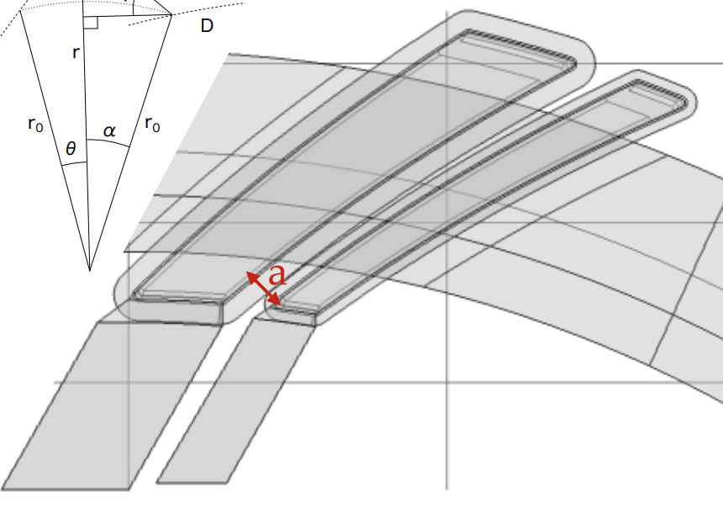
Taken from Neil Bliss presentation 28/06/23
Vacuum chamber strengthening rib here between coils if practical ?
Maybe too small a gap !
a = 200 mm

Slide 7
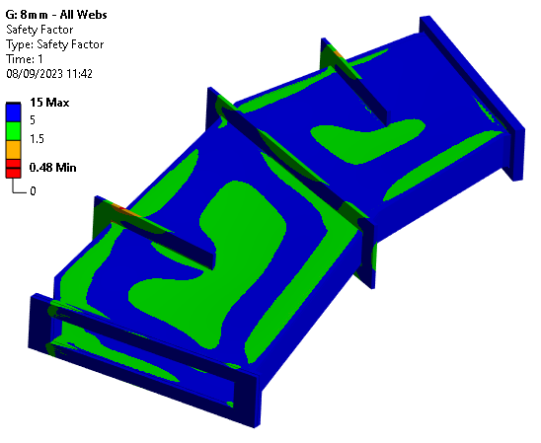
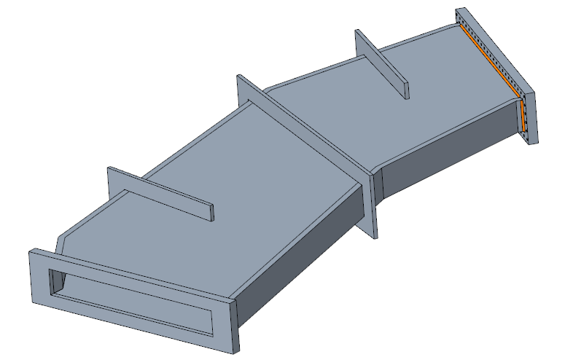
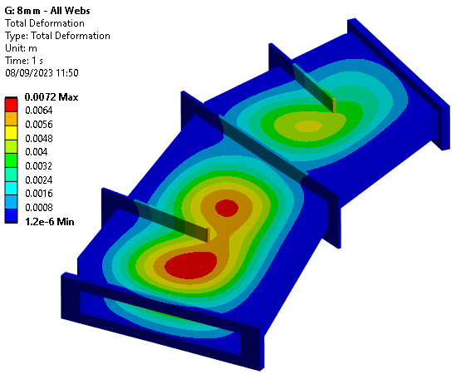
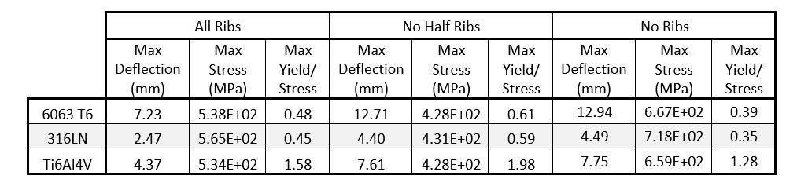
Taken from RFS-1055-meng-fea-0001-v2.0-FETS-FFA-Vacuum-Chamber-2023-09-08
Half ribs
Half ribs
737mm
700mm
Full rib

Slide 8
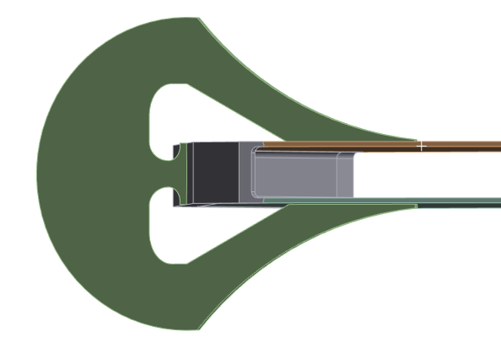
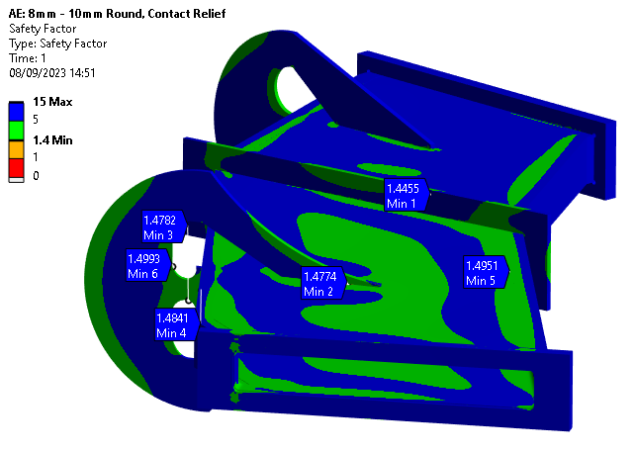
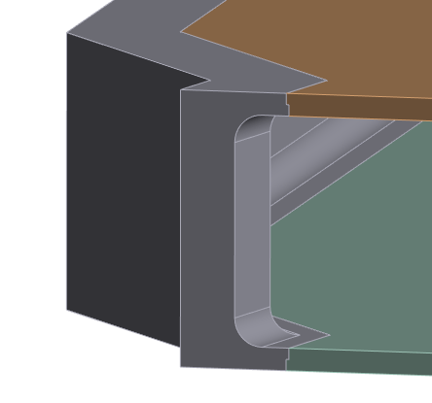
Taken from RFS-1055-meng-fea-0001-v2.0-FETS-FFA-Vacuum-Chamber-2023-09-08
Titanium and aluminium alloys are unsuitable due to their high deflections. 316LN is the only viable material of the three with the current geometry.
The original design is only suitable for the stress if made of Ti6Al4V.
Modifying the design to include rounds on the internal corners, and altering the shape of the ribs for stress relief, can achieve both the stress and deflection criteria

Slide 9
Email sent by Neil Bliss 13th September
Notes from the meeting with FETS group on 6th September:
The magnet design has now included Field Clamp plates on 3 sides. Before and after the doublet and on the outside of the ring. The field clamp plate on the outside of the ring can be in 2 pieces to let the vacuum chamber half rib protrude.
The magnet design will take ~ another 3 weeks.
The vacuum chamber described shows the worst case. In the final design there will be large box shapes in between the combined function doublet magnets to house septums, kickers, cavities and diagnostics. The introduction of the boxes will provide extra stiffness to the chamber.
With the amendments described in the FEA report the vacuum chamber wall thickness could be 8mm if designed carefully.
Allowance for the vacuum chamber deflection is 2mm.
Allowance for vacuum chamber tolerances and distortion is 2mm.
Amount that the magnet gap would have to increase is 4mm. FETS group decision is to keep the magnet gap as specified at 140mm. The beam stay clear region can reduce from 80mm to 76mm.
The field clamp plates may be able to be used to help reduce the chamber deflection.
Realistic clearances and tolerances for the coils should be engineered into the magnet design.
When further work has been done on the magnet design a STEP file of the magnet doublet can be made available to conduct further mechanical design. Integration of the magnet and chamber and further optimisation of the vacuum chamber.
Action: Request from FETS group for the DL PME group to look after the magnet tender. - Richard and Clive will need to discuss and respond.
Action: Mitchell to complete the FEA report write up and distribute – complete 8/9/23.

Slide 10
Questions
When will the magnet model with coils be ready?
The procurement schedule will need to be revised
Is the scope of work by TD@DL for the magnet only or will scope include the design of ring chambers?
Mechanical design of septum and kicker magnets?
Mechanical design of RF cavity?

