Slide 1
FFA Layout January 2024
Bradley Kirk
10/01/2024

Slide 2
FFA Location/layout options
Assumptions:
Magnets are the basic 2D profile _ Iron yoke
Transfer line needs more detail
An updated injection plan is needed
Diagnostics units and number of units needs updating
RF cavities Ferrite and MA for positional (straight section comparison)

Slide 3
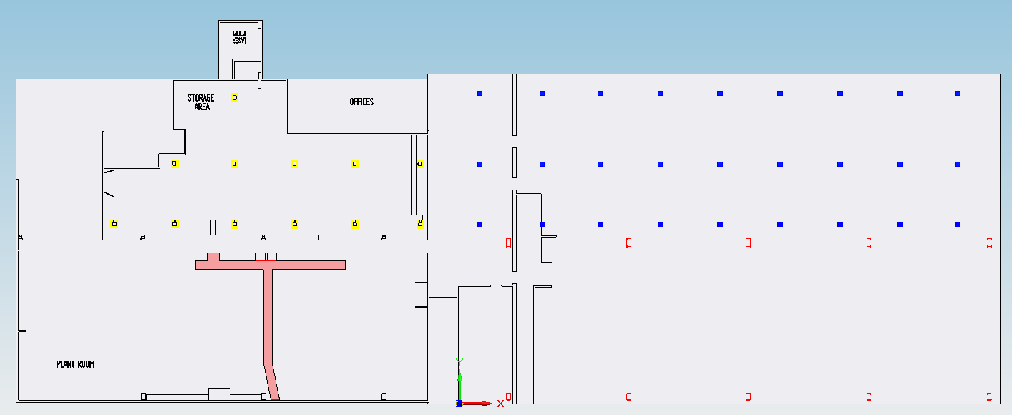
FFA - R8/R9 Floor plan
R8
R9
Notes:
Basic floor layouts R8 / R9

Slide 4
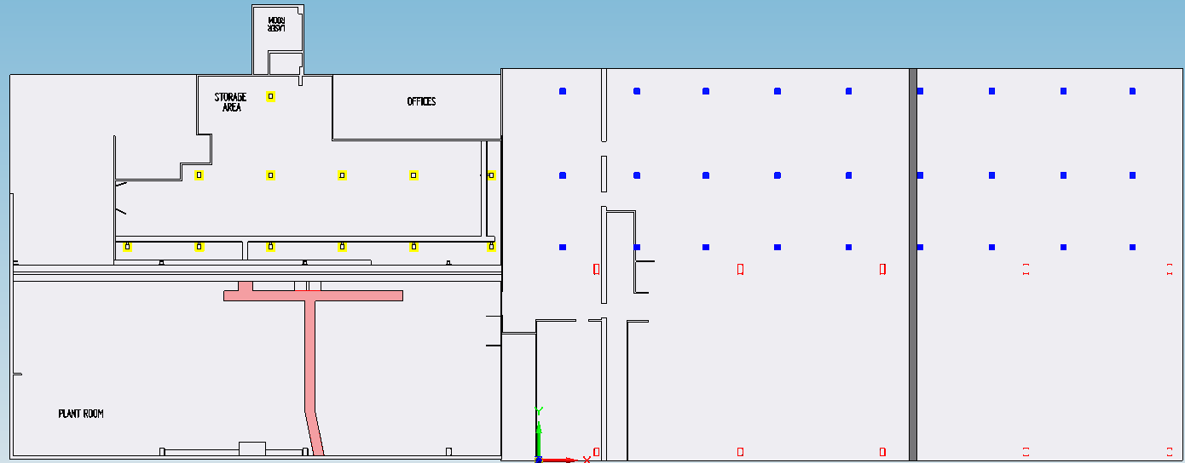
FFA - R9 Split
Technology
Equipment
Metrology and Additive Manufacturing

Slide 5
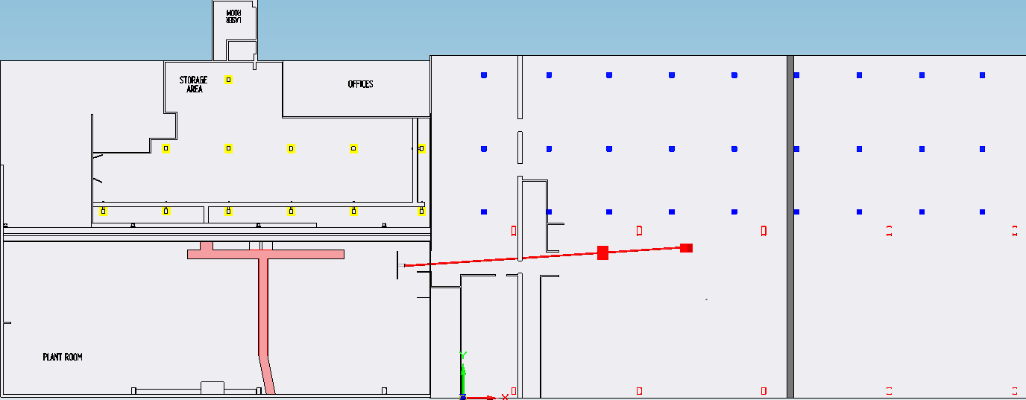
FFA - FETS Transfer line
Transfer line
Sub Station

Slide 6
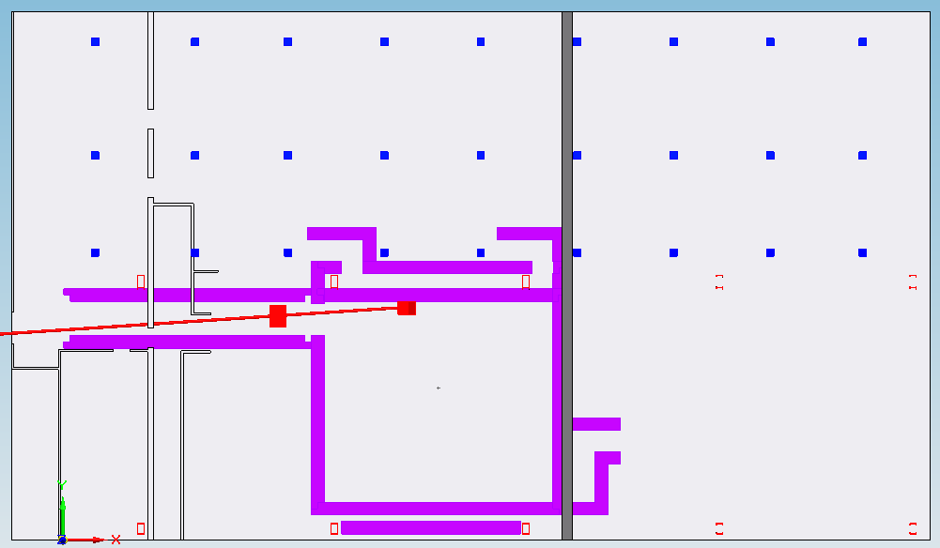
FFA - R9 Shielding options

Slide 7
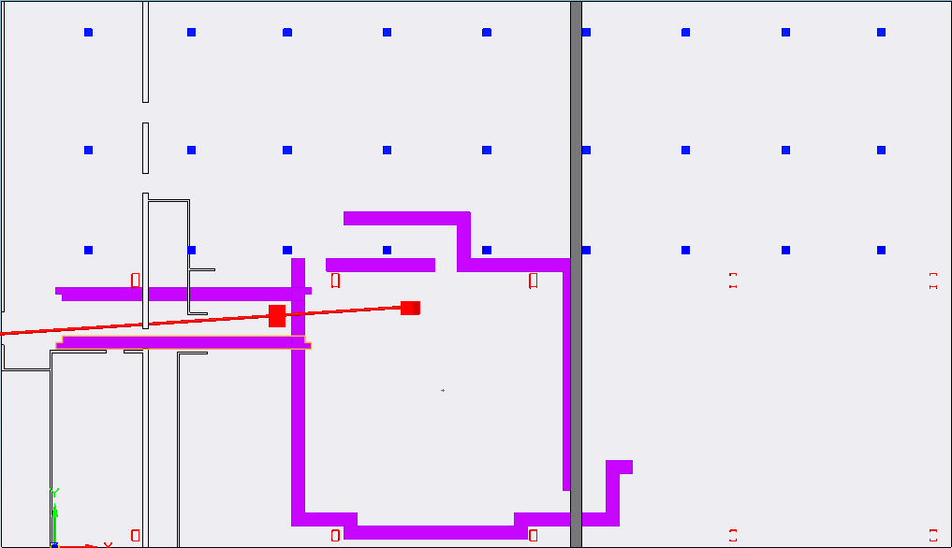
FFA - R9 Shielding options
Notes:
Out of crane area

Slide 8
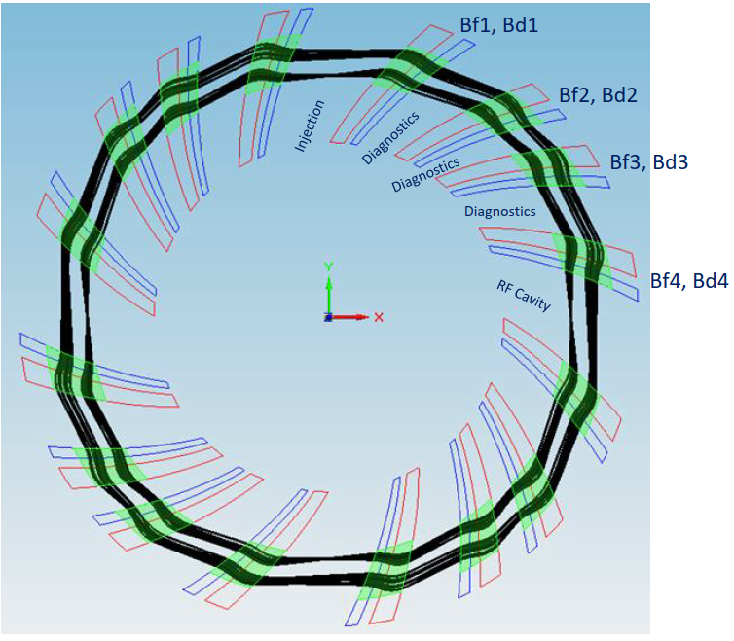
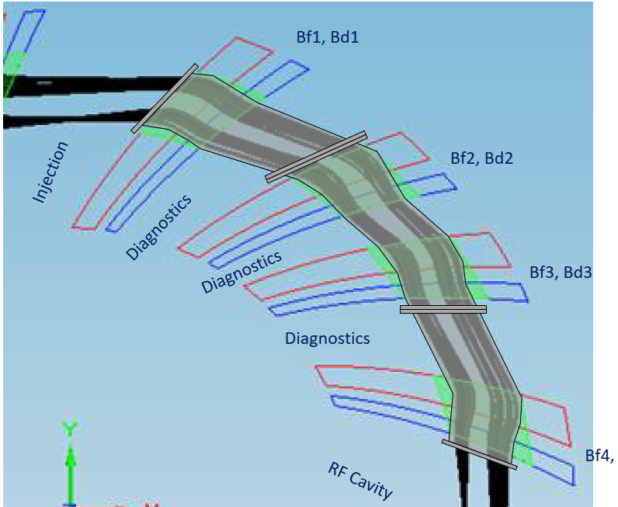
FFA – Initial Vacuum thoughts
Notes:
Larger vessels save space on flanges and joints.
Makes other units harder to design. Integration of equipment and beam line needs looking into

Slide 9
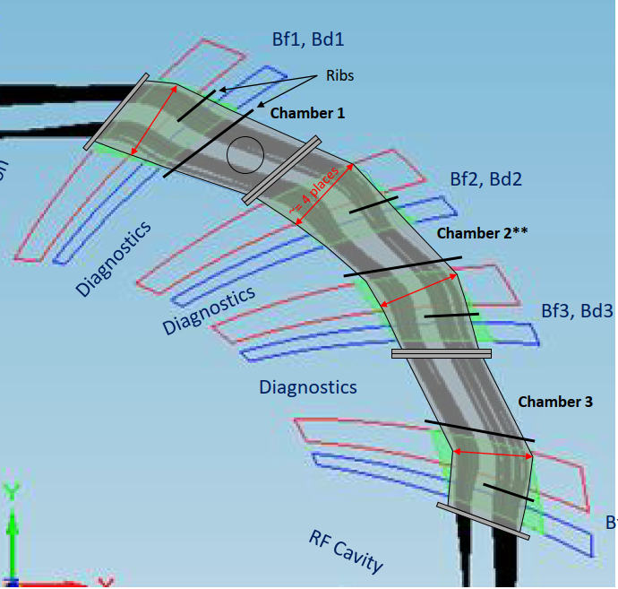
FFA – Initial Vacuum thoughts
Notes:
Larger vessels save space on flanges and joints.
Makes other units harder to design. Integration of equipment and beam line needs looking into

Slide 10
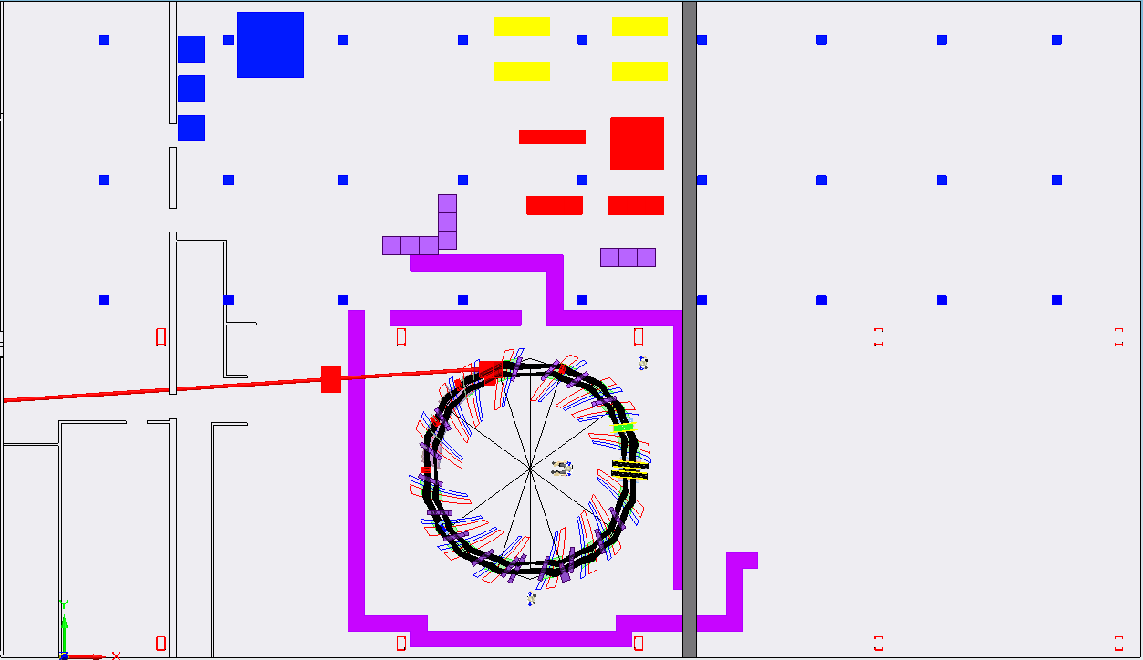
FFA – Layout Begins, available space?
Power and water services
Notes:
SPACE

Slide 11
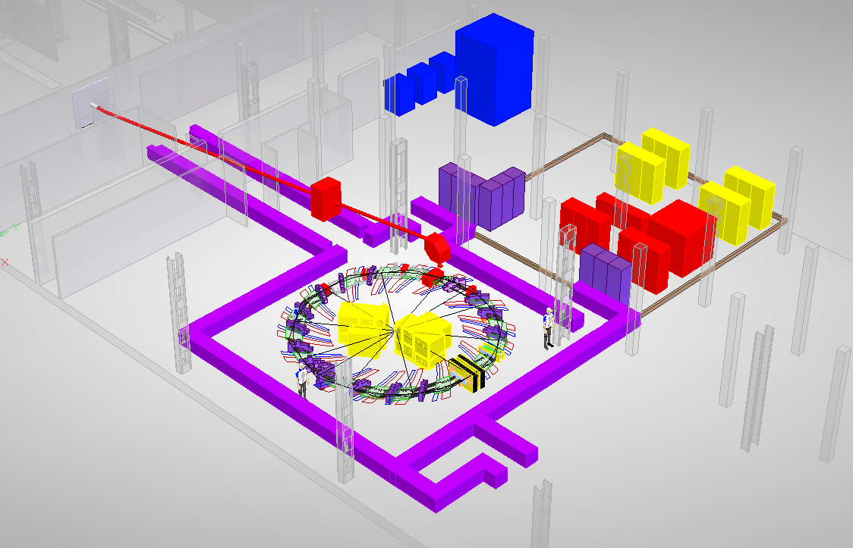
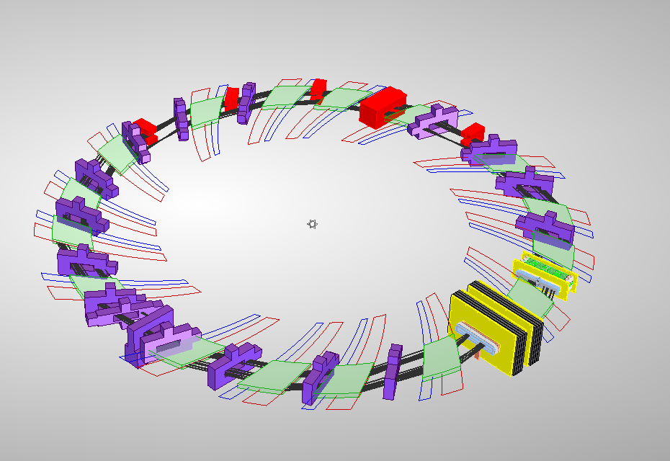
FFA – Layout Begins, available space?

Slide 12
tt

