Slide 1
Welcome, introduction and thanks!

Slide 2
MRes activity with
Leo Cancer Care
Ideas; still need to
develop
08Feb23
Making a start on developing the biological pilar:
MRC “Developmental Pathway Funding Scheme”:
  https://www.ukri.org/opportunity/developmental-pathway-funding-scheme/
  A.Giacca, J.Parsons developing outline proposal
Need Biological Science CM …

Slide 3


Our mission is to:
Deliver a systematic and definitive radiation biology programme
Prove the feasibility of laser-driven hybrid acceleration
Lay the technological foundations for the transformation of PBT
  automated, patient-specific proton and ion beam therapy
ITRF
/

Slide 4
18-month review of our programme today/tomorrow
2-year Preliminary Activity – Project start 01Oct22
To serve ITRF: 2 + 3-year project
in 6 work packages:
  Project Management
  Laser-driven proton and ion source
  Proton and ion capture
  Real-time dose-deposition profiling
  Novel, automated, end-station development
  Facility design and integration
First two years of
“Five-year plan”
CCAP-TN-10

Slide 5


Slide 7
Visions Panel feedback
…
Proposal Feedback: Ion Therapy Research Facility (ITRF)
The Visions Panel found the ITRF proposal to provide evidence of the project’s potential to deliver of a step-change in capability and understood that such a facility would allow experimentation that does not currently exist elsewhere.
In terms of strategic drivers and the timeliness of the proposal within the current strategic landscape, the panel considered the proposal to be timely but felt that the proposal may benefit from clarifying the existing level of community support for the proposal. It was also noted that as the collaboration involved in the proposal is wide-reaching the proposal may benefit from including further information on the level of engagement from all members of the collaboration.
Please let us know if you have any queries.
Kind regards,
STFC Visions Team
… also request to revise the
“total infrastructure cost”.

Slide 8
SB/EB feedback on PA2 proposal to STFC Visions Team
Broad support
  High impact potential
  Could deliver step change
  Potential for broad reach
  Ambitious
But not selected
  Fit with international landscape unclear
  Potential for target community unclear
  Progress of first preliminary activity unclear (but only 9 months into 2 year project when written)
Now seeking access to bridging funds

Slide 9
Structuring the bridging activity
Define bridging programme to optimise delivery of:
Biology/proof-of-principle programme
R&D programme to address key project risks
Strategic partnerships

Slide 10
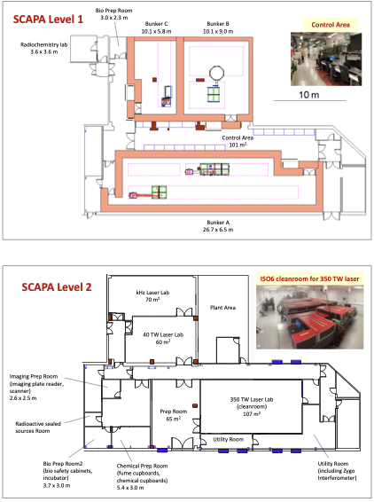
Development of radiation biology programme:
  At existing facilities:
    Novel (e.g. laser driven)
    Conventional
LhARA proof-of-principle experiment:
  CW: “… include as many of key LhARA elements as possible …”
“WP7”, led by J. Parsons
Increasingly import aspect of the programme going forward

Slide 11
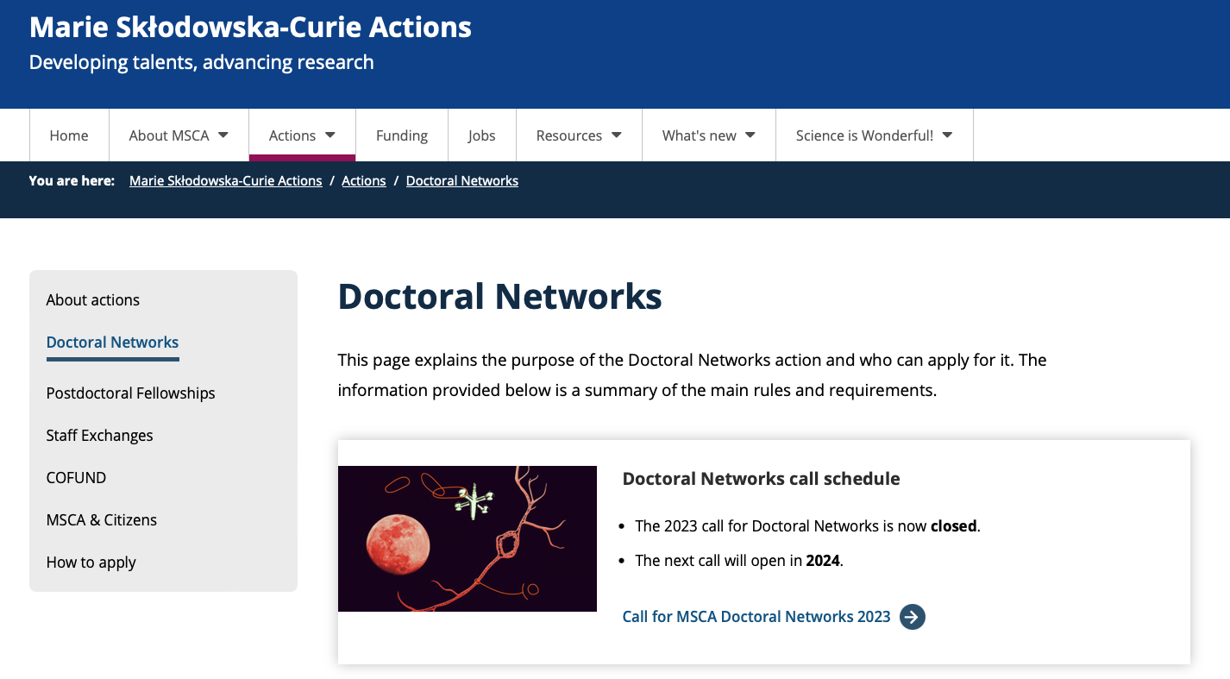
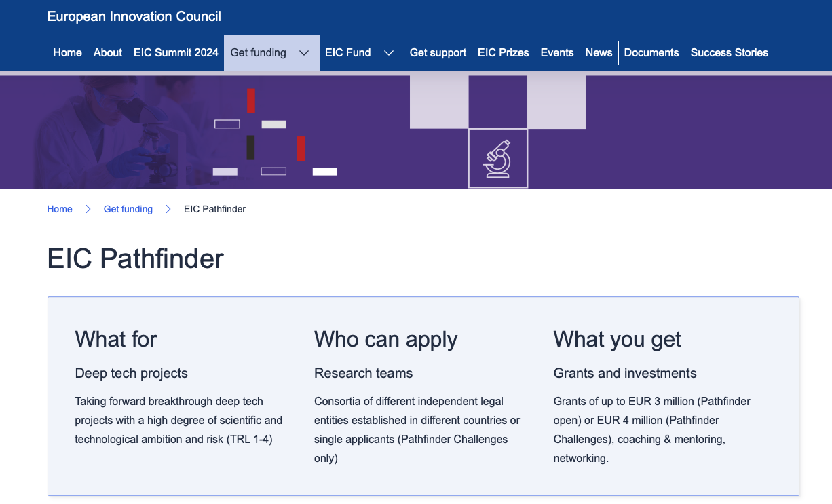
EU actions
Start preparation today!

Slide 12
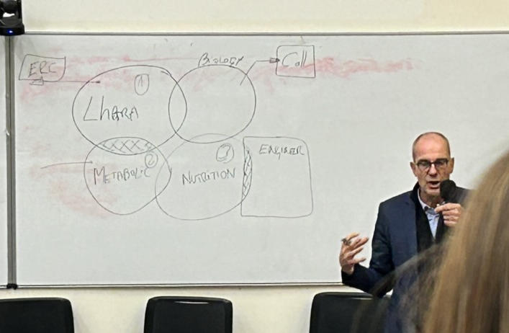
CNRS/Imperial IRC & CNRS/STFC
CNRS/Imperial IRC:
  FONS/FOM @ Imperial
  Biologie, IN2P3, … @ CNRS
  LhARA central to “Health” pilar
CNRS/STFC meeting March ‘24
Identified various avenues for collaboration:
  ITRF/LhARA is one
Contact:
  Kevin Cassou, IJCLab
Joined up CNRS/ICL/STFC

Slide 13
Lets start the meeting …
Today/tomorrow:
  Review progress … substantial
  Agree steps to complete 18-month report, milestone reports …
  Continue discussion of bridging period
  Initiate discussion of MCSA network
    Pathfinder next
Exciting!

