Slide 1
LhARA FFA magnet 3D design
25/04/24
Ta-Jen Kuo
Supervisor: Jaroslaw Pasternak, Jean-Baptiste Lagrange
Imperial College London, STFC

Slide 2
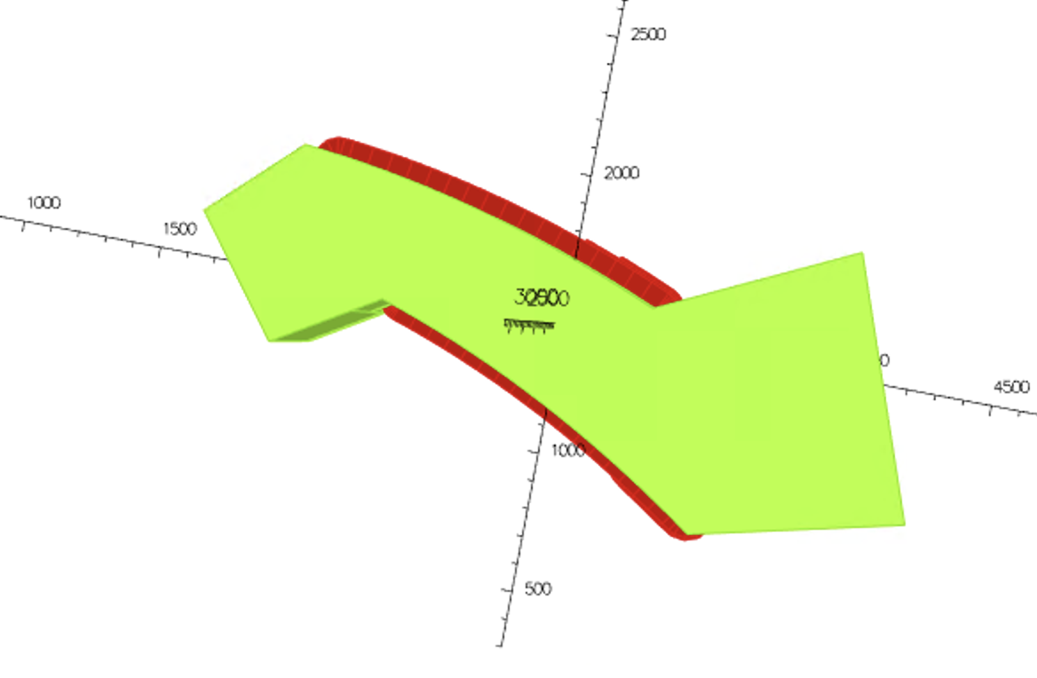
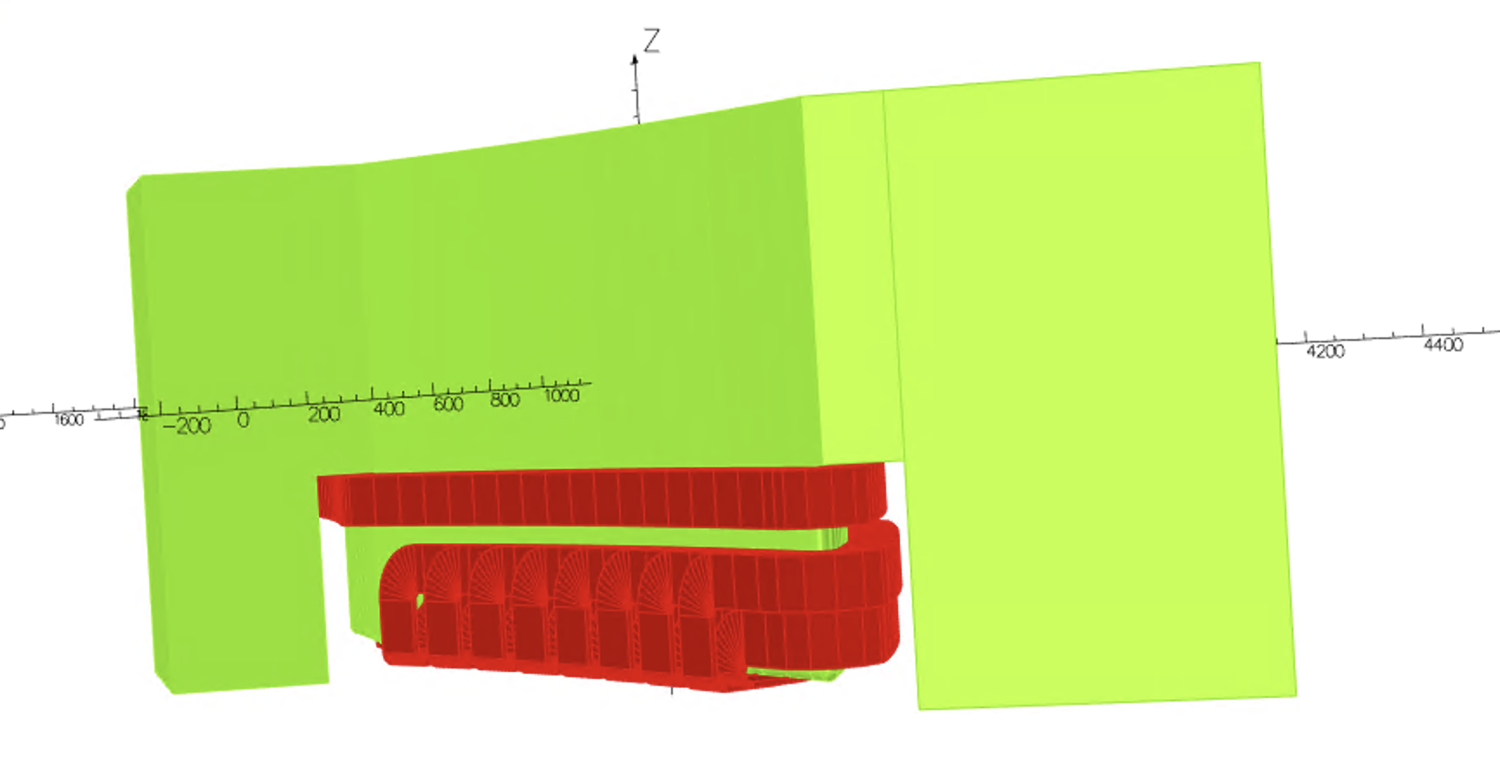
Pictures of the spiral magnet
Top View
Conductors shown in red
Iron shown in green
Side View
(Only top half of the magnet shown)

Slide 3
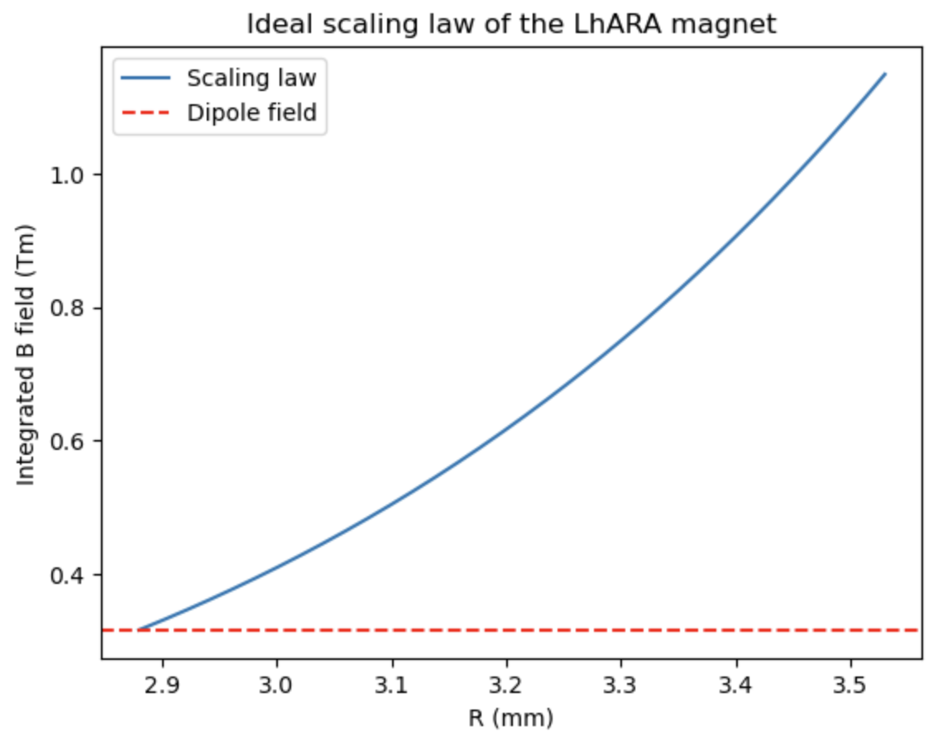
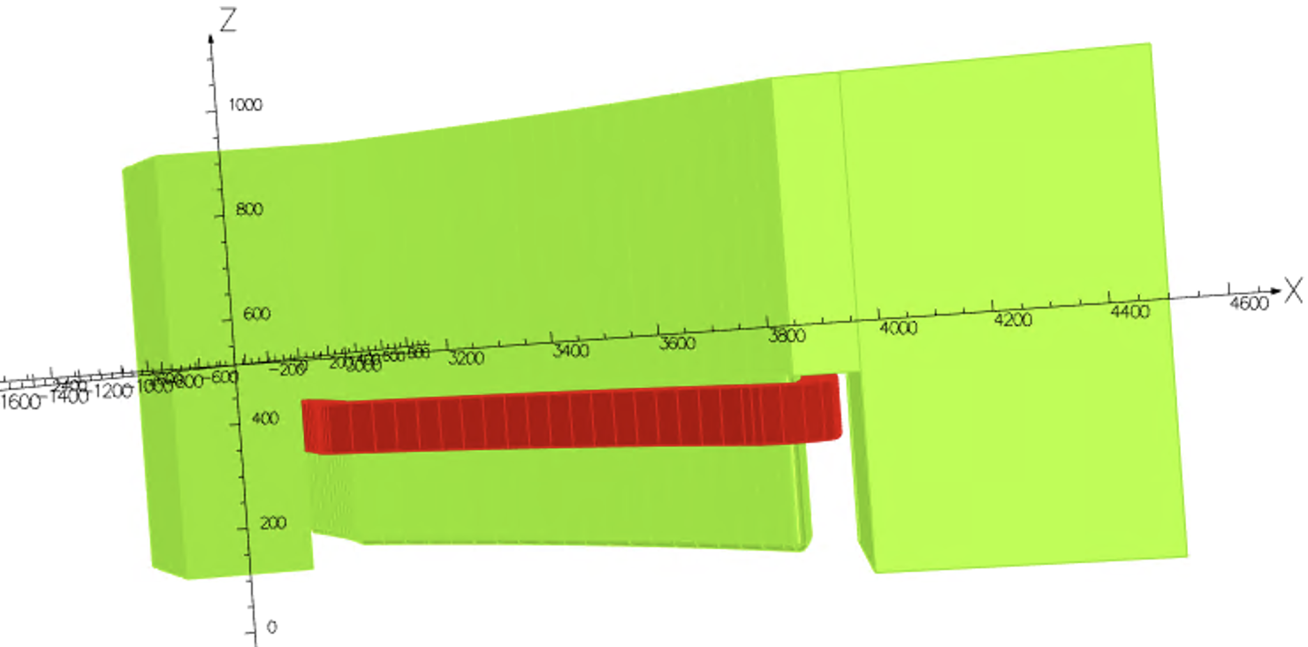
Pictures of the spiral magnet
The integrated B field should scale as: $BL ={BL}_{0} {(\frac{r}{r_{0}})}^{k+1}$, more details in the following slides
The main coil wraps around the side
of the pole and provides the dipole field

Slide 4
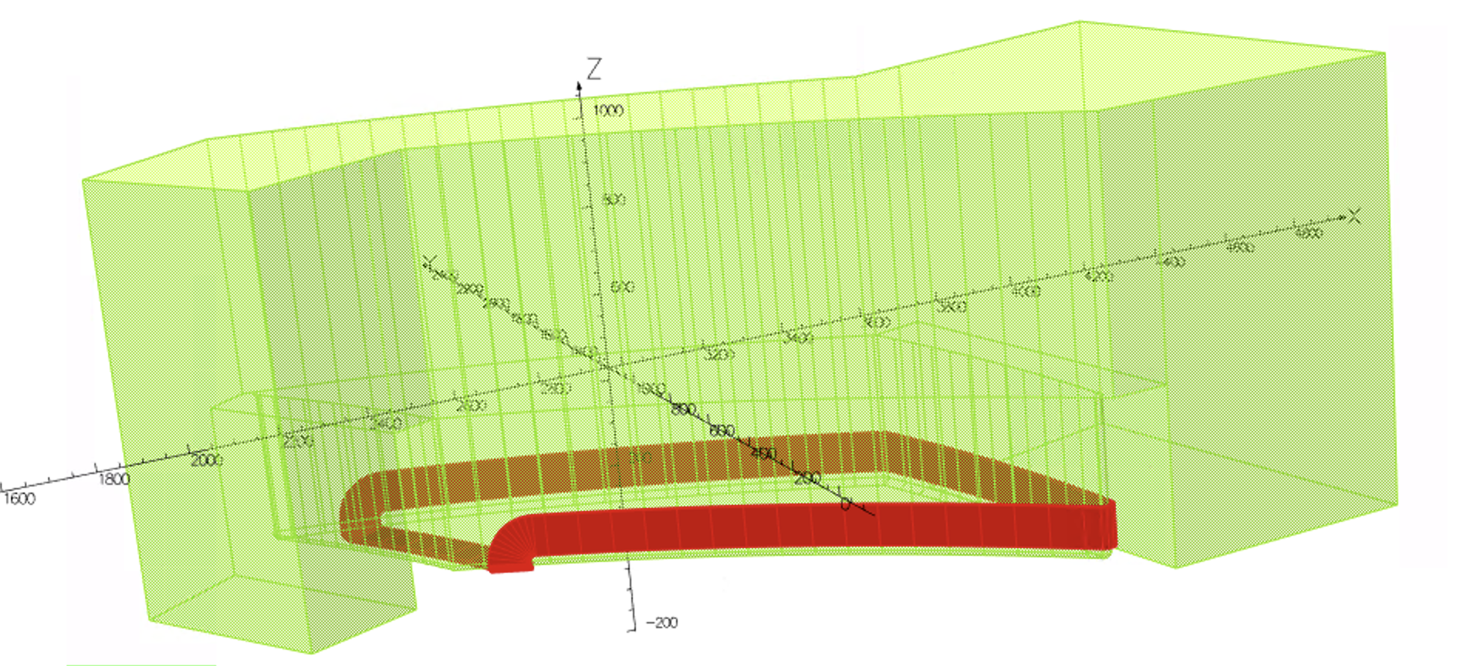
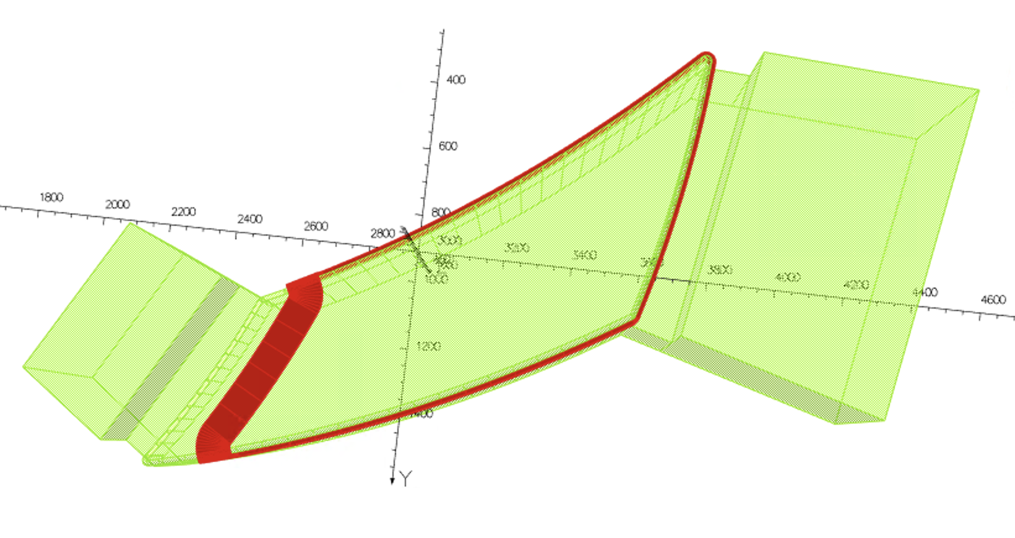



Pictures of the spiral magnet
Trim coils cross the pole face at constant radii and return around the side of the pole. Gradient of the magnetic field achieved by adjusting the set of currents through the coils
$$↑$$
$$↑$$
$$↑$$

Slide 5
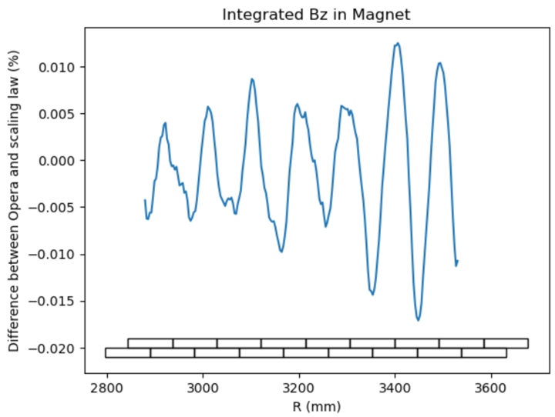
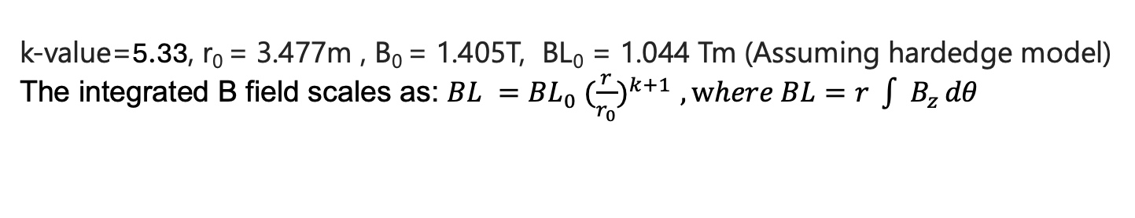
Integrated B Field
k-value=5.33, r₀ = 3.477m , B₀ = 1.405T, BL₀ = 1.044 Tm (Assuming hardedge model)
The integrated B field scales as: $BL ={BL}_{0} {(\frac{r}{r_{0}})}^{k+1}$ $, where BL=r \int{ B_{z }dθ}$
Coil Number | Current Values (Ampere turn)
0 | 14227.21
9 | 6220.45
8 | 4220.33
7 | 3416.29
6 | 2834.05
5 | 2411.90
4 | 2065.92
3 | 1774.55
2 | 1495.80
1 | 1183.96

Slide 6
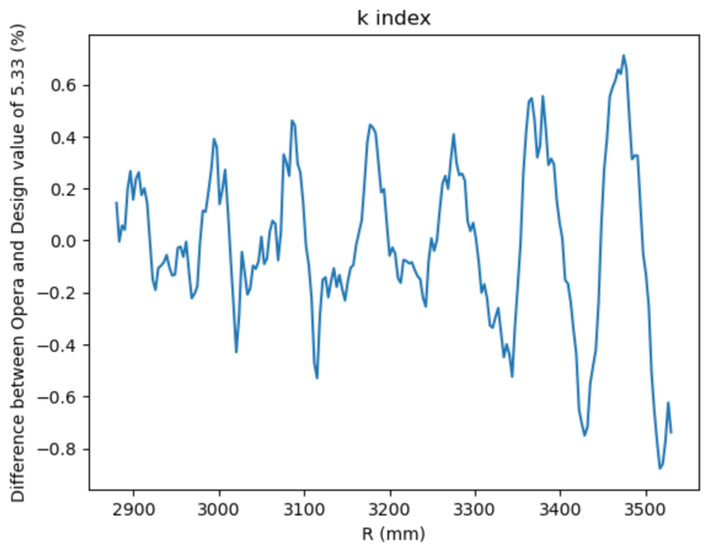
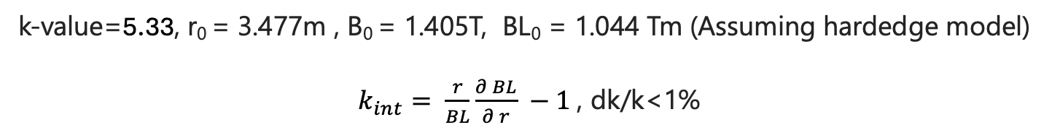
Integrated B Field
k-value=5.33, r₀ = 3.477m , B₀ = 1.405T, BL₀ = 1.044 Tm (Assuming hardedge model)
$k_{int}= \frac{r}{BL}\frac{∂ BL}{∂ r} −1$, dk/k<1%

Slide 7
Power estimation for current
Trim |  |  |  | Main
Coil width | 0.01 | m |  | Coil width | 0.075 | m
Coil height | 0.0925 | m |  | Coil height | 0.117 | m
Coil area | 0.000648 | m^2 |  | Coil area | 0.006143 | m^2
Cu Resistivity | 1.68E-08 | Ohm.m |  | Cu Resistivity | 1.68E-08 | Ohm.m
Trimcoil | Length (m) | Current (AT) |  | Resistance (Ohm) |  | Power (W)
0 | 4.479109 | 14227.21121 |  | 1.23E-05 |  | 2.48E+03
1 | 2.36 | 6220.449896 |  | 6.12E-05 |  | 2.37E+03
2 | 2.57 | 4220.325259 |  | 6.66E-05 |  | 1.19E+03
3 | 2.78 | 3416.294266 |  | 7.20E-05 |  | 8.41E+02
4 | 2.98 | 2834.051508 |  | 7.74E-05 |  | 6.22E+02
5 | 3.20 | 2411.899386 |  | 8.31E-05 |  | 4.83E+02
6 | 3.41 | 2065.924322 |  | 8.84E-05 |  | 3.77E+02
7 | 3.61 | 1774.553751 |  | 9.36E-05 |  | 2.95E+02
8 | 3.82 | 1495.803586 |  | 9.90E-05 |  | 2.22E+02
9 | 4.02 | 1183.955937 |  | 1.04E-04 |  | 1.46E+02
10 | 2.75 | 6220.449896 |  | 7.13E-05 |  | 2.76E+03
11 | 2.96 | 4220.325259 |  | 7.67E-05 |  | 1.37E+03
12 | 3.16 | 3416.294266 |  | 8.21E-05 |  | 9.58E+02
13 | 3.37 | 2834.051508 |  | 8.75E-05 |  | 7.03E+02
14 | 3.58 | 2411.899386 |  | 9.29E-05 |  | 5.40E+02
15 | 3.79 | 2065.924322 |  | 9.83E-05 |  | 4.20E+02
16 | 4.00 | 1774.553751 |  | 1.04E-04 |  | 3.27E+02
17 | 4.20 | 1495.803586 |  | 1.09E-04 |  | 2.44E+02
18 | 4.41 | 1183.955937 |  | 1.14E-04 |  | 1.60E+02
 |  |  |  |  |  | Total Power (W)
 |  |  |  |  |  | 1.65E+04
16.5 kW for a half of the magnet
16.5 x 2 x 10 magnets = 330 kW
Overall power for current

Slide 8
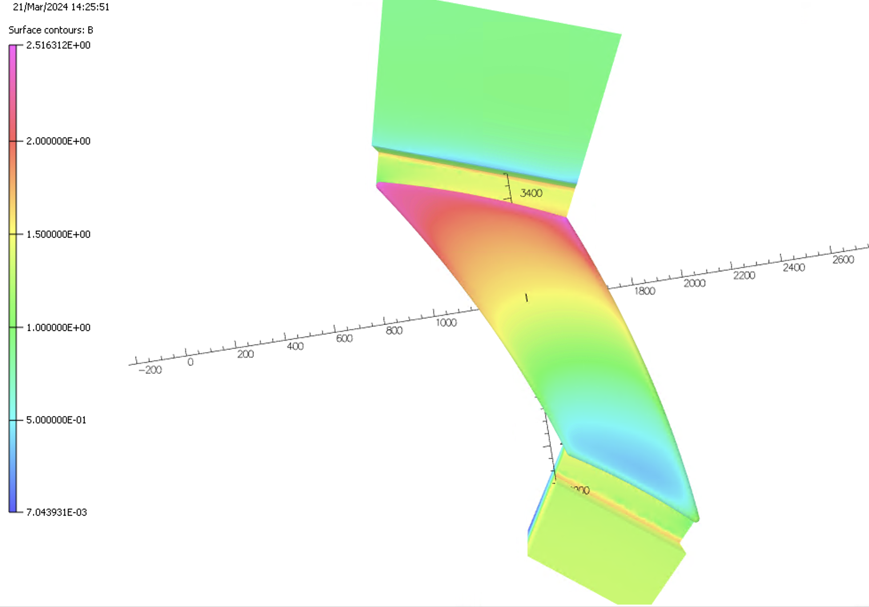
Saturation level of pole face
Reaches 2.5 T at the
outer radii of the pole

Slide 9
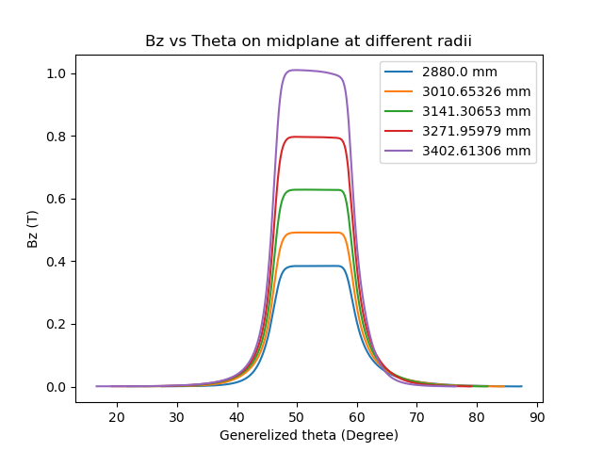
Bz vs theta at different radii
Flat top of field slanted at higher
Radii due to saturation
Fringe field extent not constant
Clamps yet to be added

Slide 10
Further Work
Add in field clamps to control the fringe field extent
Produce a field map and track the particles to investigate
the tune variation

