Slide 1
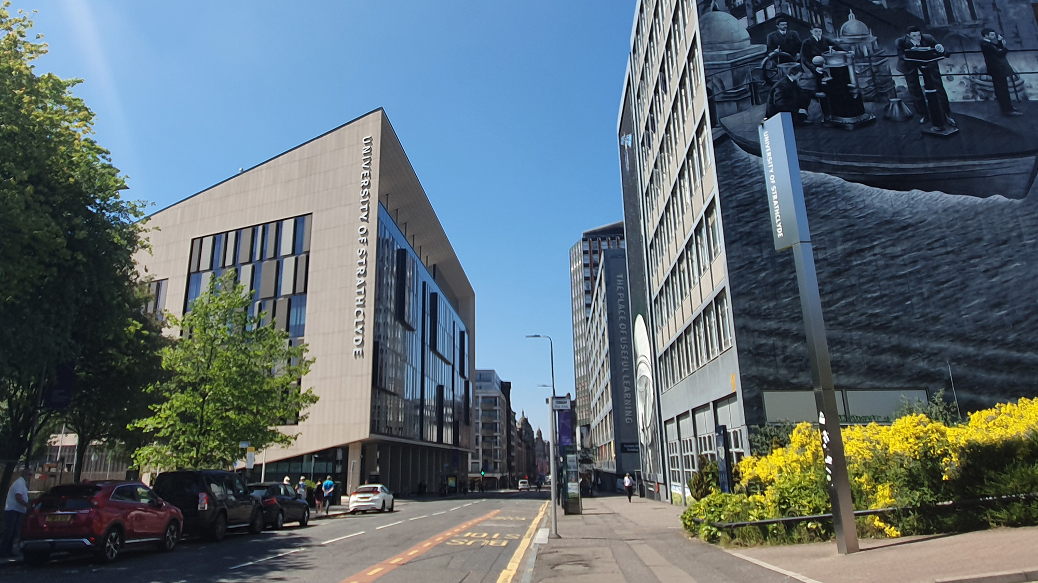
LhARA Collaboration Meeting #5
WP2 Source Session
X THE PLACE OF USEFUL LEARNING
WP2 Overview
26th April 2024
Dr. Ross Gray
ross.gray@strath.ac.uk

Slide 2
Session Overview
9.30 – Ross Gray: Overview and Update on WP2
9.45 – Titus Dascalu: Review of Progress on PIC simulations for WP2 (Remote)
10.00 – Robbie Wilson: Update on SCAPA Development and Experiments
10.15 – Matt Alderton: Update on Ion Diagnostic Calibrations (Remote)

Slide 3
WP2 Team
University of Strathclyde
R. Wilson, T. Frazer, E. Dolier, C. McQueen, B. Torrance, M. Alderton R. Nayli and P.McKenna
Imperial College
O. Ettlinger, G. Casati and N.P. Dover
Queens University Belfast
P. Parsons and C. Palmer
SCAPA, University of Strathclyde
M. Wiggins, E. Brunetti, G. Manahan, W. Li
Central Laser Facility
J. Green, C. Armstrong, C. Spindloe, W. Robins, S. Astbury
Lancaster University
T. Dascalu

Slide 4
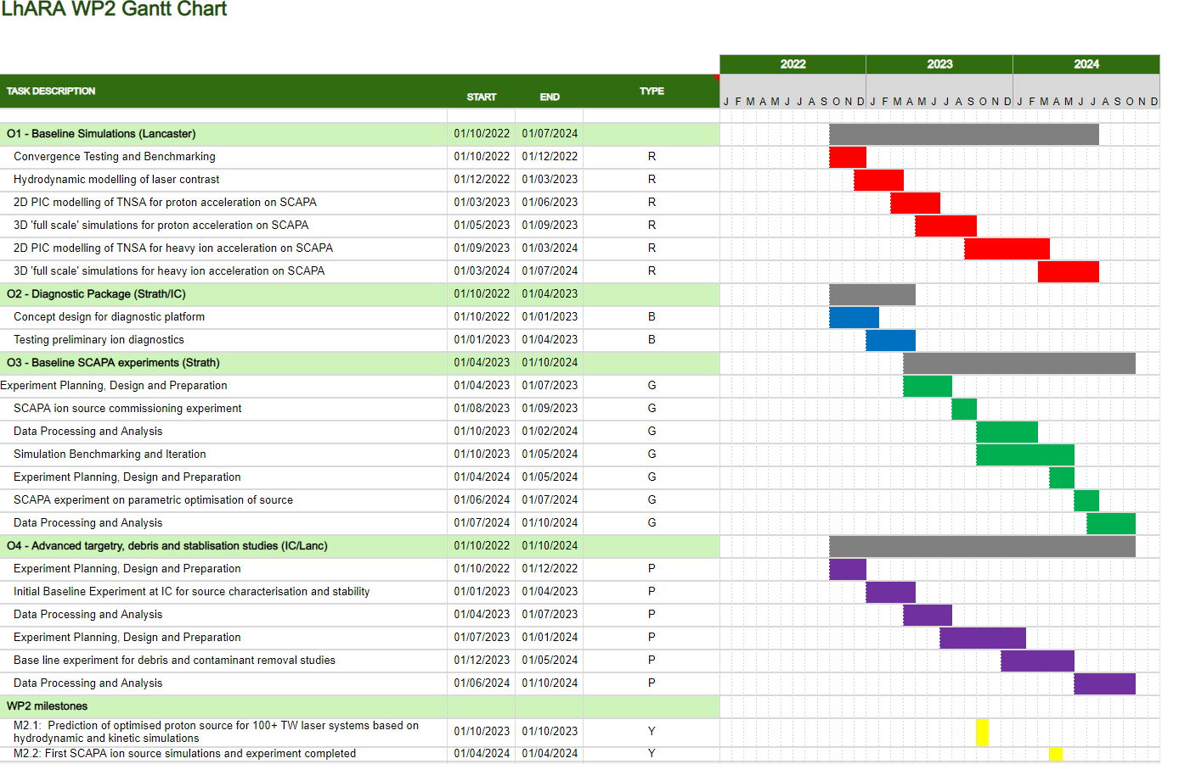
WP2 project plan…
Deliverables for the first two years are focused on early experiments and source benchmarking in simulations, as well as initial technology development in diagnostics and targetry.
For the initial experiments we would ideally like to perform detailed, statistically significant parameter scans to establish and optimise the source performance.

Slide 5
Implementing the project plan…
Experimental R&D:
‘Full scale’ LhARA specification testing on SCAPA laser, Strathclyde
Application focused diagnostic and targetry development
High repetition rate, automation and longevity studies on Zhi laser, Imperial
Numerical modelling:
State-of-the-art high fidelity 3D simulations of the ion source
Parametric optimisation to support experimental studies

Slide 6
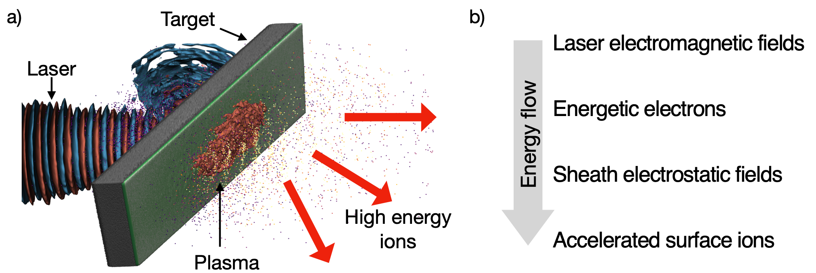
Planned outputs from WP2
High energy (e.g. ~15 MeV p+, 4 MeV/u C6+) from source
Operations at up to 1 Hz for extended periods (extending to 5 and 10 Hz)
Aiming to deliver 10⁹ protons or 10⁸ carbon ions per shot, eventually other ions
Initially tape targets, but developing other options, e.g. water jet

Slide 7
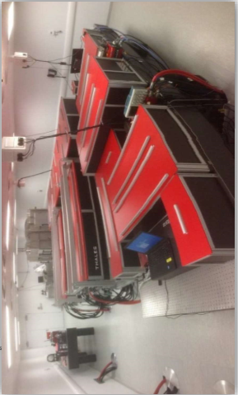
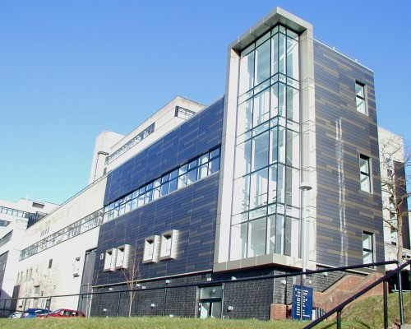
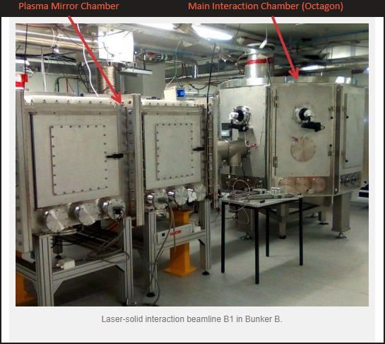
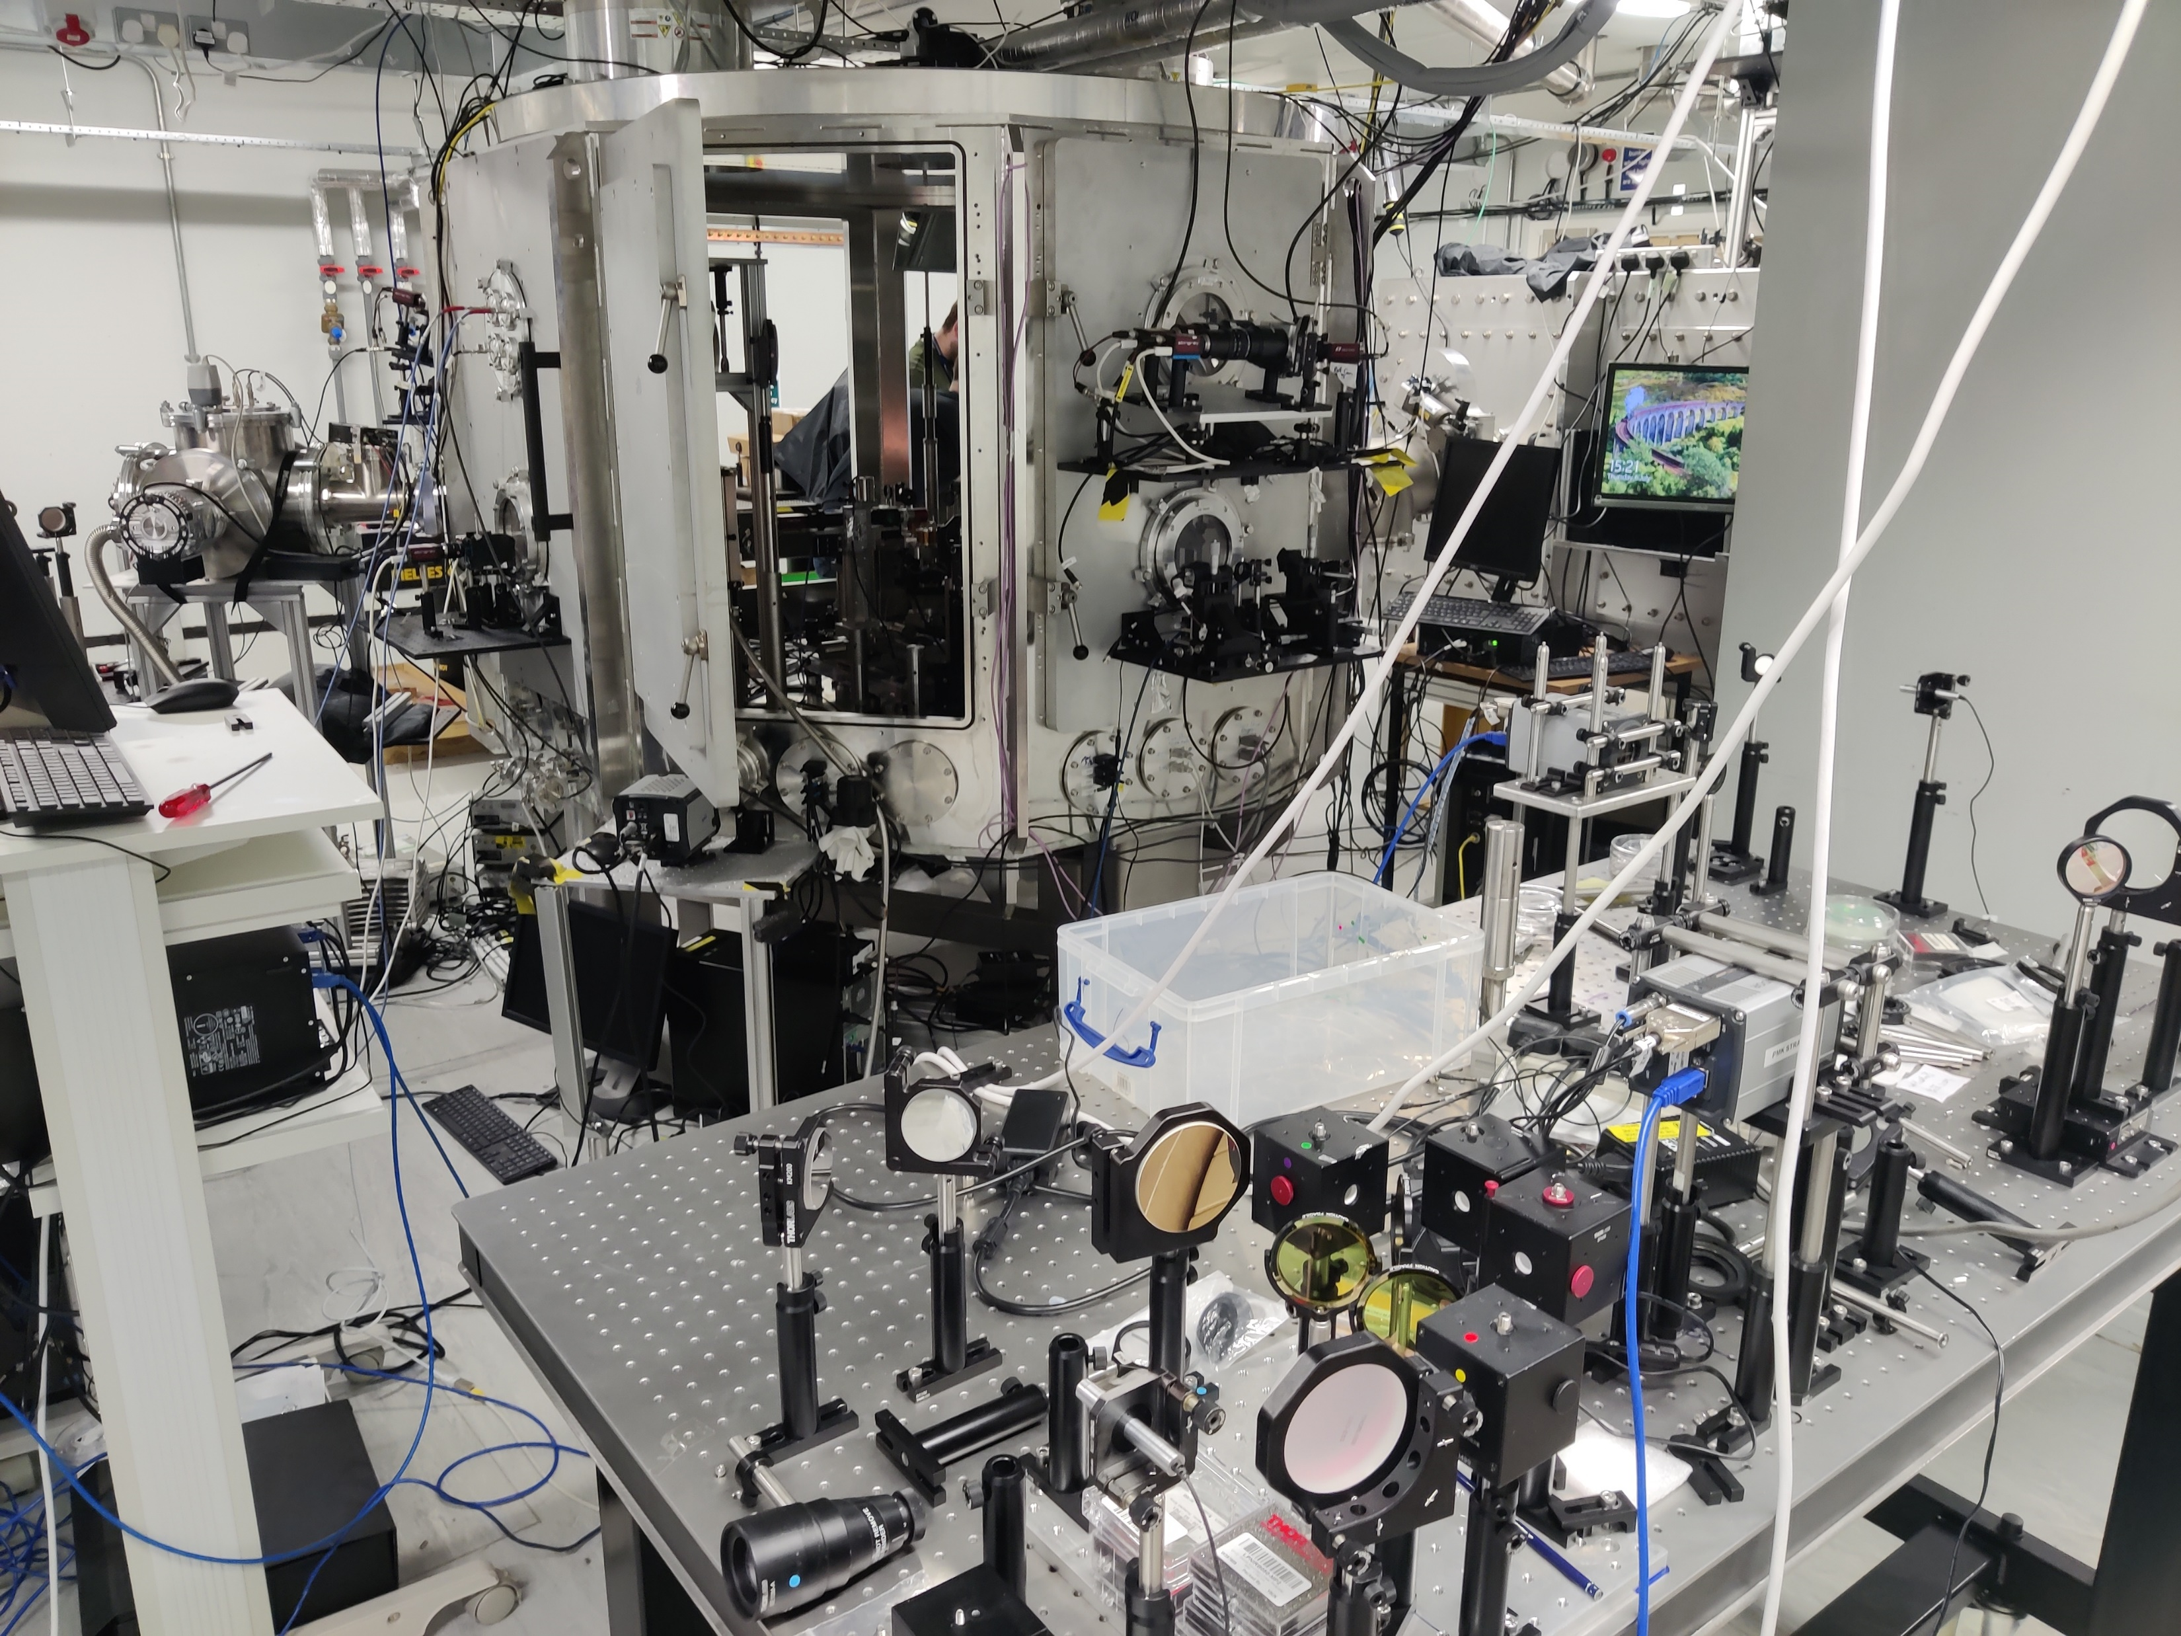
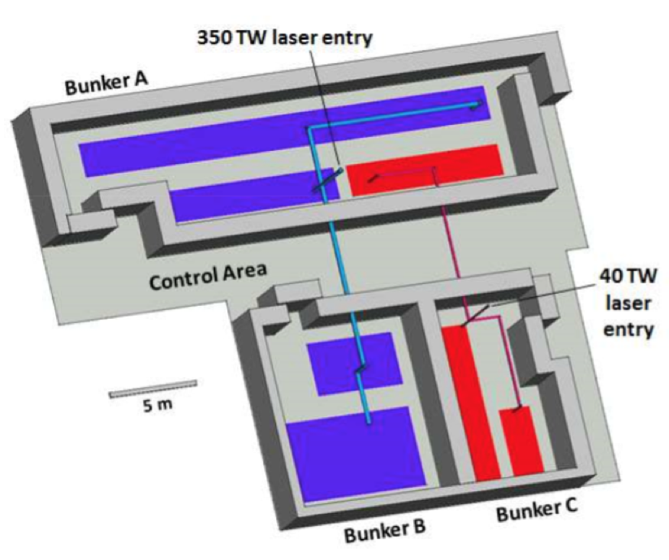
SCAPA: Scottish Centre for the Application of Plasma-based Accelerators
Parameters
Peak Power | $≥$350 TW
FWHM pulse duration | $≤$25 fs
Energy per pulse (on target) | $≥$ 6.5 J
Pulse repetition rate | Up to 5 Hz
Temporal intensity contrast | 10¹⁰:1 @ 100 ps 10⁸:1 @ 30 ps 10⁴:1 @ 2 ps ASE contrast 10¹⁰:1
Central wavelength | 800 nm
Beam quality Strehl ratio | $≥$0.85
Attenuator | 10-100%

Slide 8
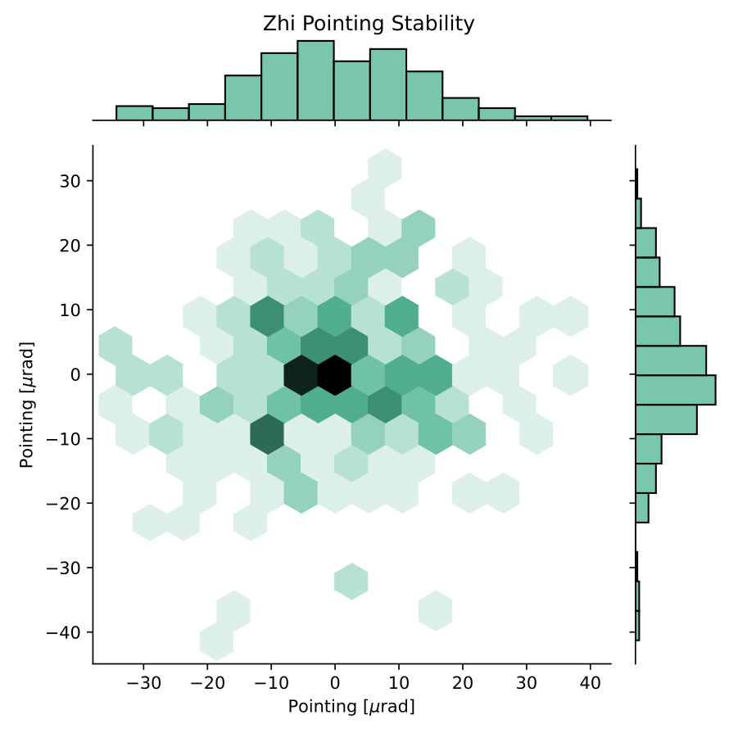
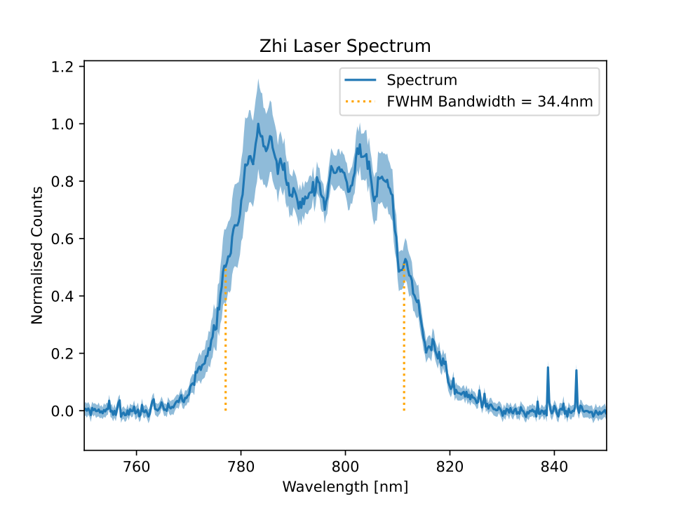
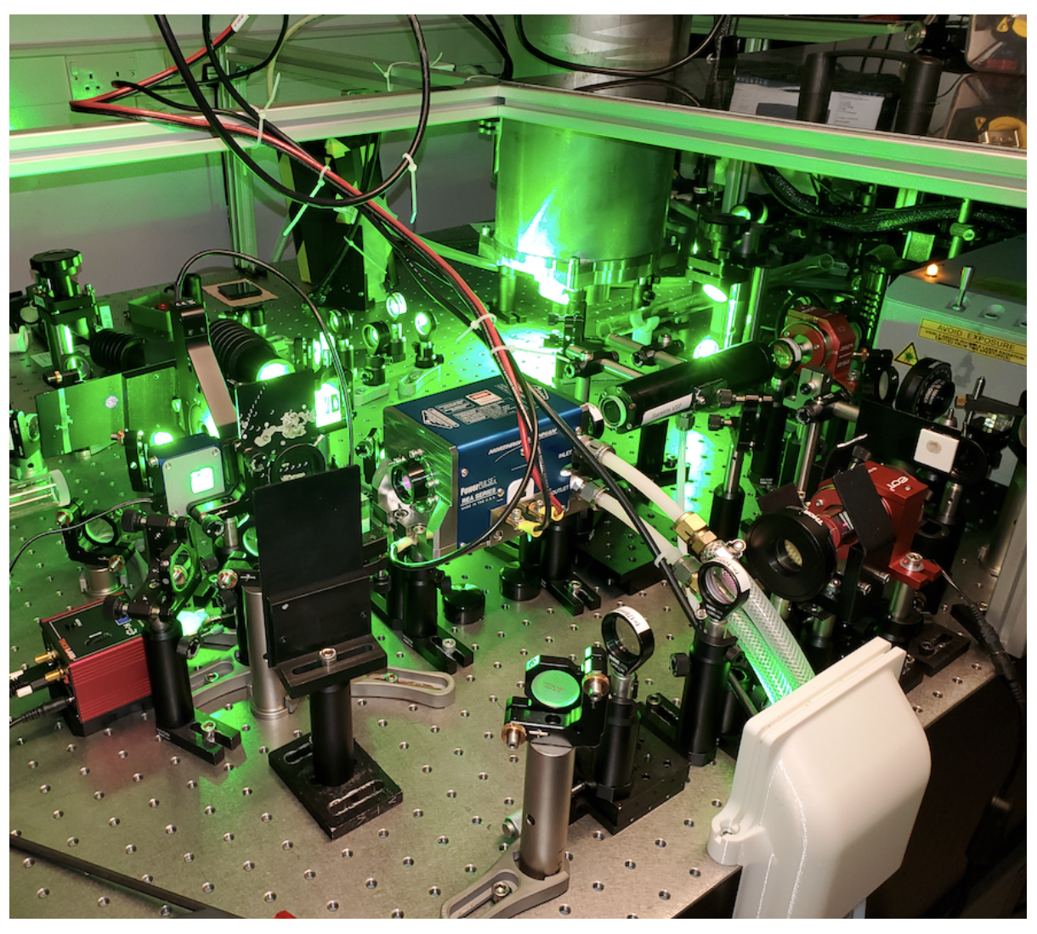
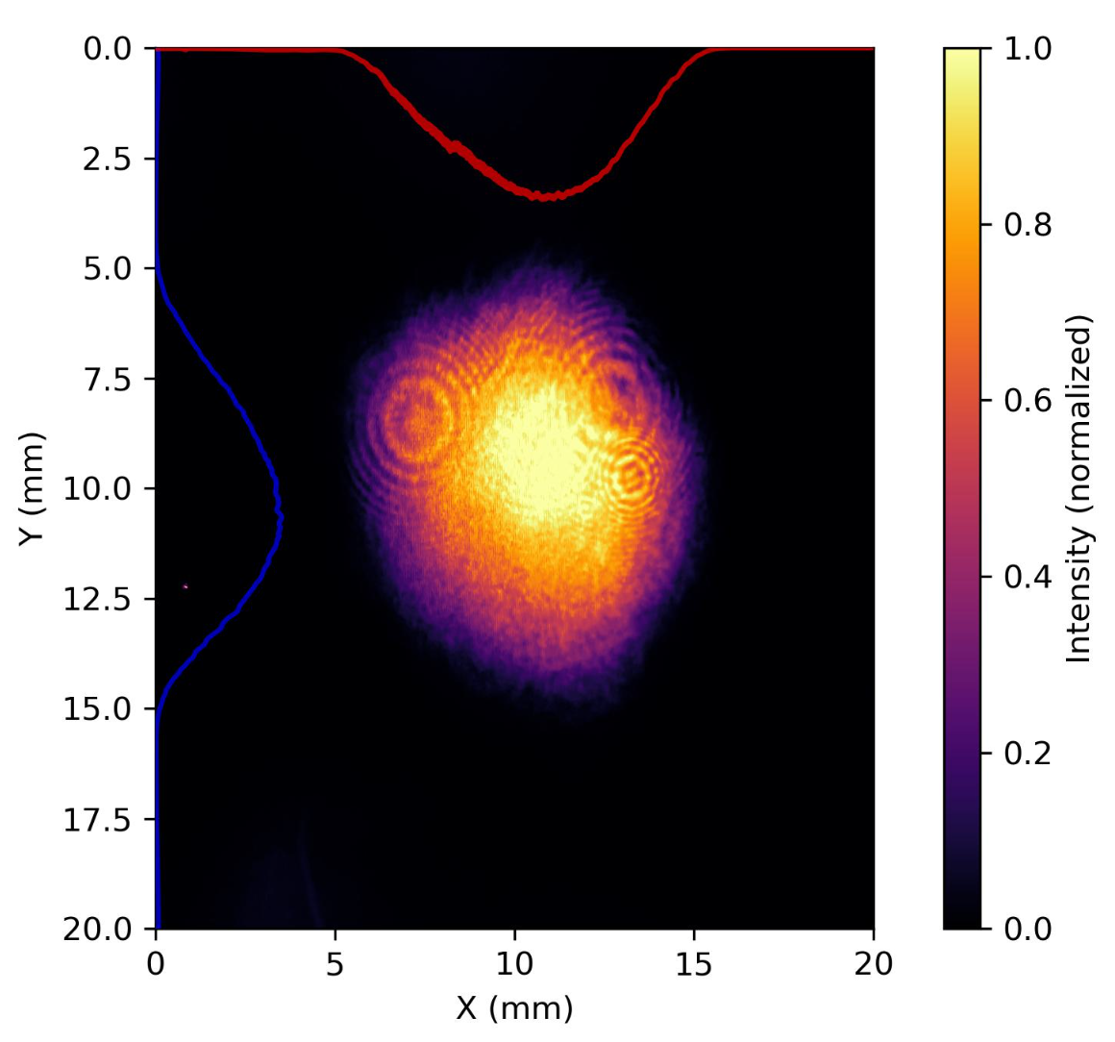
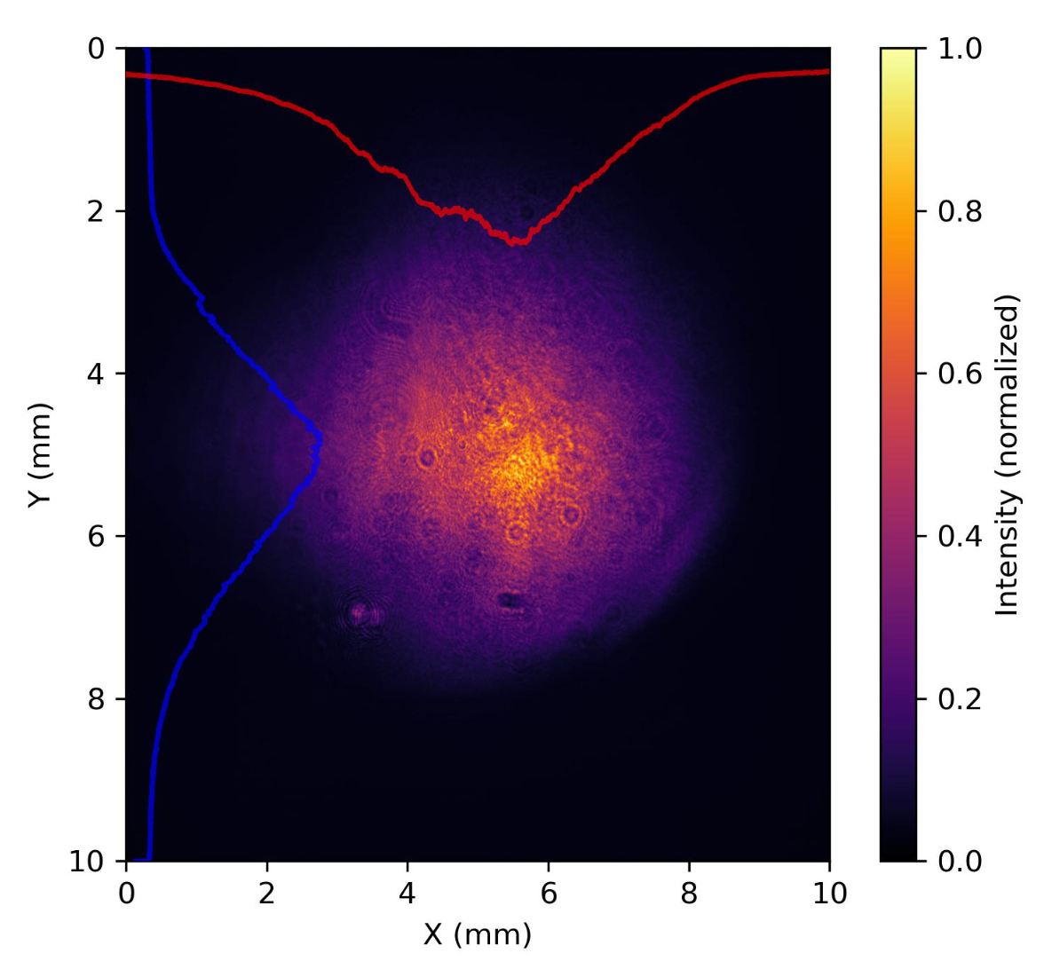
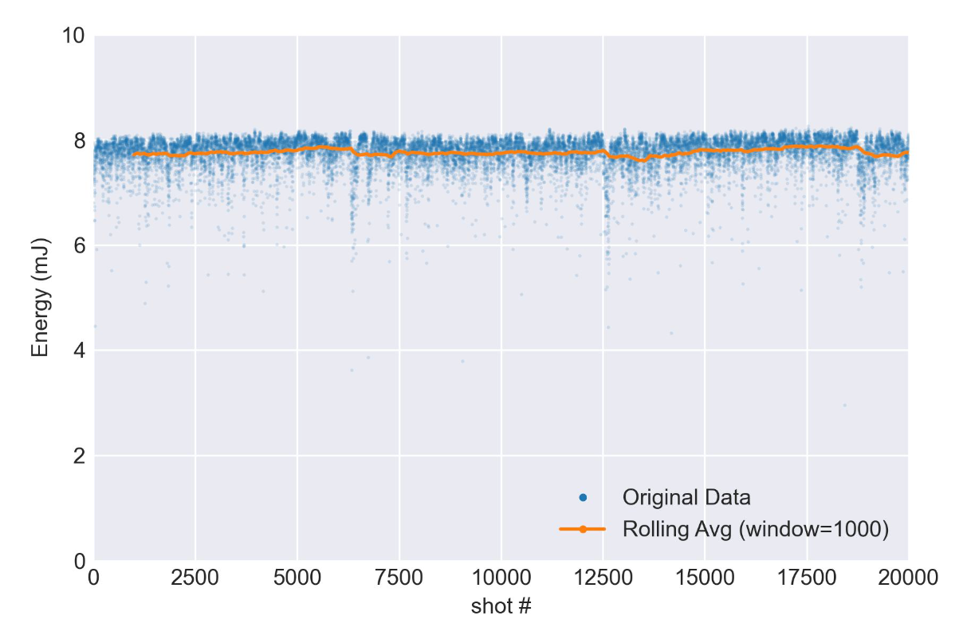
R&D with Zhi
100Hz Ti:Sapphire Laser System:
mJ level operation for “table top” experiments at % level stability
100mJ level output for higher power electron and ion acceleration experiments
current design offers scalability to run at current levels to multi-kHz repetition rates, or Joule level Ti:Sapphire energies at 100Hz.
High energy output
Low energy output
65mJ output already demonstrated - new amplifier will allow >100mJ

Slide 9
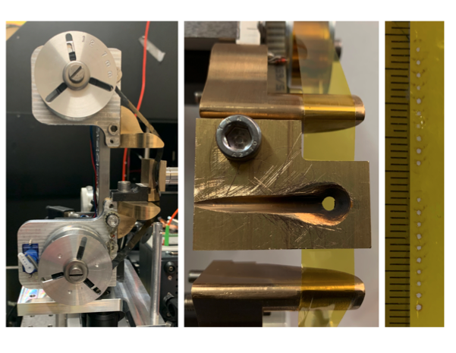
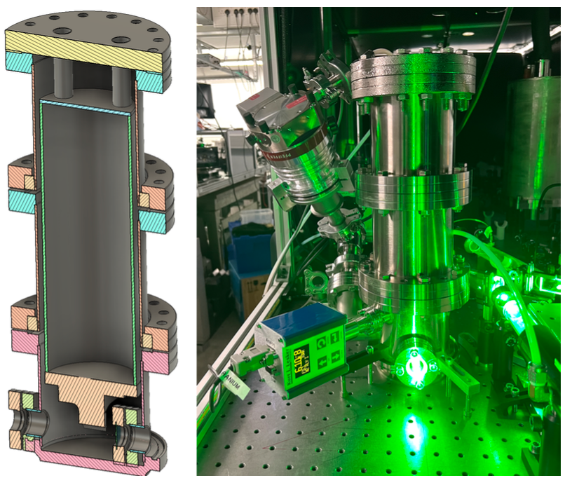
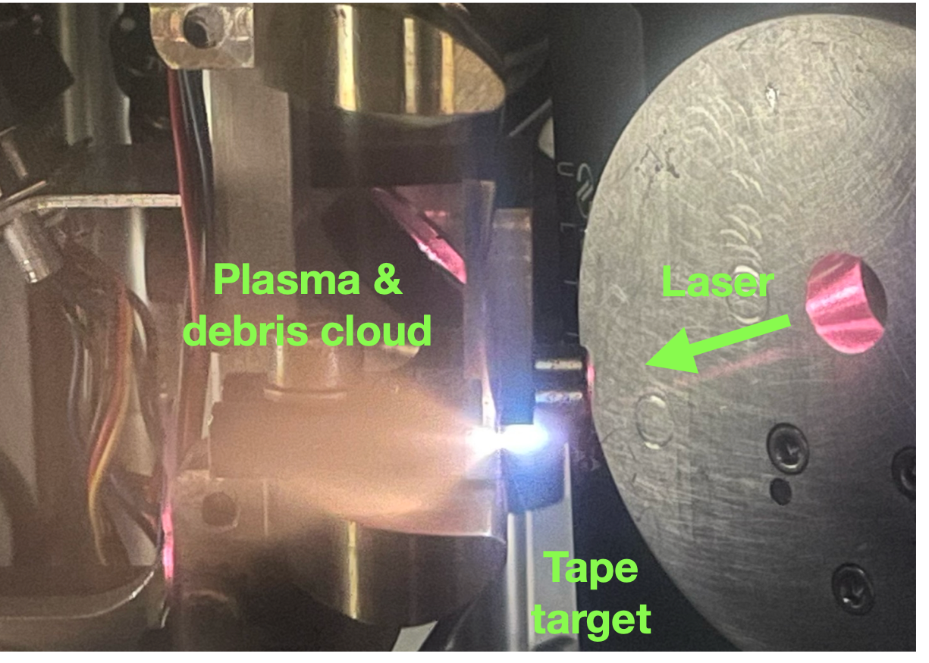
R&D with Zhi
Cryogenic regenerative amplifier and 4-pass amplifier to mitigate thermal lensing
High stability homemade tape target for 100 Hz operation
Xu et al., HPLSE 11, e43 (2023)
Ion source and diagnostics are undergoing testing to run at 10+ Hz

Slide 10
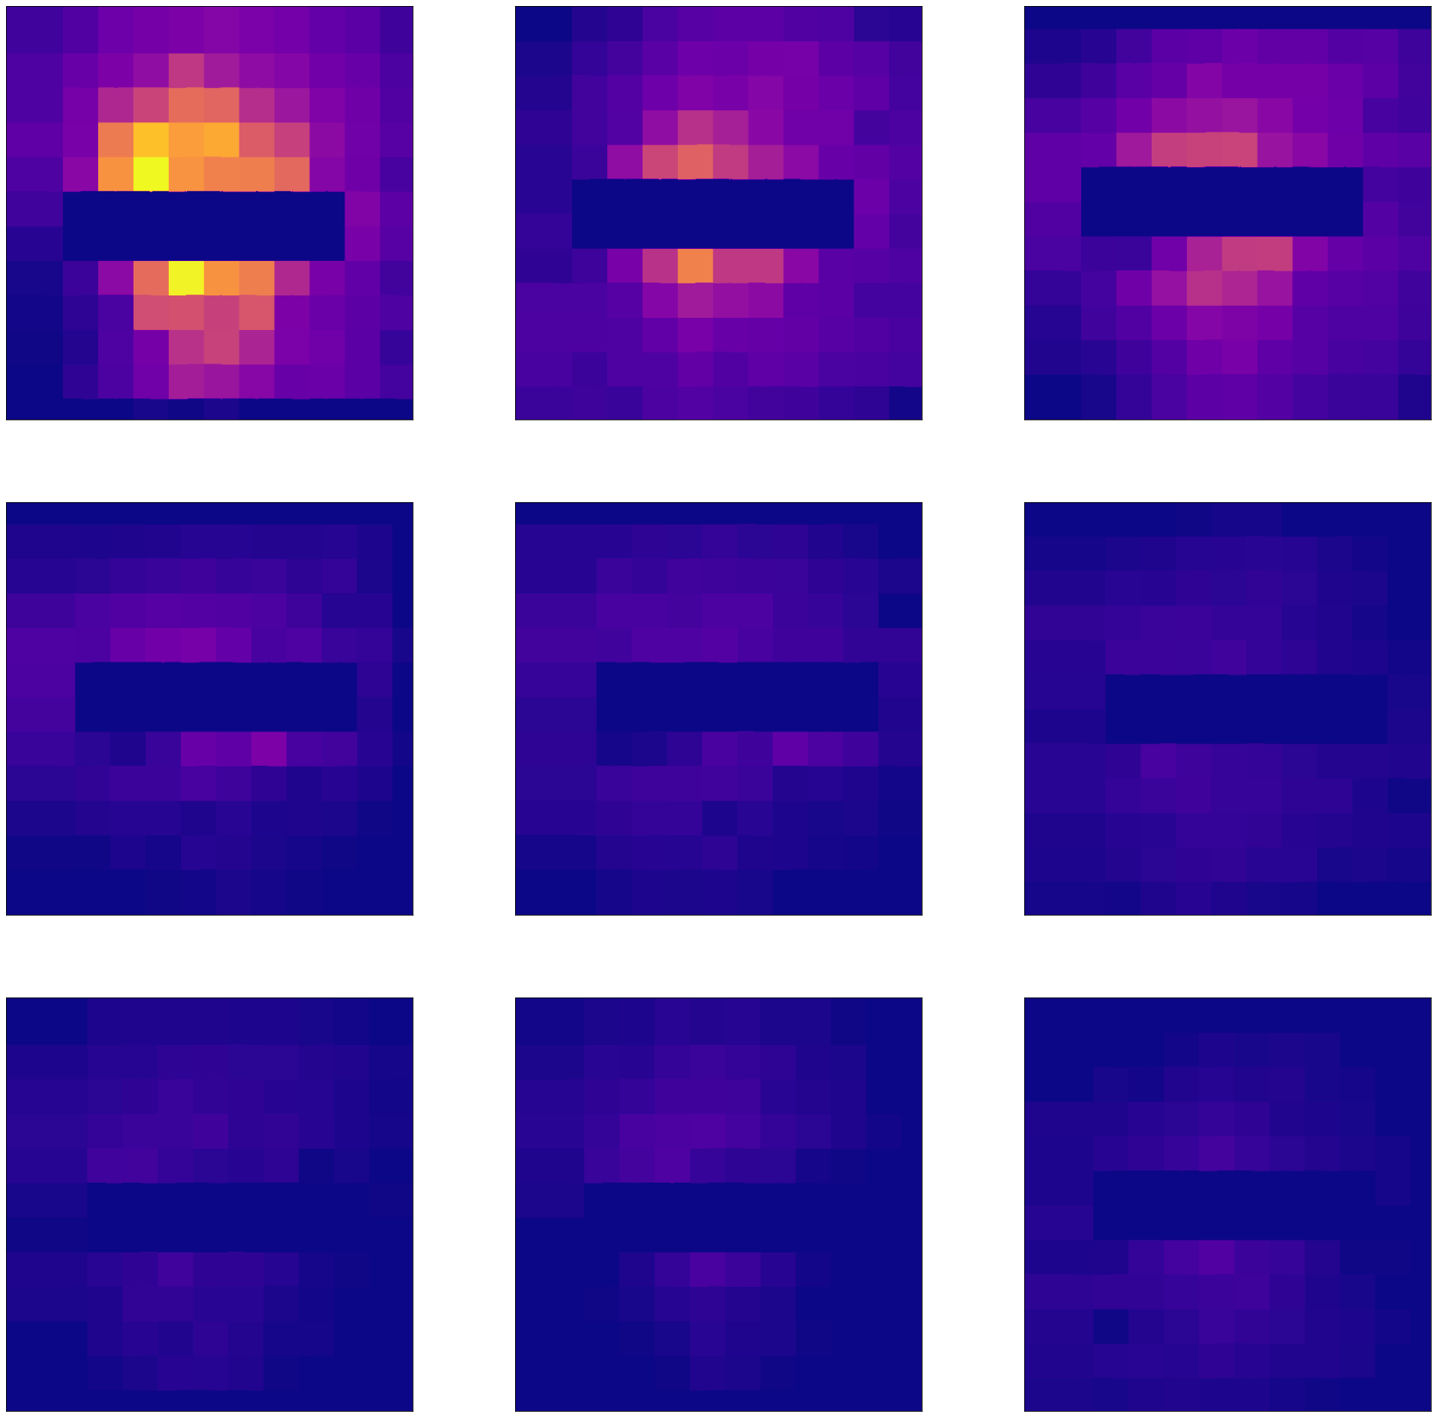
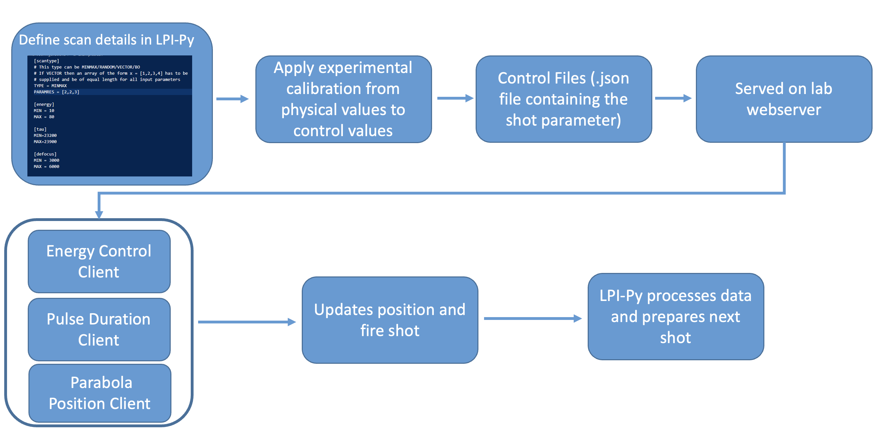
Delivering on the WP2 Objectives…
High Rep & Targets
High-repetition tape rate target now updated and operational
3x Experimental beamtimes (1 LhARA funded and 2 as part of internal commissioning) all exceeding 1000 Shots
Comfortably operating at 0.1 Hz and have operated at 1 Hz for short periods. Key issues around ‘pellicles’ at rep rate have now been resolved.
Diagnostics
PROBIES: High-repetition rate proton beam profiler and spectrometer now tested with an updated design
New high repetition rate TP code has been tested and validated on calibration shots (1Hz analysis)
Work ongoing at Birmingham and SCAPA to aid in diagnostic development and absolute calibrations
Automation and ML
Substantial updates to our LPI-Py library enabling automated data scans
Also updates to enable Bayesian optimisation/ML-driven experimental runs
New and ongoing work to update our drive system to streamline these controls
Now running fully 3D EPOCH+FLASH simulations

Slide 11
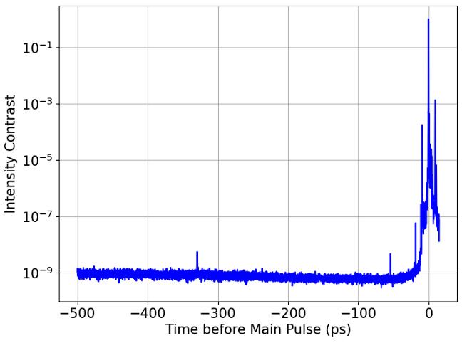
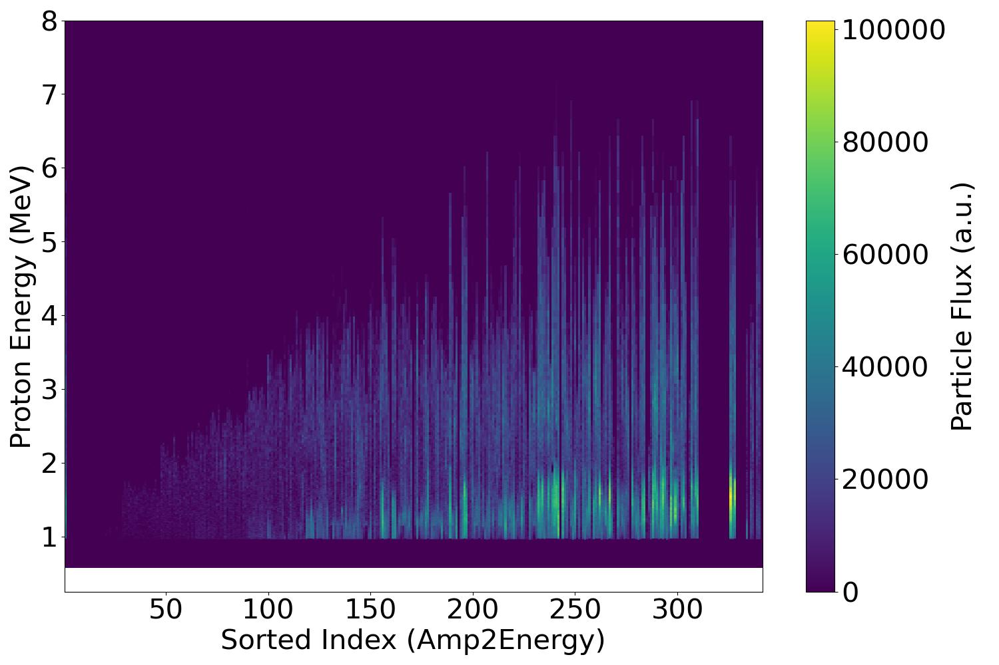
Next steps….Further optimisation of TNSA ion source on SCAPA
Robbie will report on the details of SCAPA development but we have identified an issue which is currently limiting our maximum proton energy to around 7 MeV.
This is likely to be related to the laser ‘temporal intensity contrast’ which results in changes to the front surface plasma profile and significantly changes the source performance
Main pulse
Pre-pulse ~325 ps
Pre-pulse ~50 ps

Slide 12
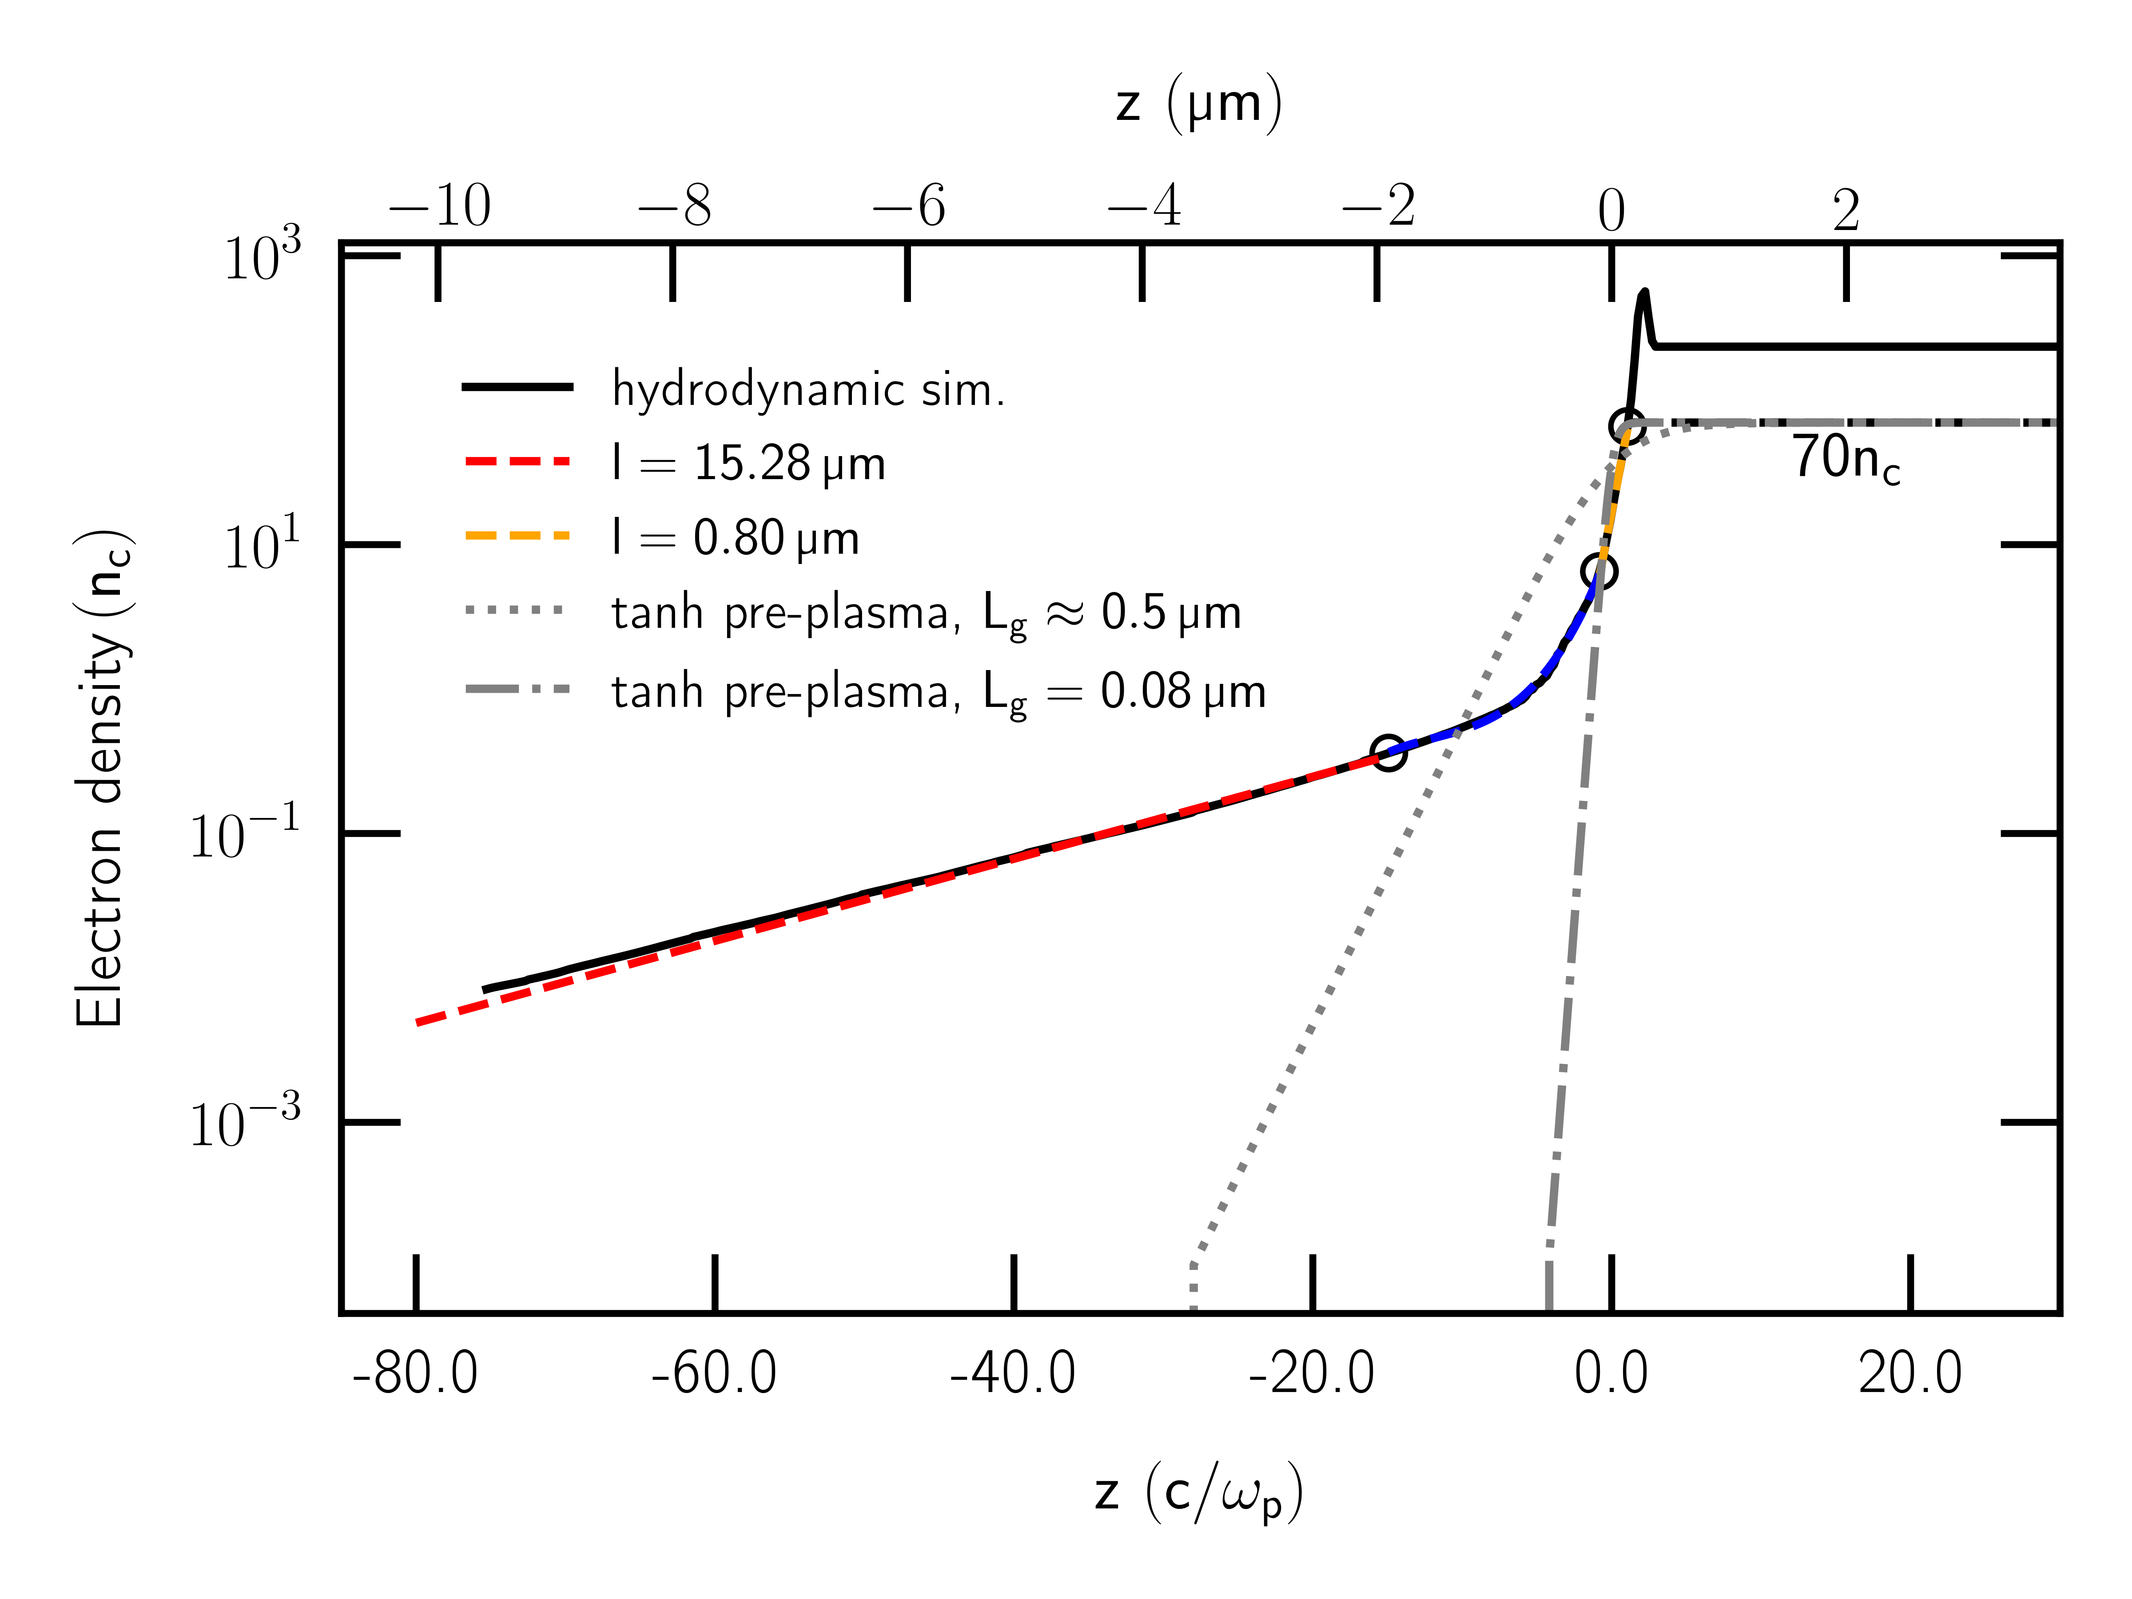
Next steps….Further optimisation of TNSA ion source on SCAPA
We will need to bring our double plasma mirror system online in the short term while also investigating optics which are generating prepulses in the system.
Simulations by Titus will also help us understand the role of these prepulses and the contrast overall on the optimisation of the ion source.
Main pulse
Pre-pulse ~325 ps
Pre-pulse ~50 ps

Slide 13
Summary
At the 18 month mark we have made significant progress towards key objectives
The ‘hard part’ is almost complete. We have demonstrated high repetition rate operations, automated control and have developed suitable online diagnostics
Work at Imperial will identify new directions in terms of long-term operations and the simulation programme will support further optimisation of the source
Prepulses identified via contrast measurements on SCAPA are likely to be the main culprit preventing higher proton energies but we have a plan…

Slide 14
Session Overview
9.30 – Ross Gray: Overview and Update on WP2
9.45 – Titus Dascalu: Review of Progress on PIC simulations for WP2 (Remote)
10.00 – Robbie Wilson: Update on SCAPA Development and Experiments
10.15 – Matt Alderton: Update on Ion Diagnostic Calibrations (Remote)

Slide 15
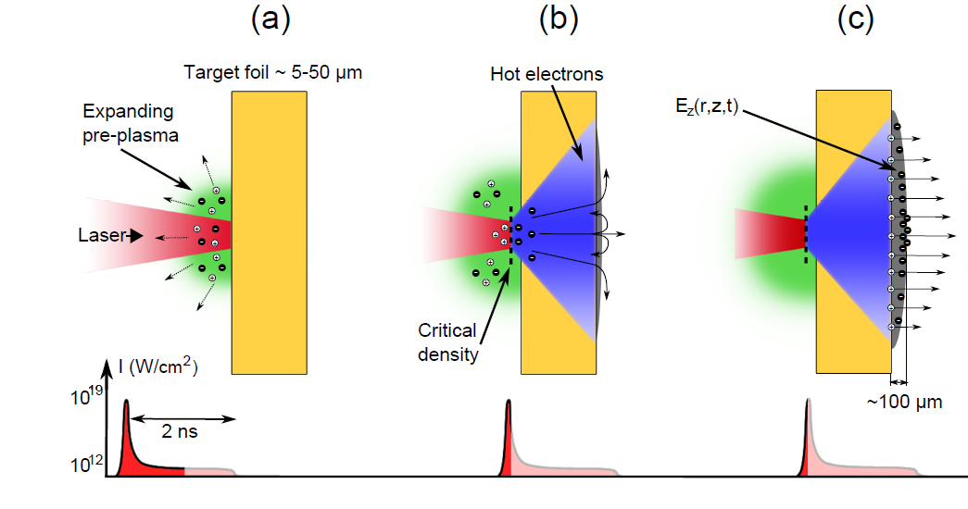
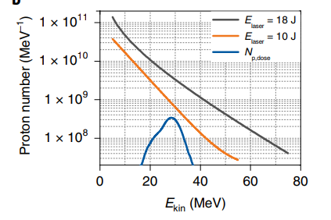
Considerations for a laser driven proton source from Target Normal Sheath Acceleration mechanism (TNSA)
Fast electron temperature and fast electron density and total number at the rear surface drive proton spectral characteristics
The fast electron properties are sensitive to a wide range of input parameters:
Maximum proton energy measured: ~85 MeV
Laser-P⁺ Conversion efficiency: ~10%
Flux: 10¹⁰ Protons/MeV @ 10 MeV with broad thermal spectrum
Laser:
Intensity
Energy
Focal spot size
Laser intensity contrast
Polarisation
…
Plasma:
Energy conversion efficiency
Fast electron divergence angle
Z (scattering, resistivity)
Preplasma scale length
…

