Slide 1
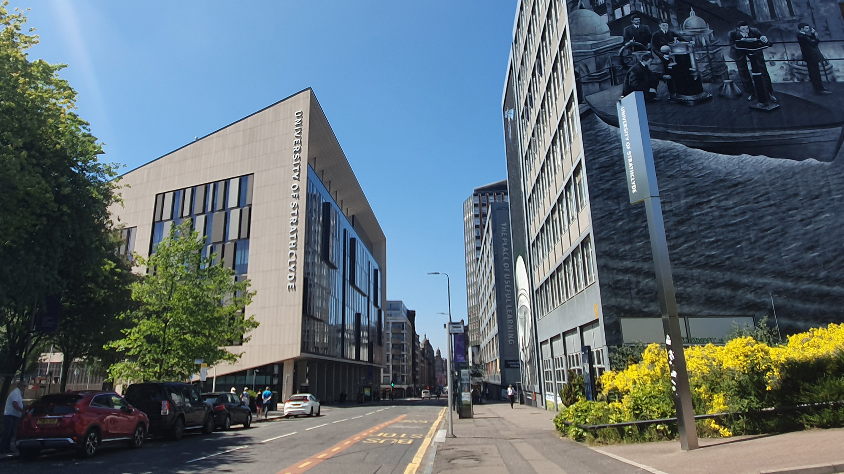
LhARA Collaboration Meeting #5
WP2 Source Session
X THE PLACE OF USEFUL LEARNING
Update on SCAPA Development and Experiments
26th April 2024
Dr. Robbie Wilson
robbie.wilson@strath.ac.uk

Slide 2
WP2 Team
University of Strathclyde
R. Gray, T. Frazer, E. Dolier, C. McQueen, B. Torrance, M. Alderton, M. Peat, R. Nayli and P. McKenna
Imperial College
O. Ettlinger, G. Casati and N.P. Dover
Queens University Belfast
P. Parsons and C. Palmer
SCAPA, University of Strathclyde
M. Wiggins, E. Brunetti, G. Manahan, W. Li
Lancaster University
T. Dascalu
Central Laser Facility
J. Green, C. Armstrong, C. Spindloe, W. Robins, H. Edwards, S. Astbury

Slide 3
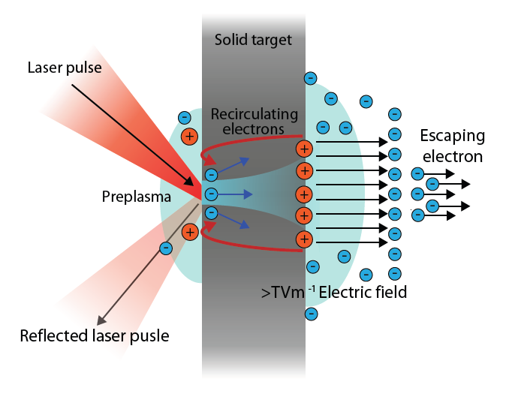
Considerations for a laser driven proton source from Target Normal Sheath Acceleration mechanism (TNSA)
Laser energy absorbed producing large population of hot electrons
Hot electrons injected and propagate through the target
Generates strong ($\sim$TV/m) electrostatic sheath fields at target rear
Drives acceleration of high energy protons
Sensitive to a wide range of input parameters:
Laser:
Intensity
Energy
Focal spot size
Laser temporal/spatial intensity contrast
Polarisation
…
Plasma:
Energy conversion efficiency
Fast electron divergence angle
Z (scattering, resistivity)
Preplasma scale length
Incidence angle
…
Experimental Implementation:
Focusing geometry
Target Design
Laser intensity contrast
Polarisation
Pulse duration
…

Slide 4
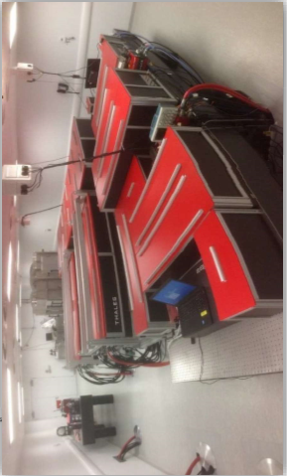
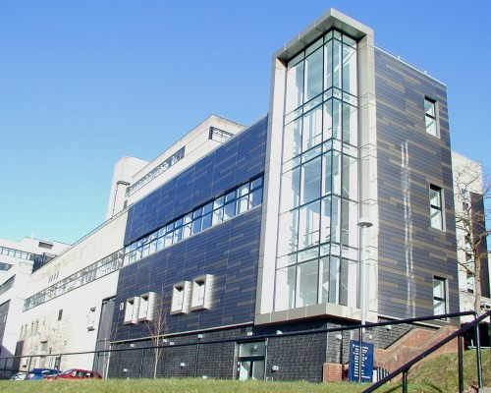
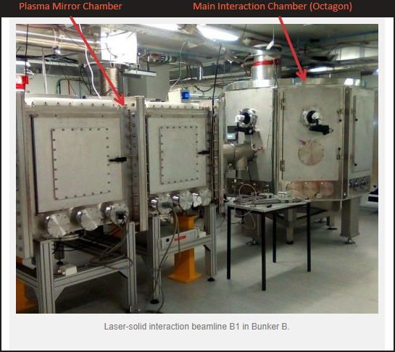
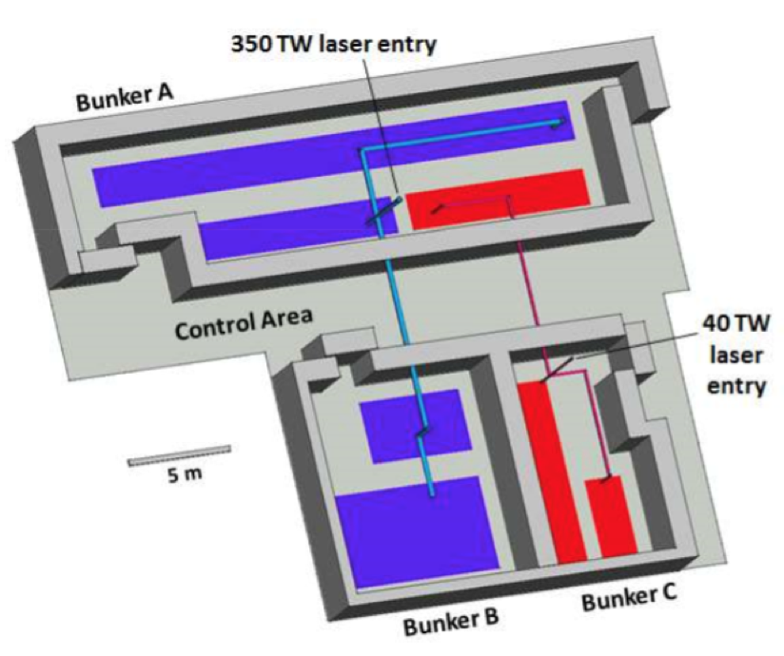
SCAPA: Scottish Centre for the Application of Plasma-based Accelerators
Research is focused on the development and application of laser-driven particle acceleration.
Parameters
Peak Power | $≥$350 TW
FWHM pulse duration | $≤$25 fs
Energy per pulse (on target) | $≥$ 7 J
Pulse repetition rate | 1 Hz
Temporal intensity contrast | 10¹⁰:1 @ 100 ps 10⁸:1 @ 30 ps 10⁴:1 @ 2 ps ASE contrast 10¹⁰:1
Central wavelength | 800 nm
Beam quality Strehl ratio | $≥$0.85
Can deliver high particle numbers (>10⁸ protons), within the MeV energy range, at Hz level repetition rate.

Slide 5
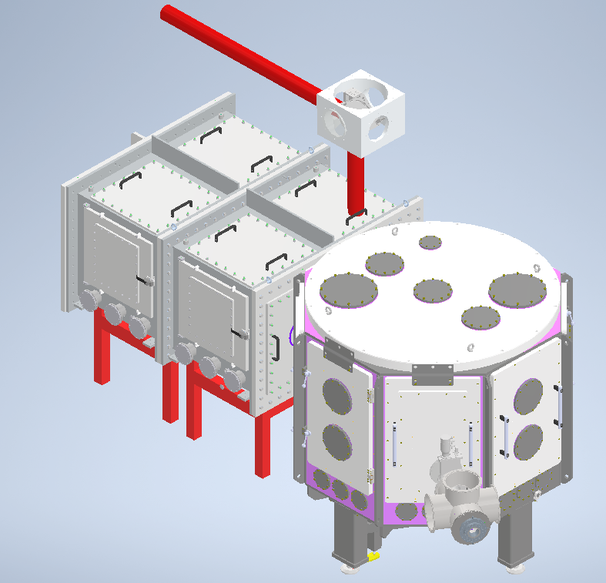
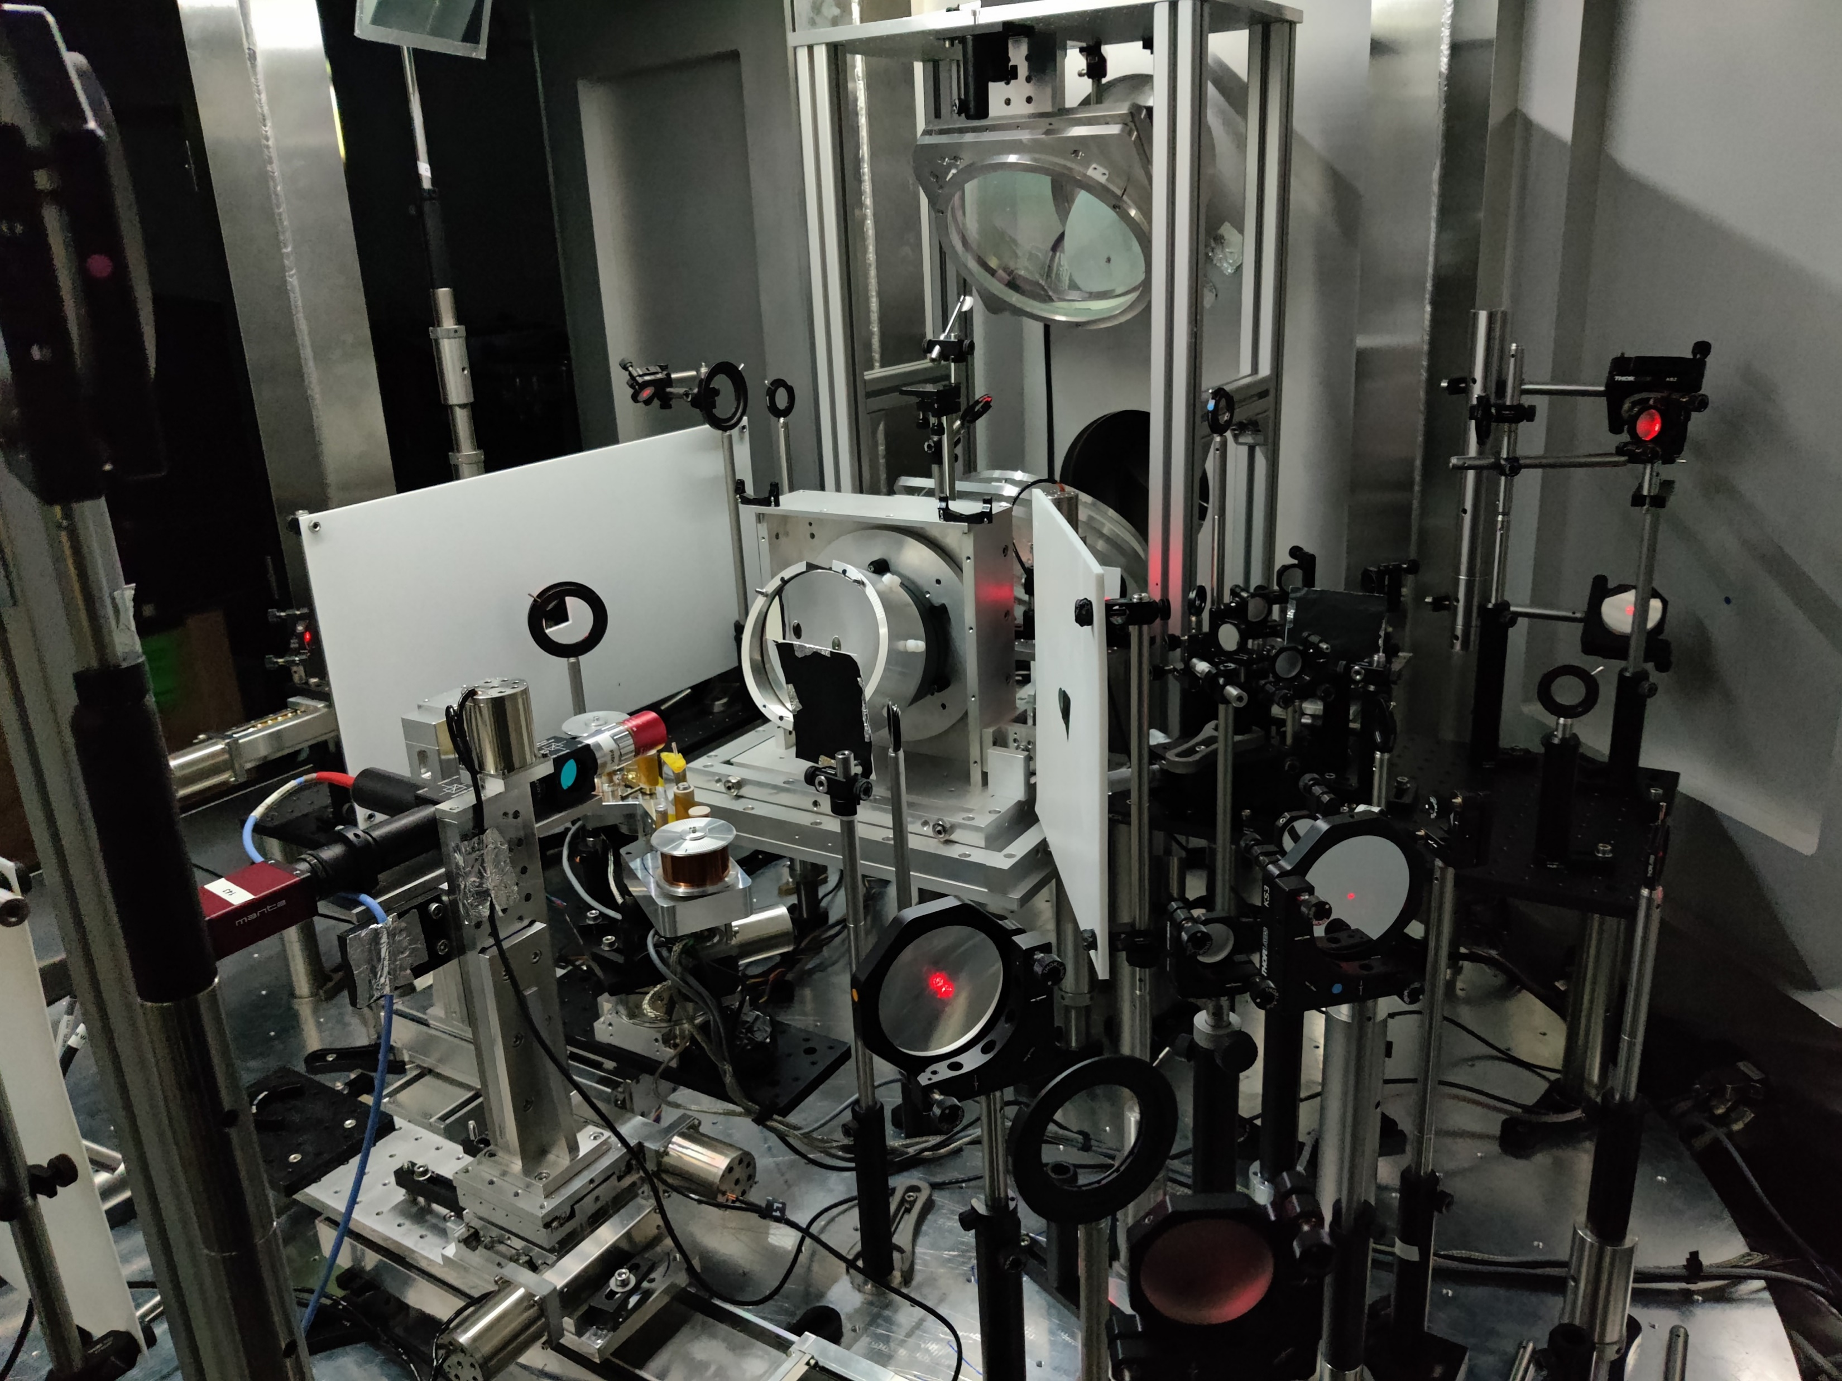
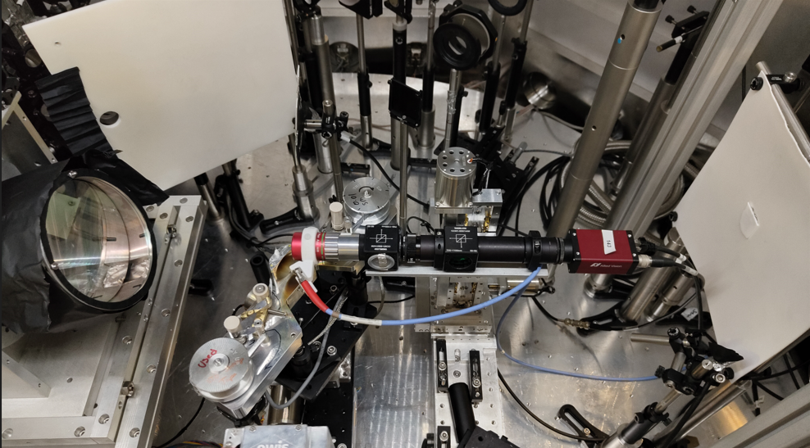
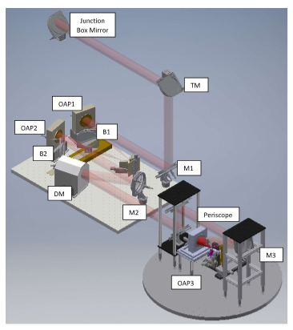
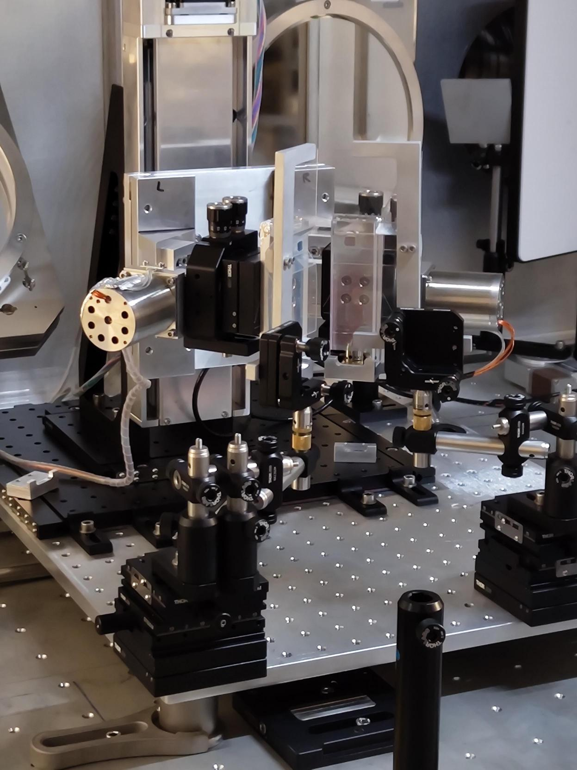
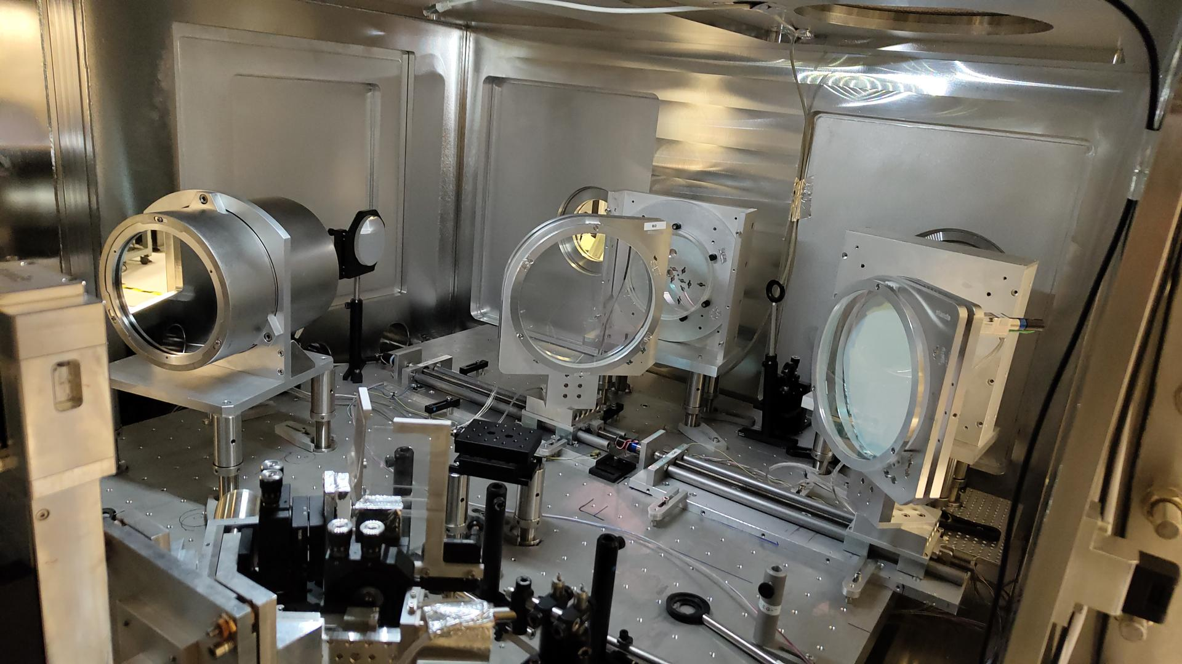
SCAPA Bunker B Target Station
Beamline
Main Chamber Internals
Plasma Mirror Chamber
Main Chamber
TP Chamber
Plasma Mirror Chamber Internals

Slide 6
Beamtime Updates
Source setup now in semi-permeant state, with fixed beamline configuration and permanently setup diagnostics. Helps reduce time to begin taking measurements, improving stability, reliability and overall quality.
Since the previous LhARA beamtime (July 2023) we have conducted three SCAPA commissioning beamtime slots;
Beamtime
Objective
Transverse optical probe and preheater commissioning.
November 2023 – 1 Week Commissioning time
January 2024 – 1 Week Commissioning time
Control system and data capture tests/ Thomson parabola calibrations.
Testing alternations to laser system (to improve beam spatial quality and temporal intensity contrast) on proton properties.
March 2024 -2 Week Commission time

Slide 7
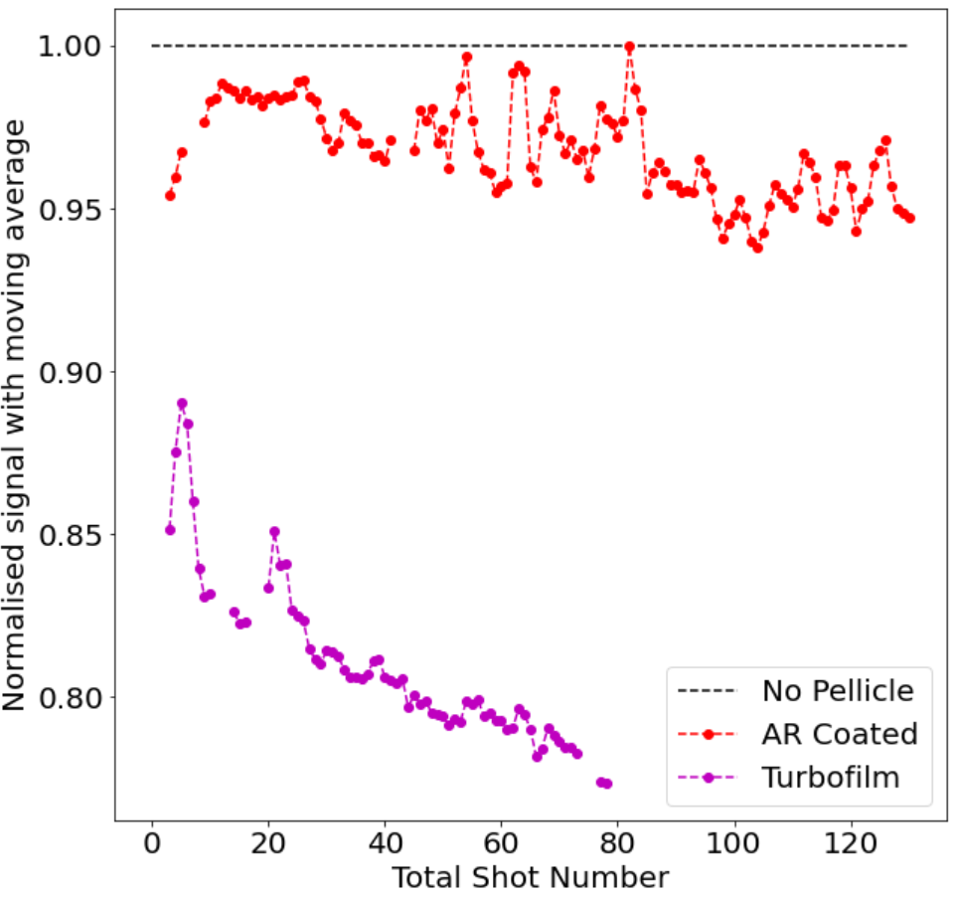
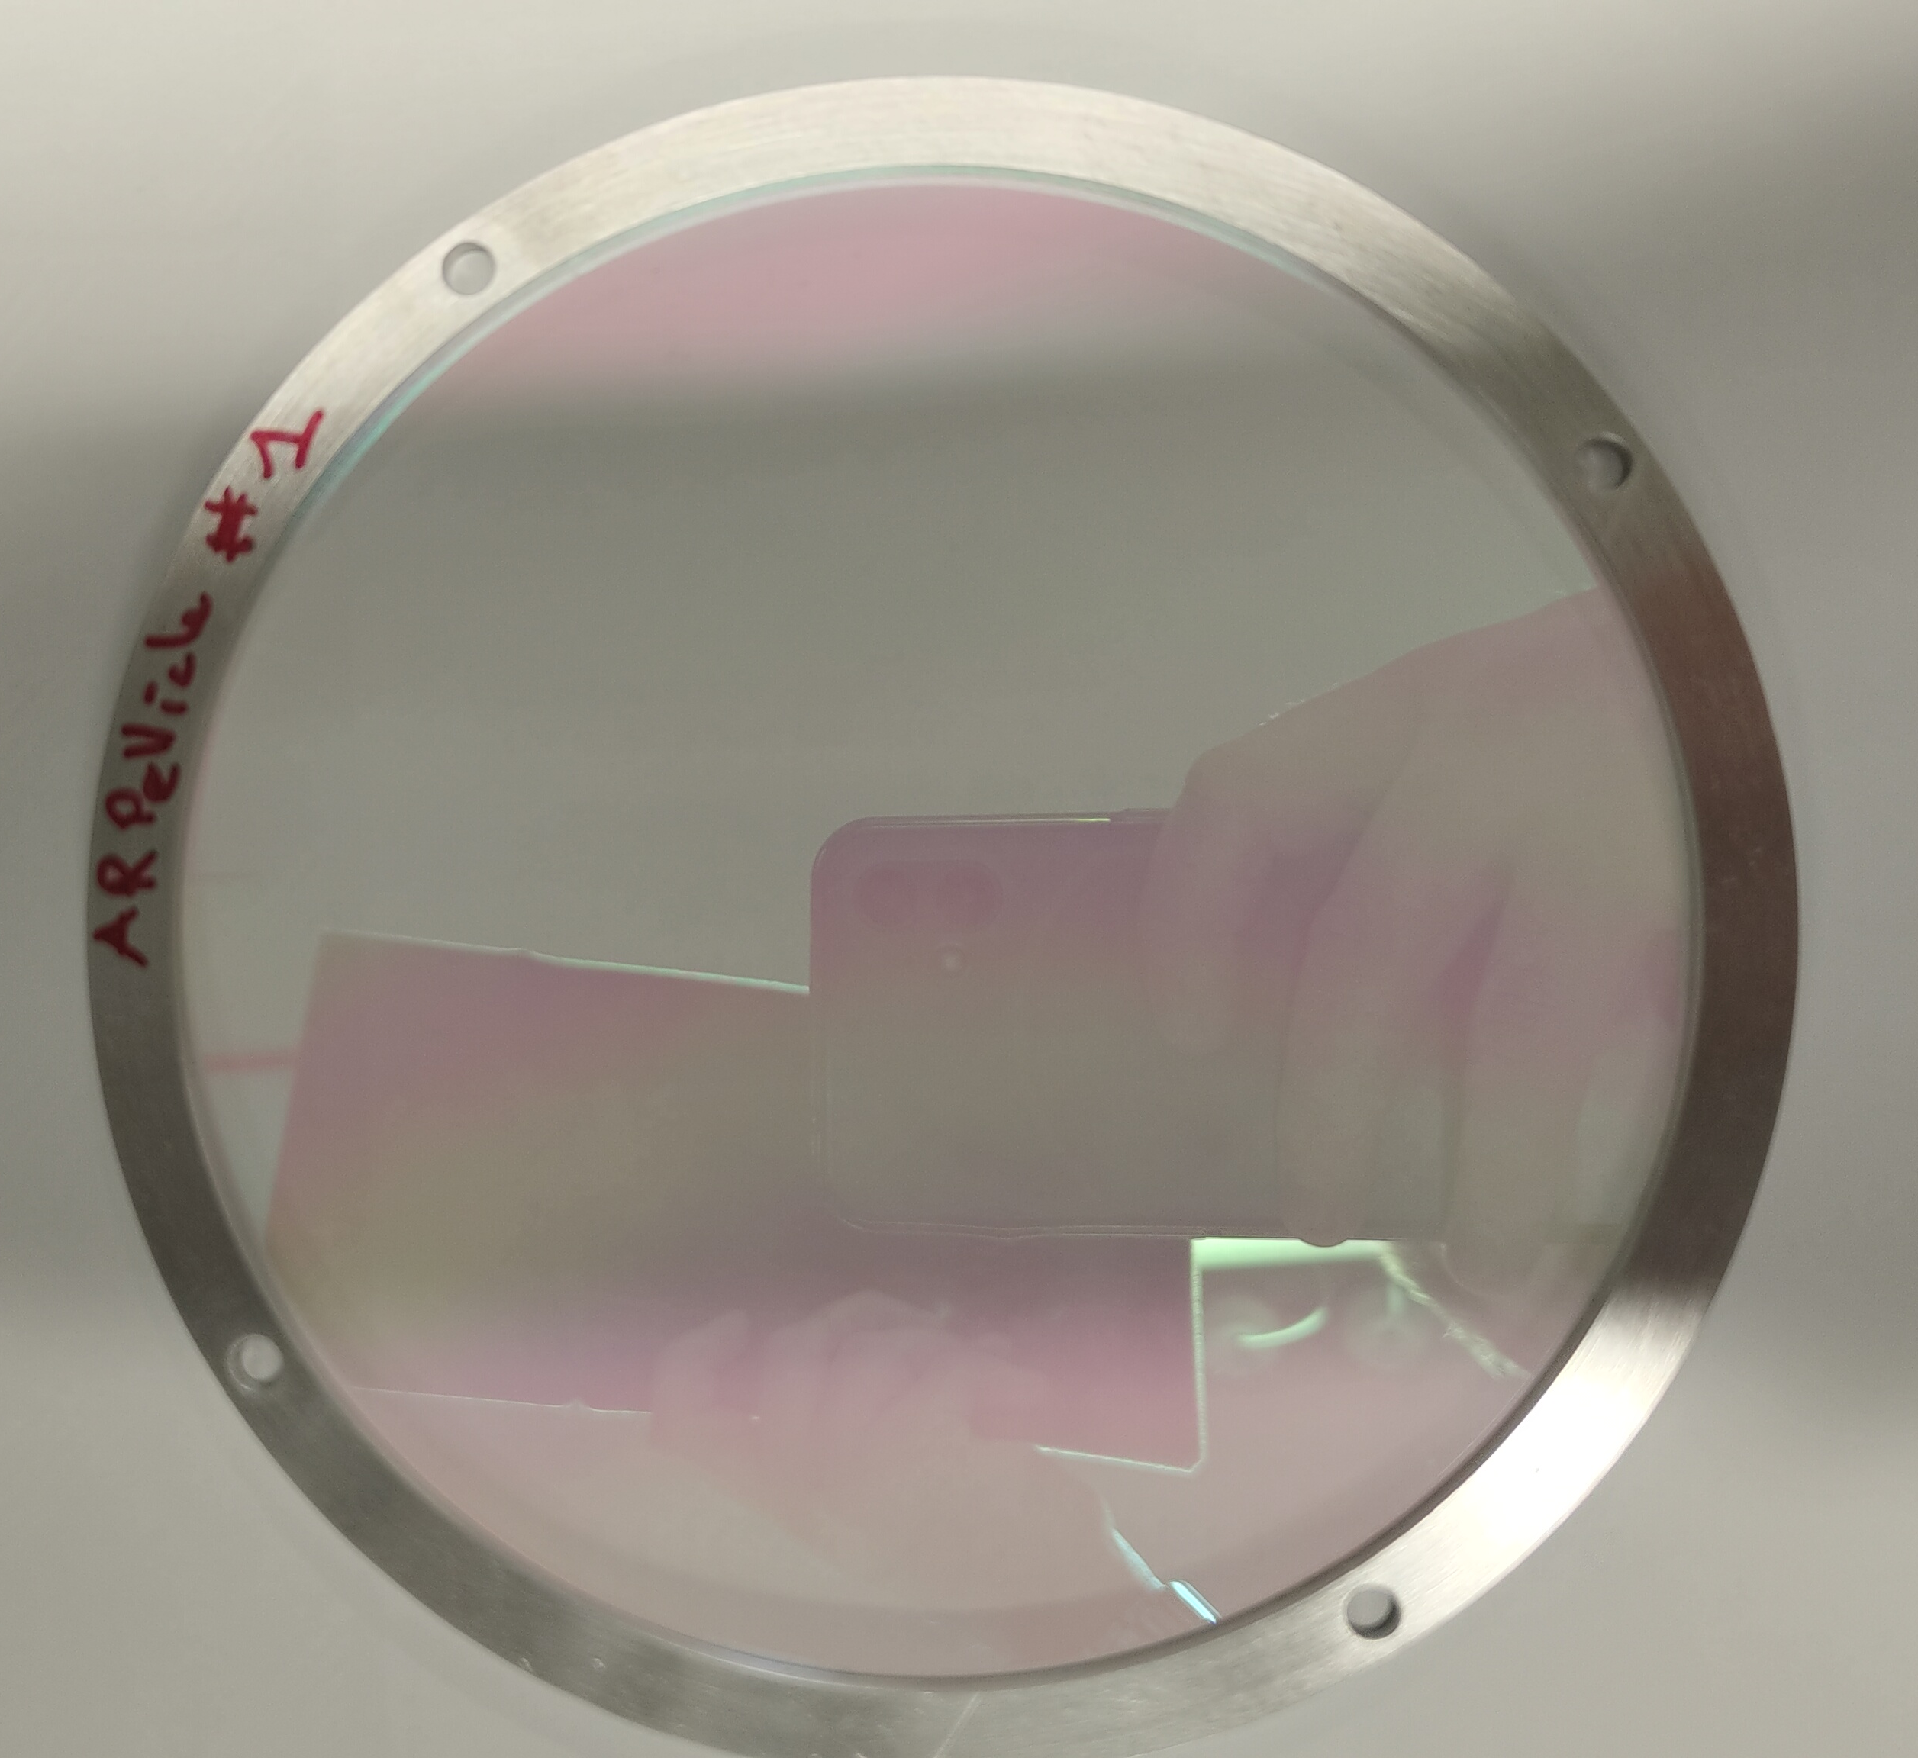
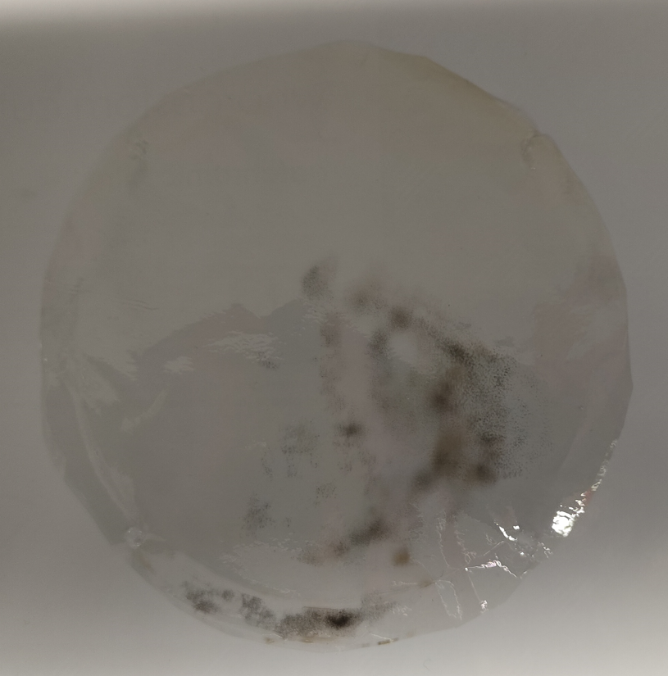
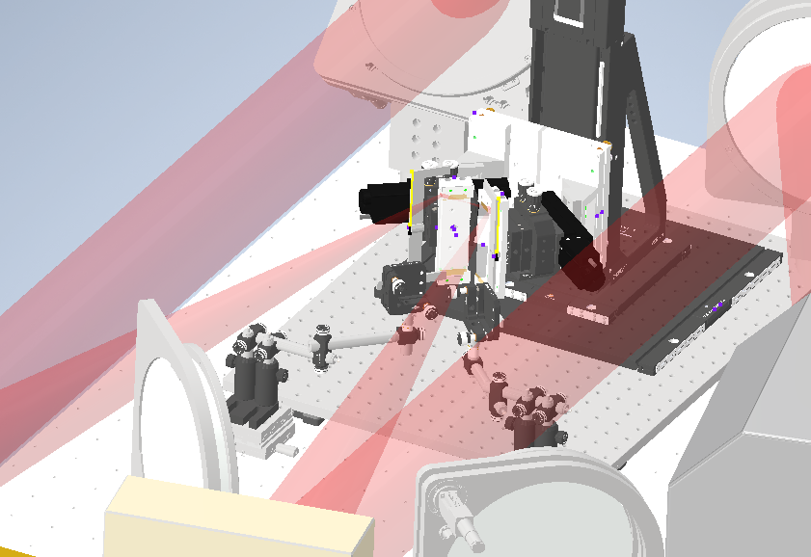
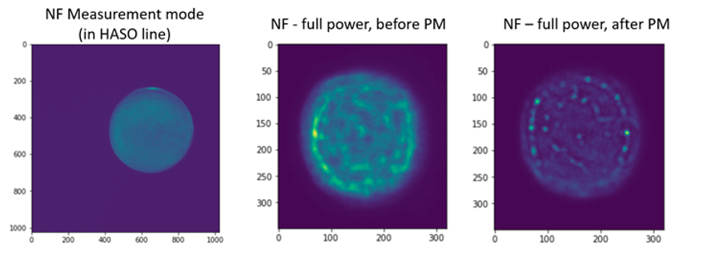
Setup Development Updates
AR Film
i) OAP protection improvements
Improved parabola protection, increased number of shots per pellicle optic and increased energy to target, with new AR coated pellicle.
Does not damage as quickly as pervious pellicle (made from turbo film).
Turbo Film
ii) Plasma mirror system
Commissioning of a double plasma mirror system has begun.
Employed to improve the laser pulse temporal-intensity contrast, enabling investigation of the influence of this on TNSA and irradiation of thinner targets.

Slide 8
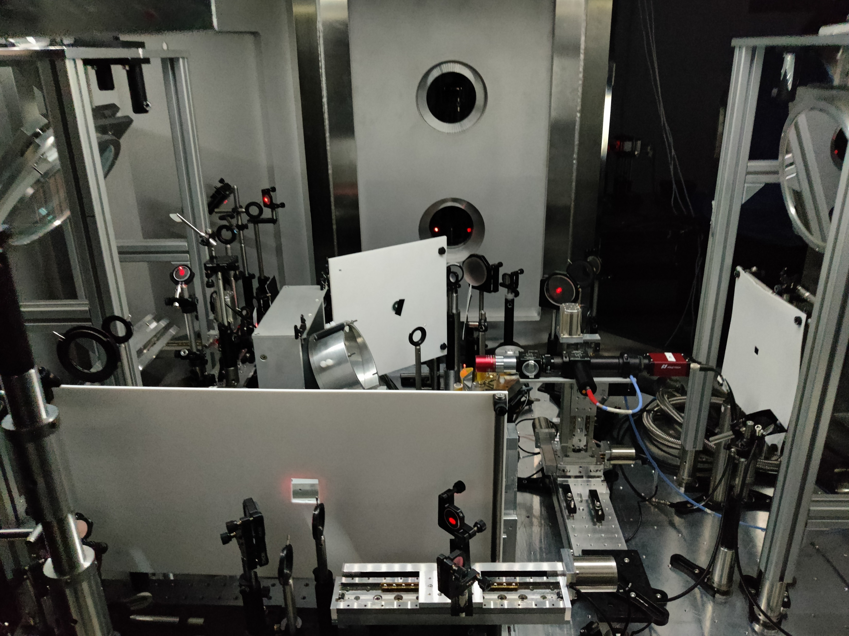
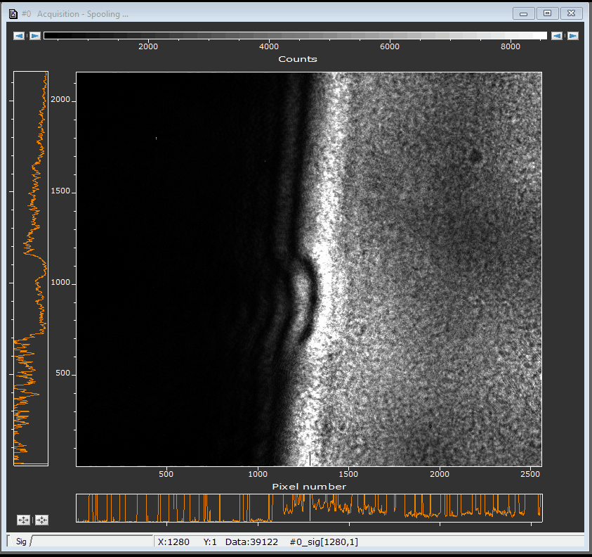
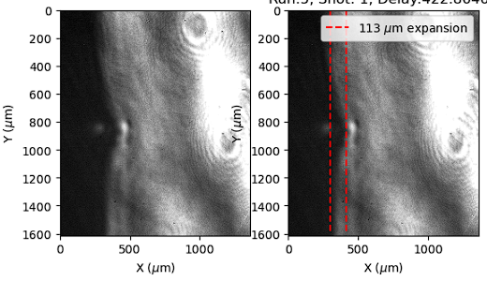
Setup Development Updates
iii) Transverse optical probe and pre-plasma generator
An optical probe and pre-heater beamline to monitor and control the front surface pre-plasma scale length has now been installed and commissioned. Both formed using a small sample of the main beam, guided to compact setups to alter their timing with respect to the main pulse.
Pick off and beamsplitter
Preheater Generator
Probe Generator
450 ps after main pulse

Slide 9
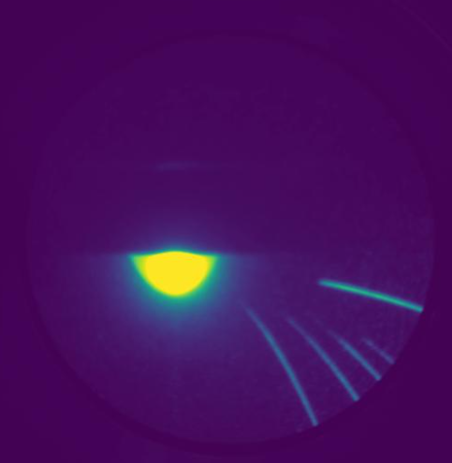
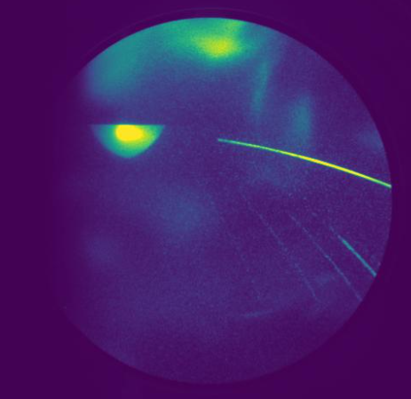
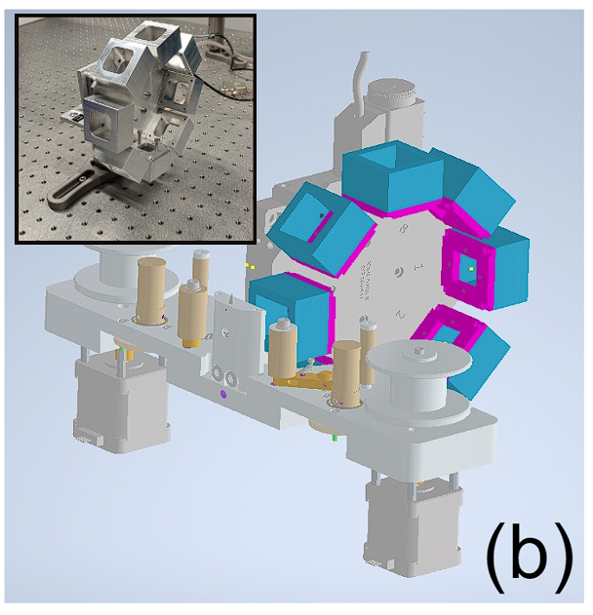
Diagnostic Updates
i) Thomson parabola ion spectrometer
Improved spectrometer measurable energy range and detector FOV, through modification of the detector (MCP mounting).
Next key development is calibration of this diagnostic for proton numbers.
Offset Mounting Flange
Before
After
ii) Proton beam spatial/spectral diagnostics
Developed a multi-shot radiochromic film stack ‘wheel’ for beam spatial/spectral measurements.
PROBIES footprint monitor (Matt Alderton will give an update on this next)

Slide 10
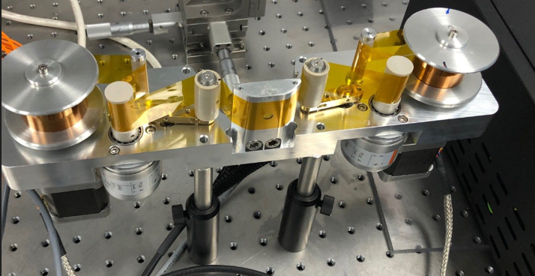
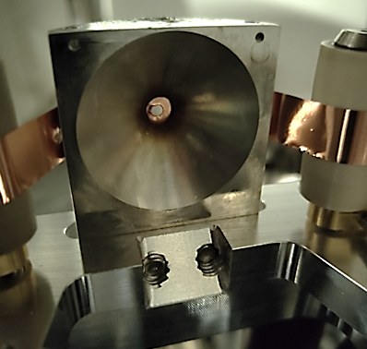
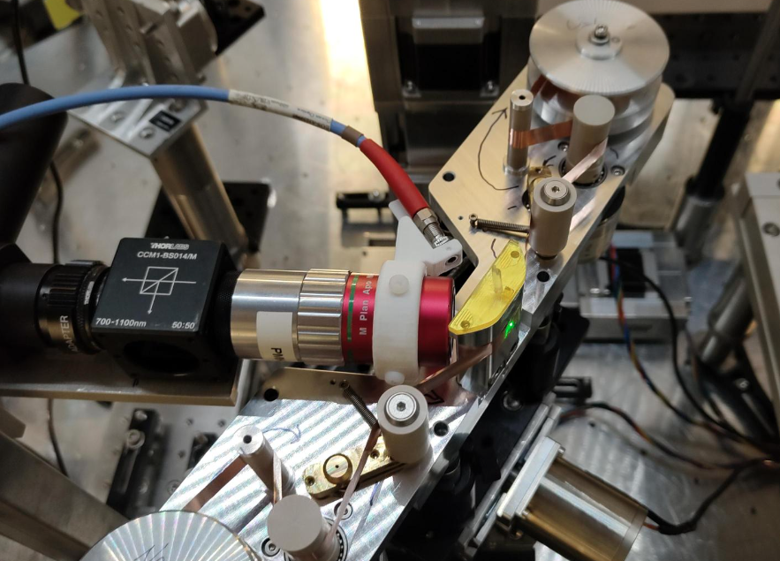
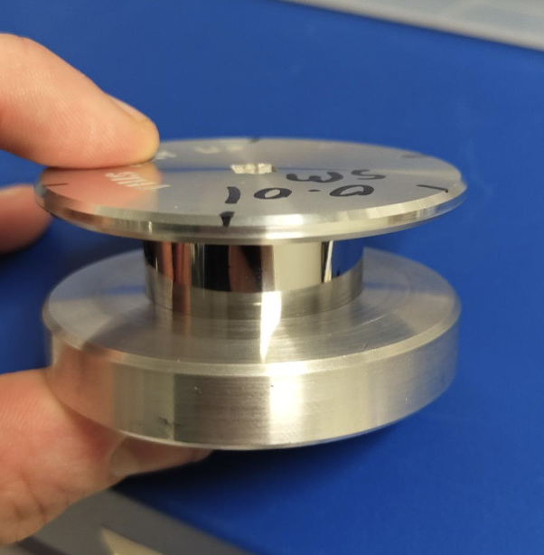
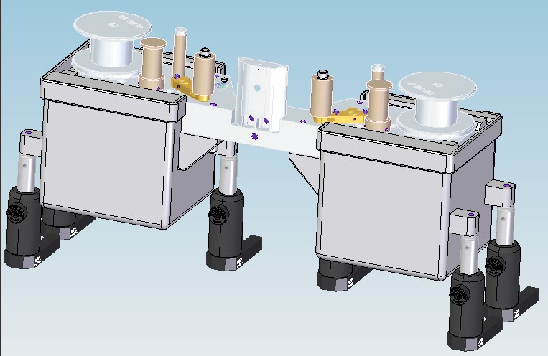
Targetry Developments (working closely with CLF/EPAC collaborators)
i) Tape drive angled operation
New modified tape drive configuration, enables use of focal spot camera to align target at a 35$°$ angle.
ii) Tape alignment improvements
Alignment issues employing target rear illumination at 35$°$ angle have been solved using side angle illimitation with a fibre optic.
iii) Testing new tapes
Testing to-date has employed 25 $µ$m Kapton (plastic) tape.
Now conducting testing of thinner metals tapes (10 um steel)…however experiencing EMP and snapping issues.
10 um Steel tape
EMP Shielding modification
iv) EMP mitigation
Adding/testing EMP mitigations, including shielding tape drive components, using plastic isolation parts and shielding controller/increased distance from interaction.

Slide 11
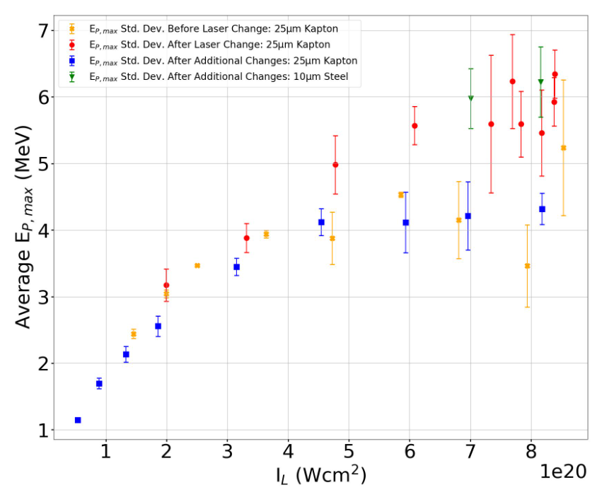
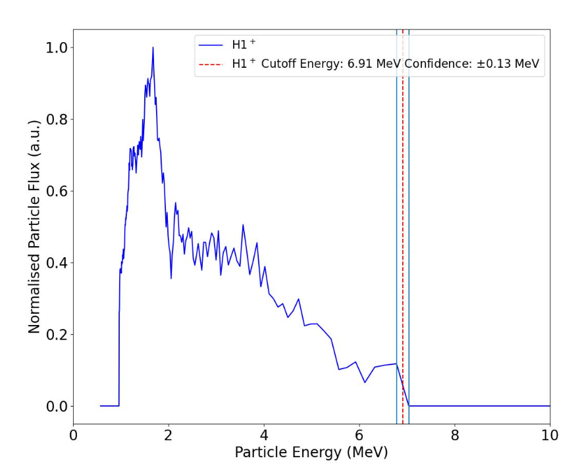
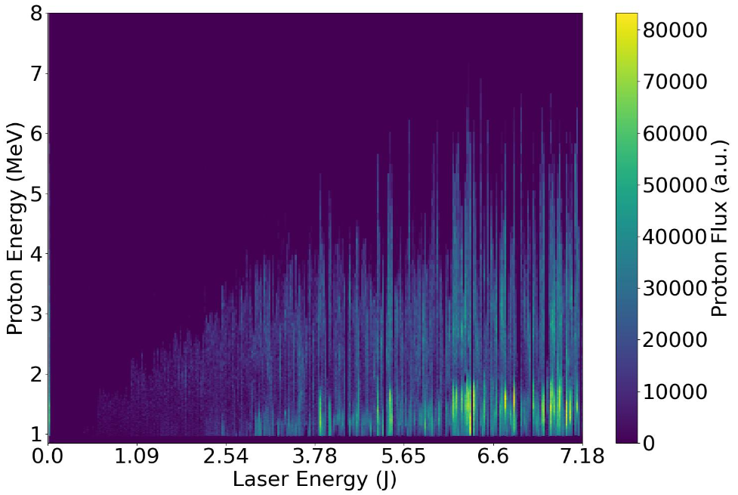
Source Development Updates
i) Proton maximum energy intensity scaling
Repeated scans of proton maximum energy (Ep Max) scaling with laser intensity, first measured on LhARA July 2023 exp, to test alterations to the laser system (laser energy, beam/spot quality, etc).
Alterations to the laser are significantly influencing the scaling and thus the Ep Max we achieve.
Initial testing of thinner targets is promising, showing increased Ep Max, however resulted in significantly more EMP issues.
ii) Proton spectral properties
Example energy spectrum presented. Next step is to calibrate, to extract real particle numbers.
Continued testing the stability of spectral properties. Measuring a high degree of variation at peak laser intensities.

Slide 12
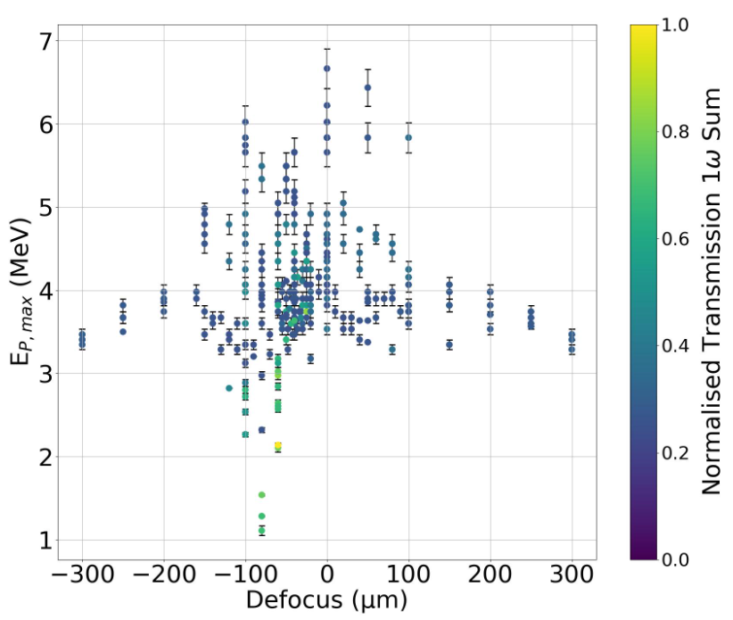
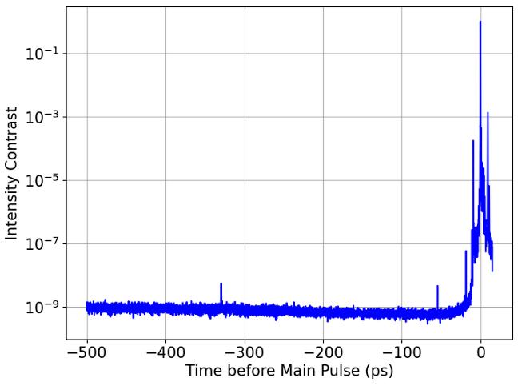
Source Development Updates
Potential source of non-ideal proton properties
Measurables
Measuring a significant portion of the laser pulse transmitted through the target plasma, up to 30%.
Transmitted light should not be occurring for these target parameters, suggesting significant pre-expansion of target prior to main pulse.
Main pulse
~10²⁰-10²¹ Wcm⁻²
Potential cause
Through measurement of the laser temporal-intensity contrast, we have discovered a few potential ‘pre-pulses’ which may help explain our proton measurements.
Laser staff have undertaken a program of work to identify the source of these and to potentially remove them over the coming months.
Pre-pulse ~325 ps
Pre-pulse ~50 ps
ASE Level
~10¹¹-10¹² Wcm⁻²

Slide 13
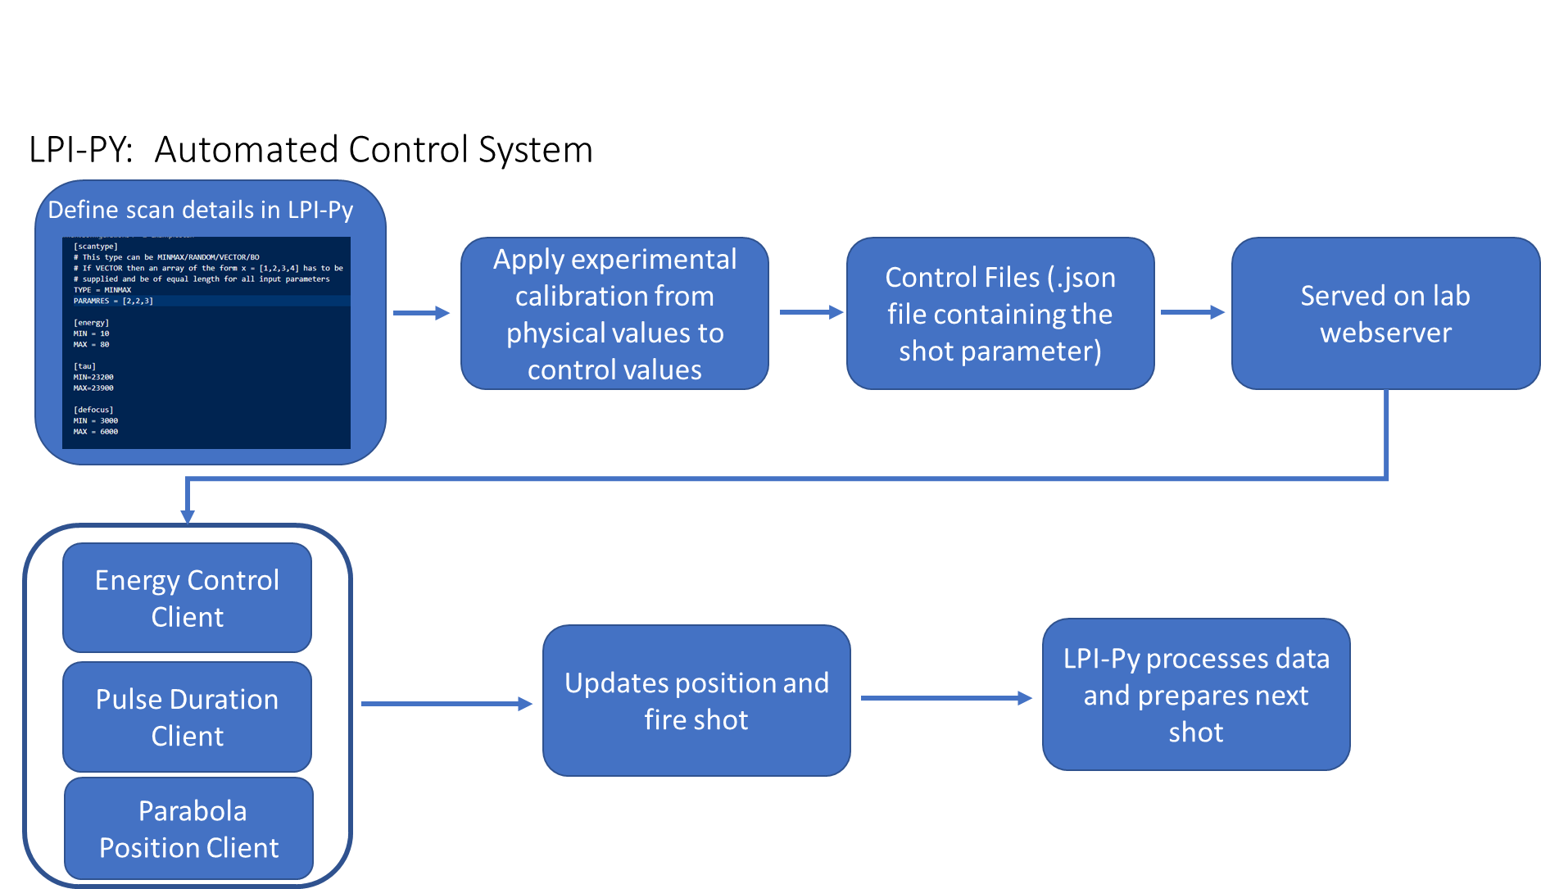
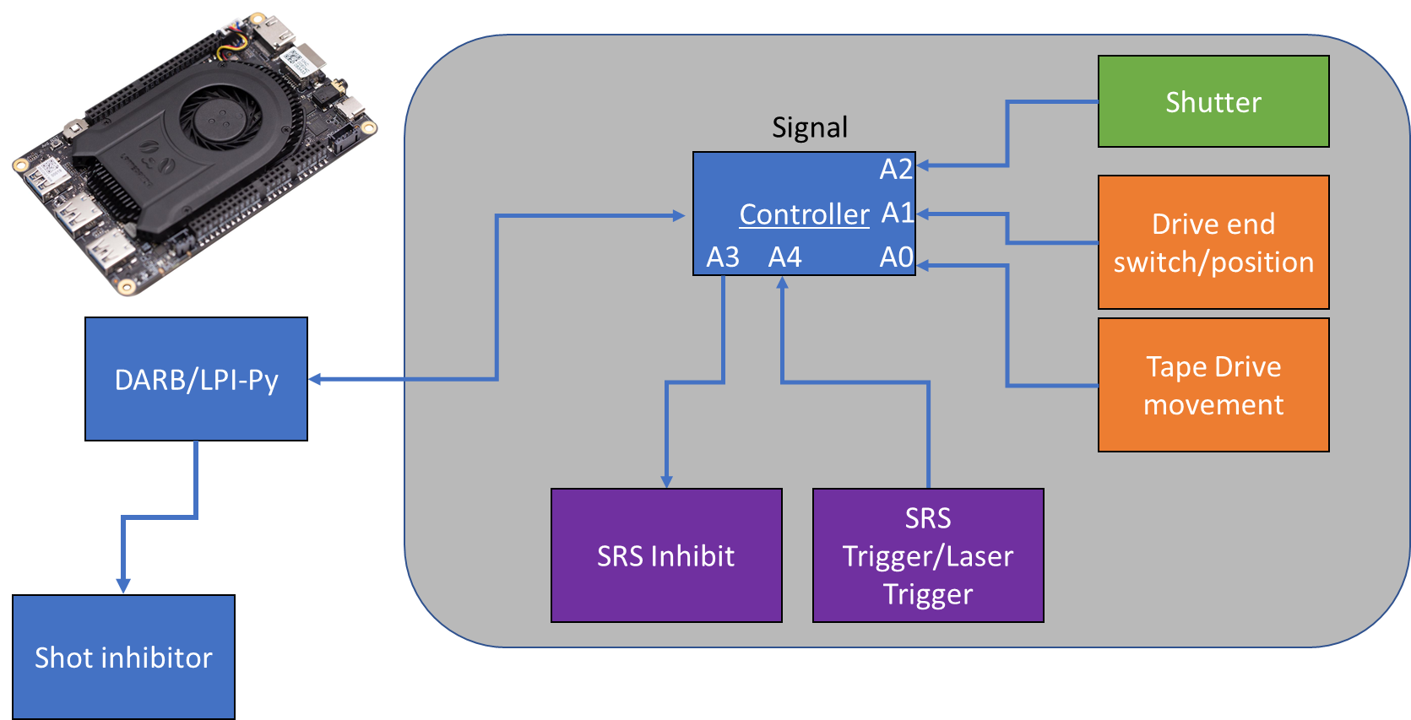
Data capture and high repetition rate operations
New version of the DARB software successfully employed to capture and structure experimental data. This update increases data capture rates to 1 Hz and is now running stable manner.
Continued the development of two new systems to i) automate parameter selection and ii) introduce a machine safety shutoff. These will significantly improve shot rate, time taken to repeat a data given scan, and data quality.
Automated Control System
Shot control system

Slide 14
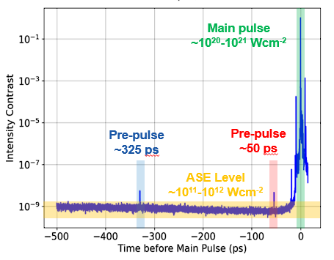
Key Next Steps
Roadmap to next beamtime (3 weeks in June)
Aim: Investigate the proton source properties after improvements to the laser system.
Pre-pulse source investigation and potential removal.
2. Beam nearfield improvement by investigating amplifier pumping.
3. Reinstallation and commissioning of double plasma mirror system.
Additionally steps
Installing EMP mitigation systems to targetry systems to facilitate thinner metal tapes.
Finalise the particle number calibration of the Thomson parabola ion spectrometer.
Thank you for your attention

Slide 15
X THE PLACE OF USEFUL LEARNING

