Slide 1

Hadron Therapy-UK
The goal of laser-driven ion beam radiotherapy is to develop well-controlled, reliable energetic ion beams of very high quality that can meet stringent medical requirements with respect to physical parameters and performance and therefore represent a viable alternative in an advancing state-of-the-art for radiotherapy

Slide 2

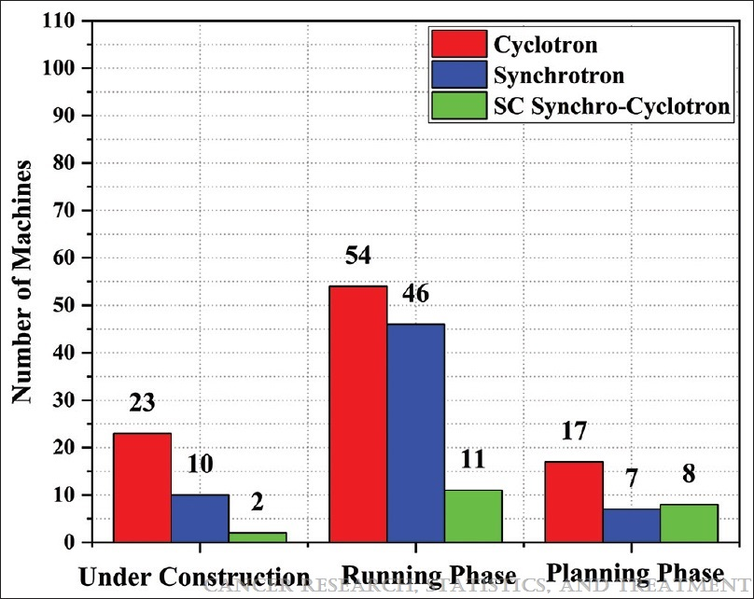
Current Status of Proton, carbon and Helium Facilities Worldwide

Slide 3
Potential Advantages of LhARA based Ion Therapy over Conventional Ion Therapy
Low-emittance and well-collimated beams are advantageous in proximal normal tissue-sparing.
Highly-peaked quasi-monoenergetic beams are ideal for fast energy selection.
High fluence and ultra-short pulse delivery should produce denser ionization track signatures (spurs, blobs, etc.) in target tumors, higher linear energy transfer, higher Bragg peak, and higher radiobiological effectiveness at the micro-level.
Ease of generating mixed ion beams.

Slide 4
  Objective: To Increase the Therapeutic Index of Radiotherapy
100
75
Tumor
Probability of Tumor Control
or Normal Tissue Damage (%)
Normal Tissue
50
25
0
A
B
C
Cumulative Dose
Hall and Giaccia, 2019

Slide 5
Hadron Therapy
Conventional radiation therapy
  = photons (x- or γ rays) + electrons
Hadron therapy = Particle radiation therapy (particles heavier than electrons)
  Protons
  Carbon ions
  Other ions (helium, neon, pions, silicon, iron, etc)

Slide 6
There is a strong rationale for the clinical benefit of proton and carbon therapies, but current evidence is limited
Therapy
Rationale for clinical benefit
Proton
  Deliver a higher, targeted radiation dose with decreased toxicity to surrounding tissue compared with photon therapy, especially near critical structures
Carbon
  Further increase target tissue damage with decreased secondary tissue affected compared with protons
  Specific potential benefit with intractable radio-resistant tumors

Slide 7
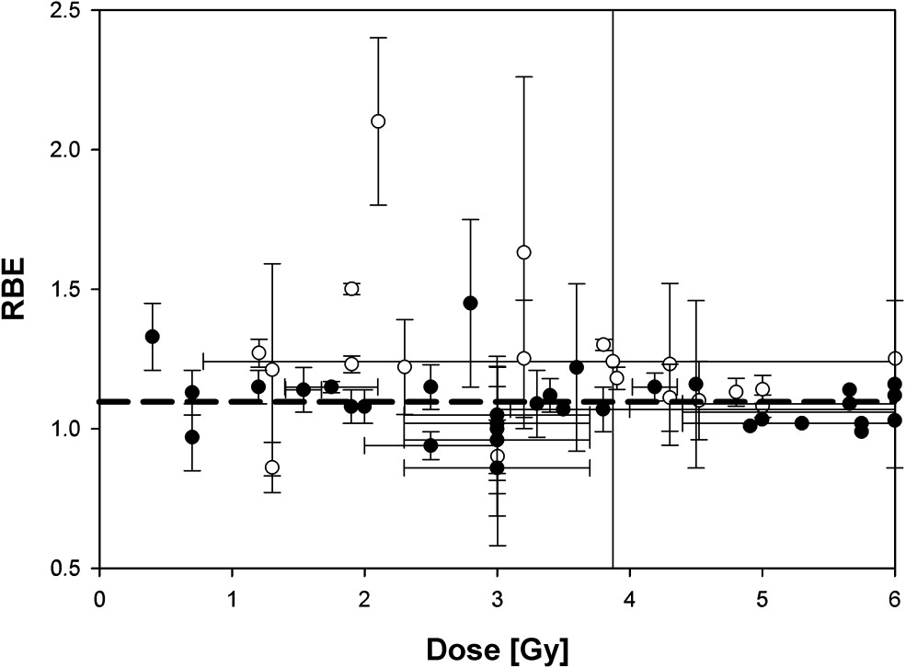
Dose-Depth Profiles
Paganetti,
van Luijk
(2013)
SemRadOncol

Slide 8
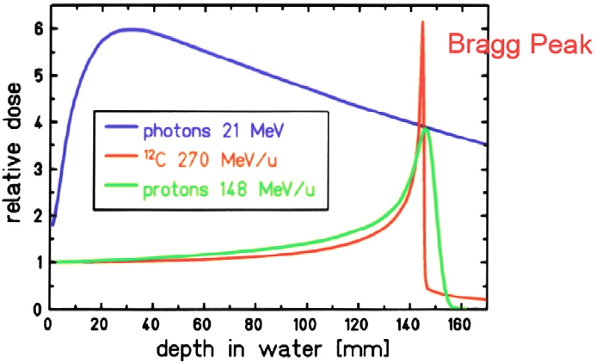

Plot of Depth-Dose Distribution of 21 MeV Photons vs 148 MeV/u Protons vs 270 MeV/u Carbon in water

Slide 9
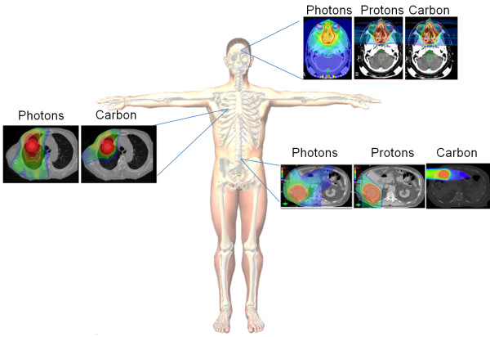
Superior Dose Distribution of Carbon Ions Compared to Protons and Photons

Slide 10
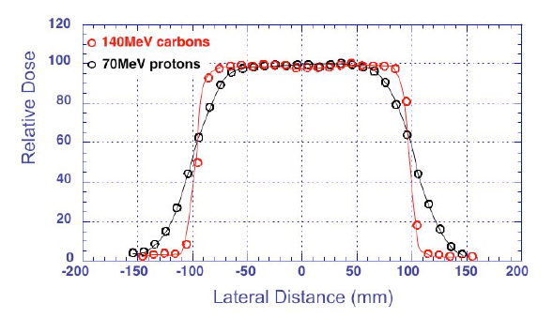
Carbon Ions Provide Highly Localized Tumor
Deposition of Dose (Sharper Transverse Edge)
Better Localization
  Tighter deposition in depth (Bragg peak is narrower)
  Transverse deposition is more narrowly collimated
  Less dose to the healthy tissue

Slide 11
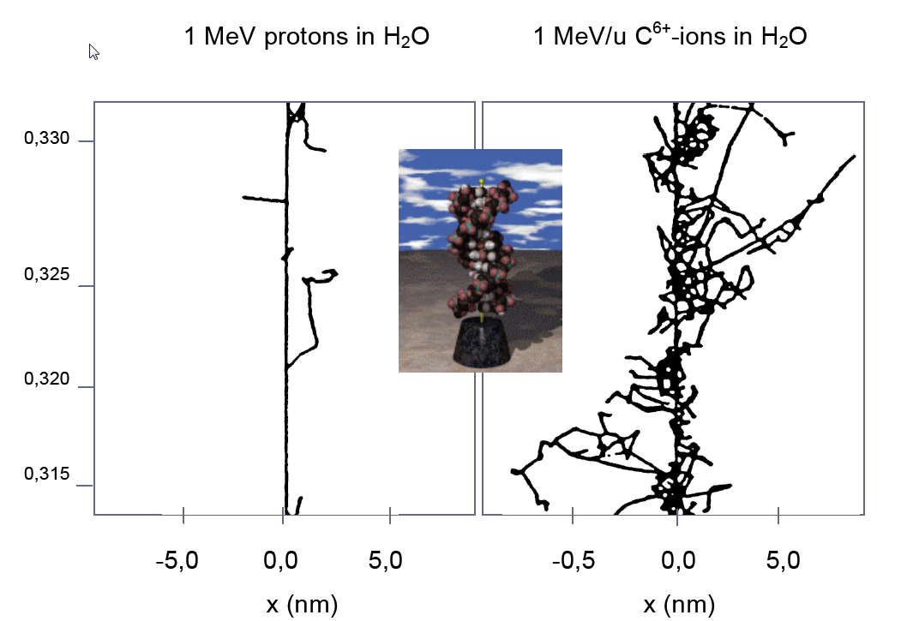
Carbon Ions Induce More Lethal Damage Per Unit Dose
than Photons or Protons
Increased Biological Effectiveness:
Relative Biological Effectiveness is 2-3 times protons
  Reduces # fractionations by ~ 2: greater patient throughput/compliance
  Countermands radio-resistance: non-repairable, double-strand breaks
Production of positrons permits active monitoring using PET

Slide 12
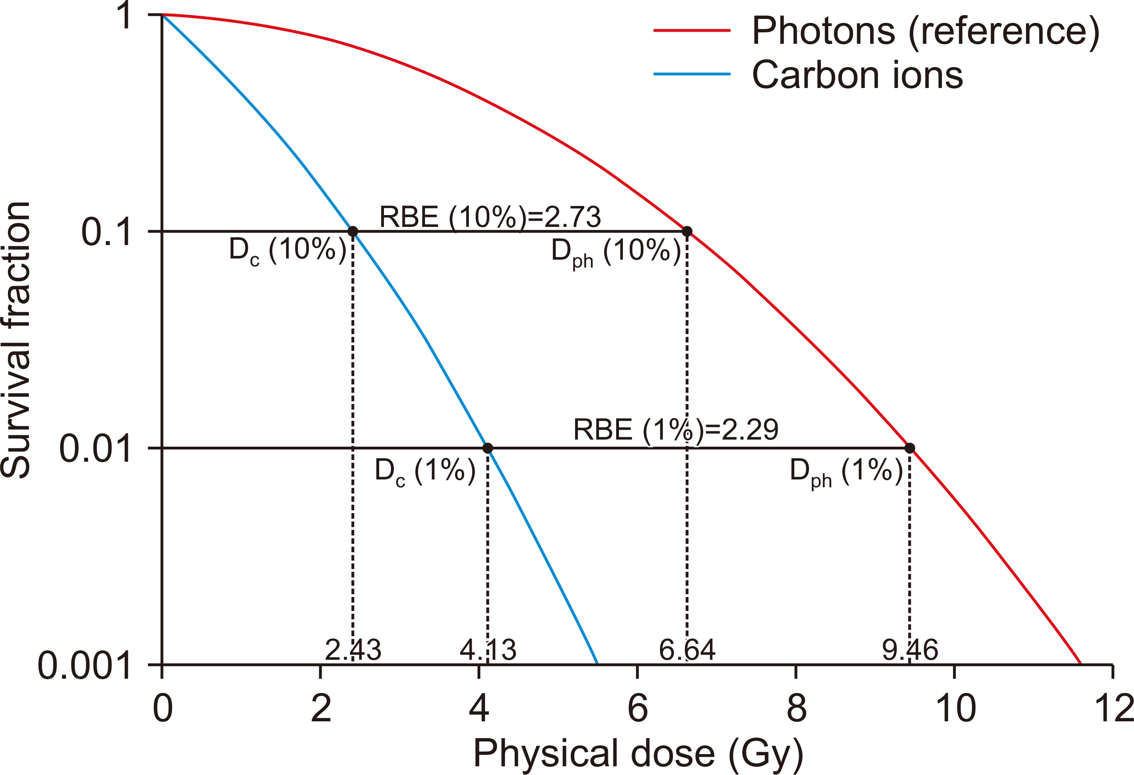
Cell Survival Based on the LQ model
Progress in Medical Physics 2020;31:1-7
Notes:
The photons and carbon ions are considered to be isoeffective when the survival fractions are identical. The ratio of isoeffective photon and ion dose is determined to be RBE. For instance, fixing the survival fraction to 10%, carbon ion RBE is 2.82 whereas fixing to 1%, respective RBE is 2.25. RBE, relative biological effectiveness; LQ, Linear Quadratic.

Slide 13
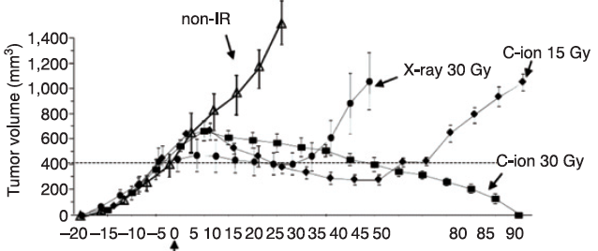
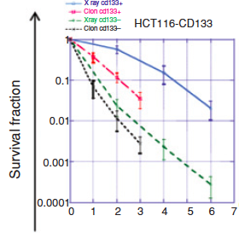
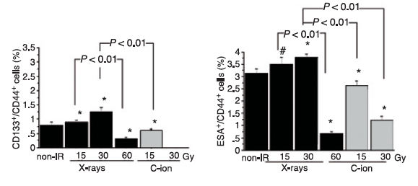
Carbon is More Effective In Killing Cancer Stem Cells
In vivo growth by beam type and dose
In vitro clonogenic survival
% putative CSC- like in vivo after RT
Cui X et al, Cancer Research 2011

Slide 14
  Objective: To Increase the Therapeutic Index of Radiotherapy
(Hadron Therapy)
100
75
Tumor
Probability of Tumor Control
or Normal Tissue Damage (%)
Normal Tissue
50
(Decreasing Lymphopenia)
(Hadron Therapy)
25
0
A
B
C
Cumulative Dose
Hall and Giaccia, 2019

Slide 15
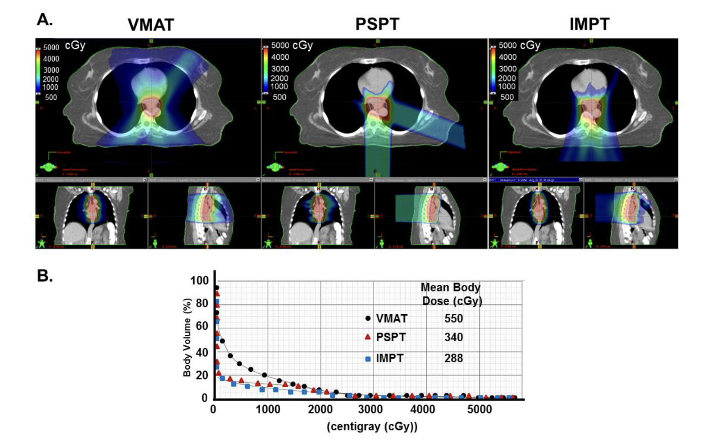
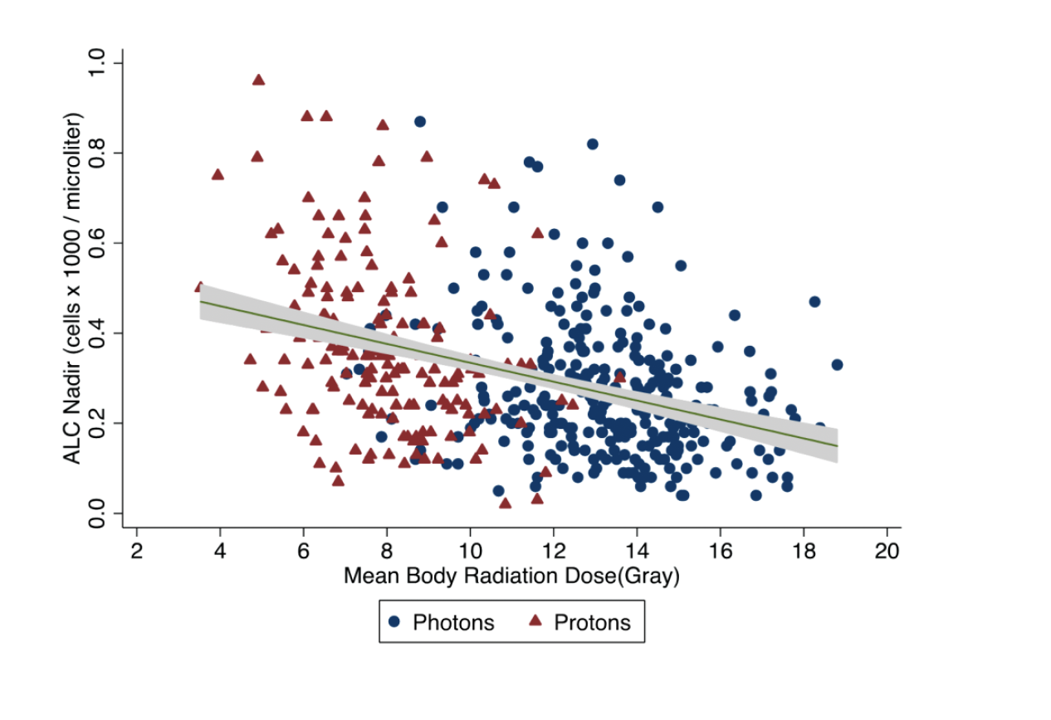
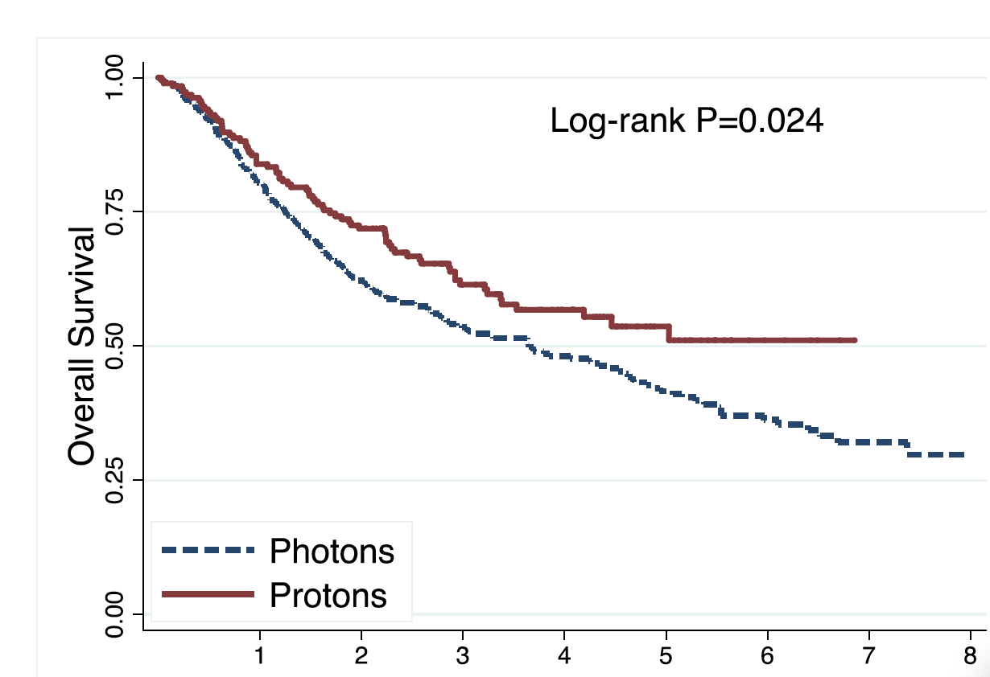
Effect of Different Therapies on Mean Body Dose and Survival
Davuluri et al, IJROBP, 2017

Slide 16
  Objective: To Increase the Therapeutic Index of Radiotherapy
100
(Hadron Therapy)
75
Tumor
Probability of Tumor Control
or Normal Tissue Damage (%)
Normal Tissue
50
(Decreasing Lymphopenia)
(Hadron Therapy)
(FLASH)
25
0
A
B
C
Cumulative Dose
Hall and Giaccia, 2019

Slide 17
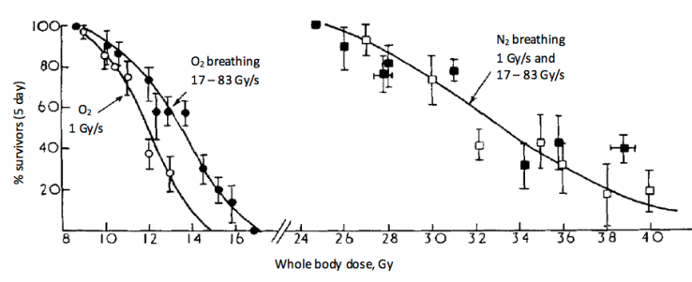
Hornsey S, Bewley DK. Hypoxia in mouse intestine induced by electron irradiation at high dose-rates. Int J Radiat Biol Relat Stud Phys Chem Med. 1971;19(5):479-483.
The Origins of FLASH Radiotherapy
Notes:
Fraction of mice surviving 5 days after whole-body irradiation delivered at different dose rates while animals breathing oxygen or nitrogen.

Slide 18
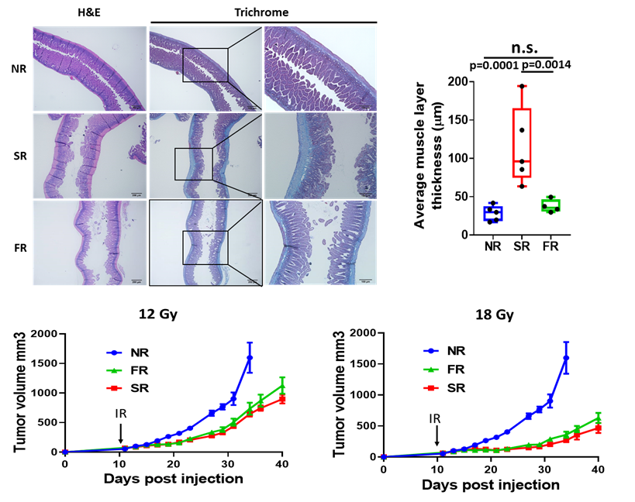
Flash-Proton Radiotherapy Highly Effective in Controlling Pancreatic Tumor Growth and Reduces Normal Tissue Toxicity
Koumenis et al, 2022

Slide 19
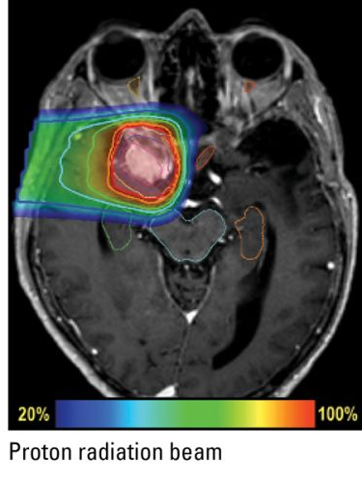
Treating Deep-Seated Tumours with Proton-FLASH
Problems/challenges:
    Scanning/scattering needed to cover the target volume
      Dose rate decreases!
    Several beam energies needed to cover the target volume in depth
      Dose rate decreases!
    Several beams needed for dose conformity
      Dose rate decreases!
      Takes time to change beam angle.

Slide 20
  Objective: To Increase the Therapeutic Index of Radiotherapy
(Overcoming Hypoxia)
(Hadron Therapy)
100
75
Tumor
Probability of Tumor Control
or Normal Tissue Damage (%)
Normal Tissue
50
(Decreasing Lymphopenia)
(Hadron Therapy)
(FLASH)
25
0
A
B
C
Cumulative Dose
Hall and Giaccia, 2019

Slide 21
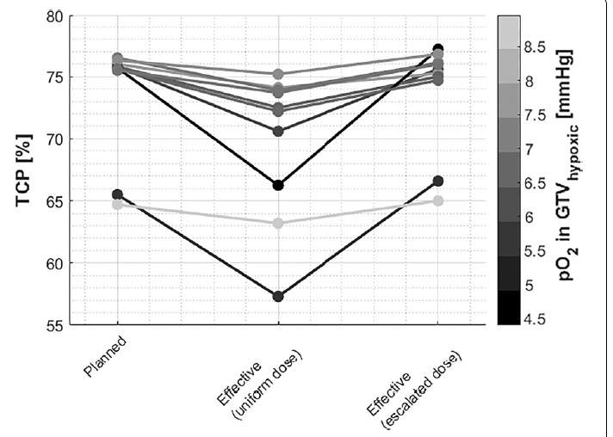
TCP for Individual Patients Treated
with Protons
Kothe et al, Radiat Oncol, 2021

Slide 22
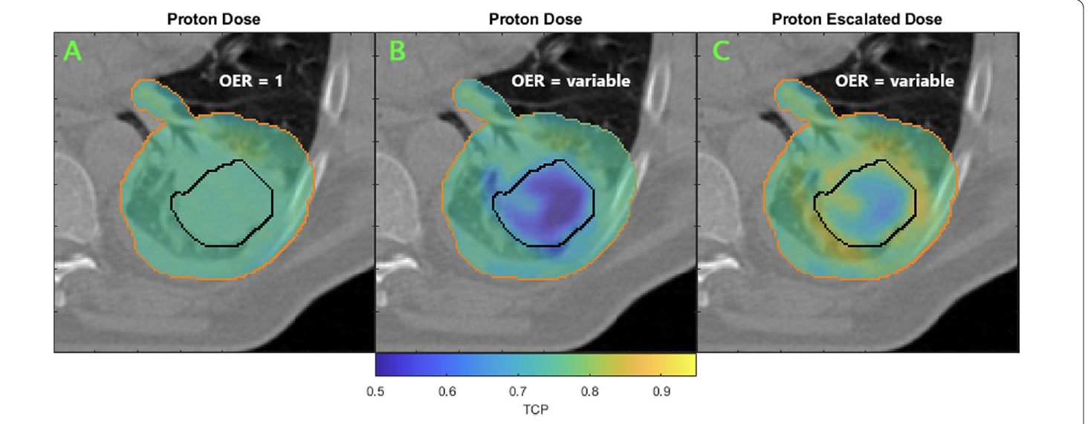
Voxel-wise TCP Calculation and Overcoming
Hypoxia with Proton Escalation
Kothe et al, Radiat Oncol, 2021

Slide 23
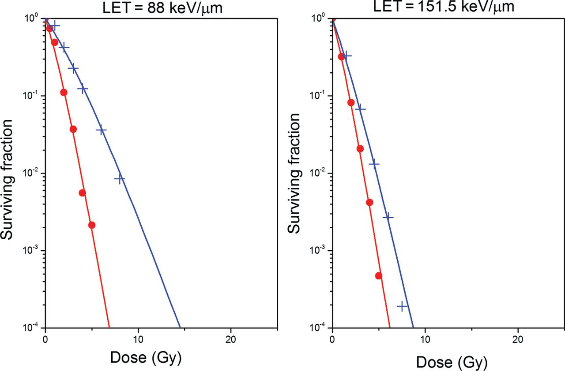
Survival of Cells Irradiated with Carbon Ions
in Oxic (red curves) and Hypoxic conditions (blue curves)
for Two Different LETs
Antonovic L et al. J Radiat Res 2013;54:18-26
Notes:
Survival curves for V79 cells irradiated with carbon ions in oxic (red curves) and hypoxic conditions (blue curves) for two different LETs predicted by the RCR parameterized model described by Equations 2–7.

Slide 24
  Objective: To Increase the Therapeutic Index of Radiotherapy
(Overcoming Hypoxia)
(Hadron Therapy)
(Targeting Therapeutic Resistance)
100
75
Tumor
Probability of Tumor Control
or Normal Tissue Damage (%)
Normal Tissue
50
(Decreasing Lymphopenia)
(Hadron Therapy)
(FLASH)
25
0
A
B
C
Cumulative Dose
Hall and Giaccia, 2019

Slide 25
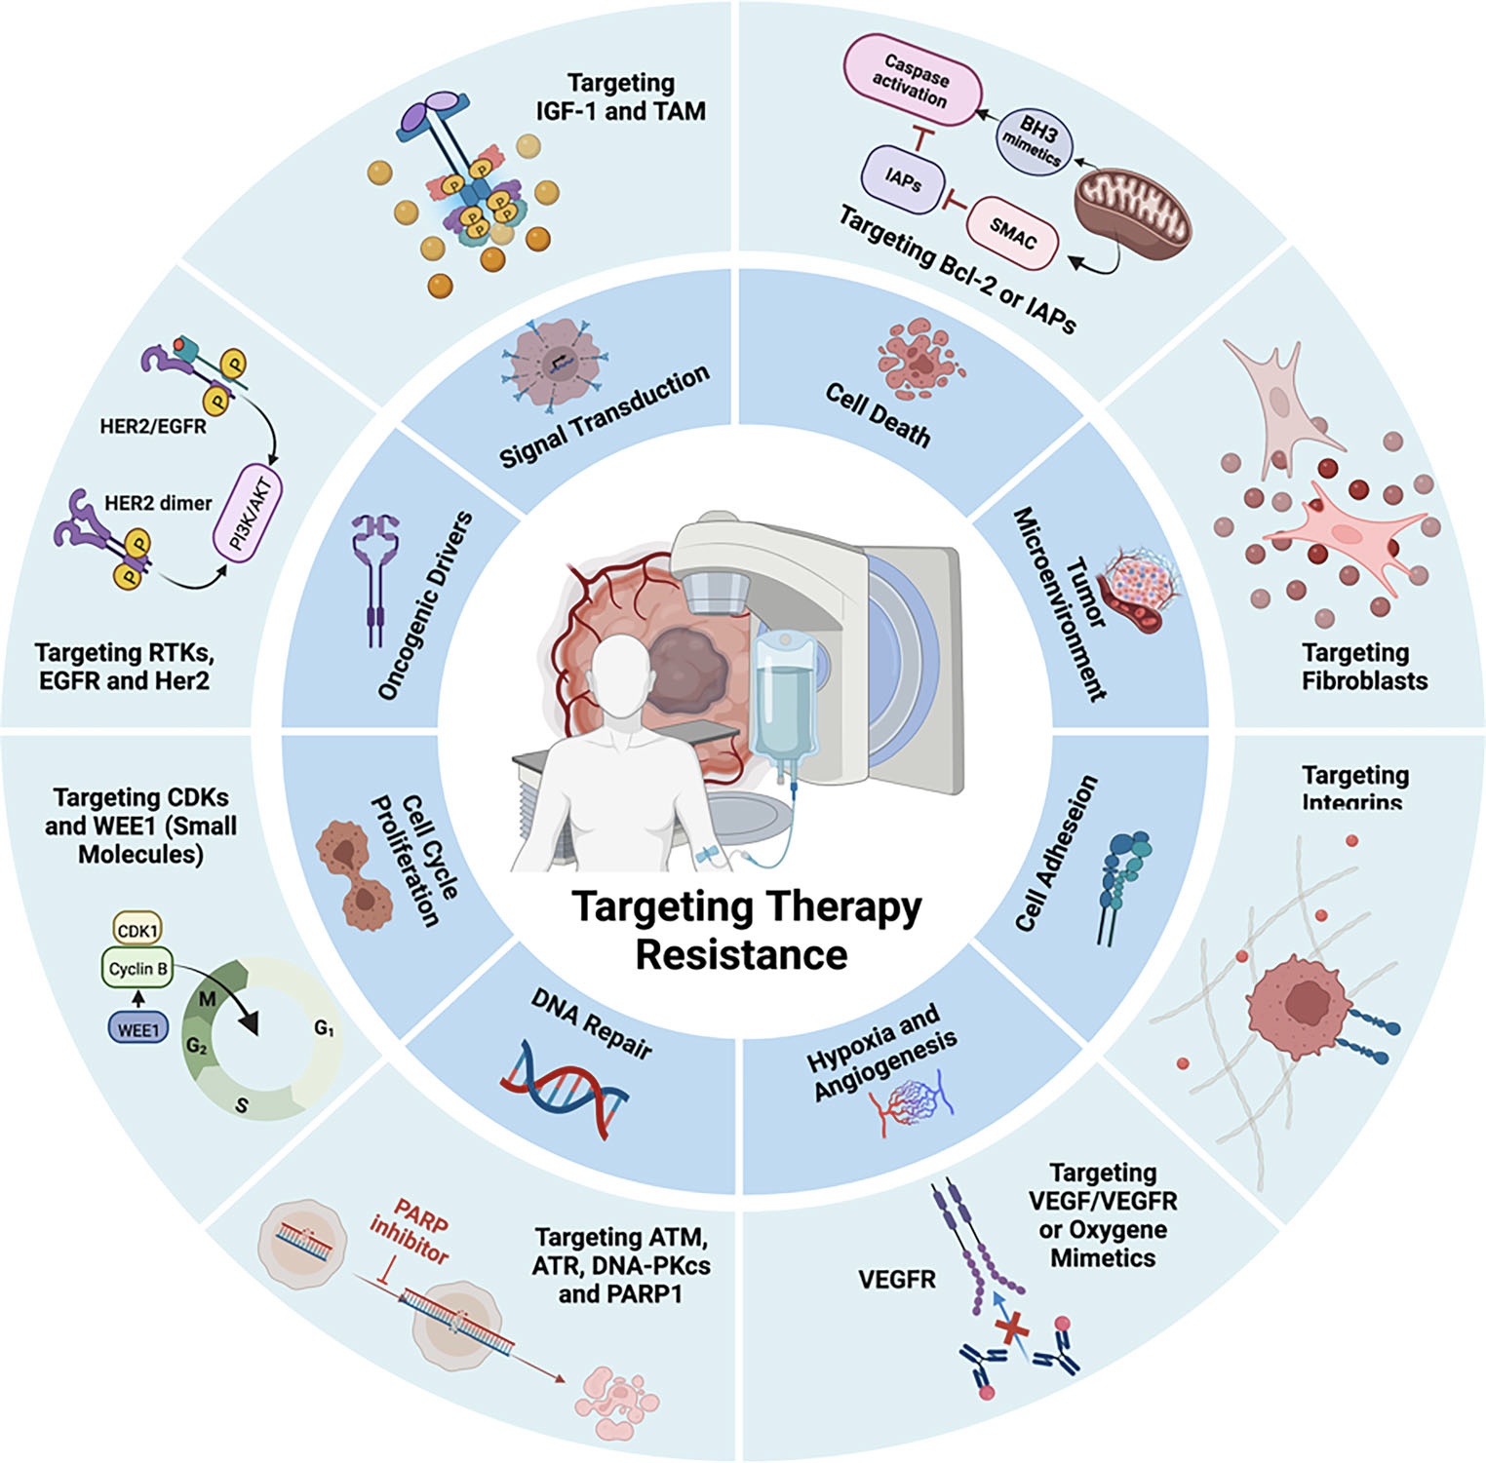
Schematic representation
of molecular mechanisms associated
with treatment resistance
in solid tumors and molecular
targeting approaches for cancer
chemo- and radiation sensitization.
Modified from Viktorsson et al, Strahlenther Onkol, 2023

Slide 26
Keap-Nrf2 Pathway
Notes:
Nrf2/Keap1 signaling pathway. Under basal conditions, Nrf2 binds to Keap1 by its two motifs (ETGE and DLG) and activates Cul3‐mediated ubiquitination followed by proteasomal degradation. Under stress conditions, due to the modification of Keap1 cysteine residues, Nrf2 dissociates from Keap1 and translocates into the nucleus. Nrf2 then forms a heterodimer with sMaf protein and binds to ARE to initiate the transcription of various downstream genes

Slide 27
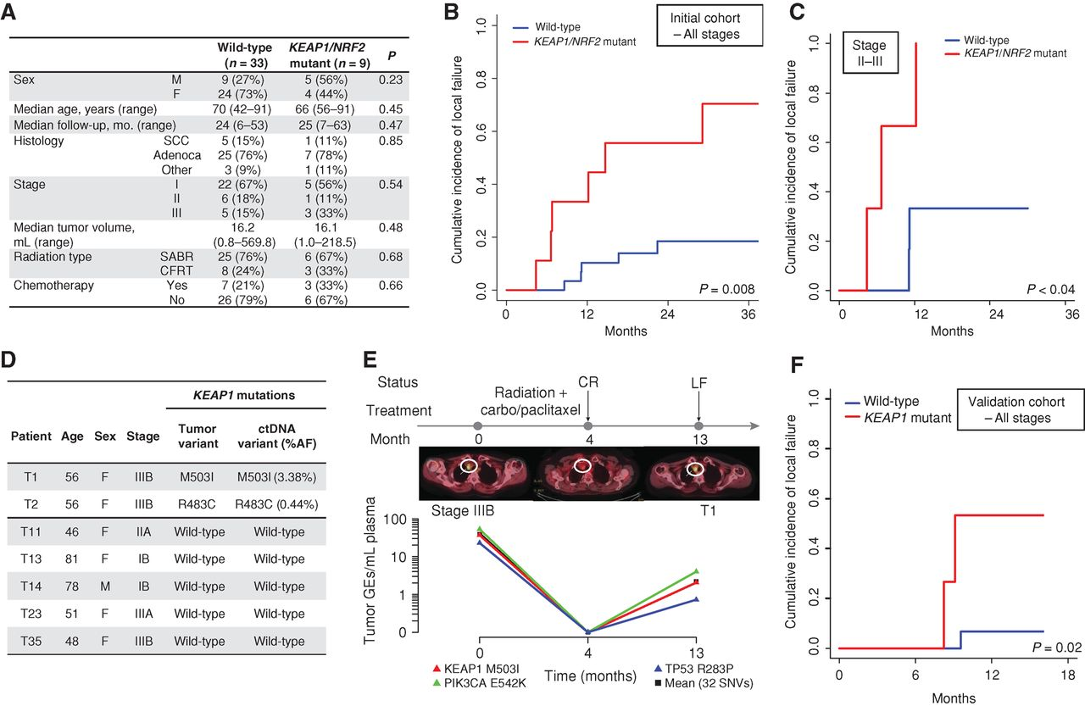
KEAP1/NRF2 Mutation Status Predicts Local Failure after Radiotherapy in Human NSCLC
Youngtae Jeong et al. Cancer Discov 2017;7:86-101
Notes:
KEAP1/NRF2 mutation status predicts local failure after radiotherapy in human NSCLC. A, Clinical characteristics of a cohort of patients with stage I–III NSCLC treated with curative intent RT and analyzed for KEAP1/NRF2 mutation status using targeted next-generation sequencing. B and C, Association of KEAP1/NRF2 mutations with local failure in patients with NSCLC treated with RT. B, Entire cohort. C, Stage II–III patients treated with conventionally fractionated radiotherapy or chemoradiotherapy. D, Noninvasive identification of KEAP1 mutation status in ctDNA isolated from pretreatment plasma samples of 7 patients from the cohort in A using CAPP-Seq. E, Monitoring of ctDNA in a KEAP1-mutant patient from D treated with chemoradiation. CR, complete response; LF, local failure; carbo, carboplatin. F, Clinical characteristics of a validation cohort of patients with stage I–III NSCLC treated with curative intent RT and analyzed for KEAP1/NRF2 mutation status using targeted next-generation sequencing.

Slide 28
Combining Ion Therapy with Immune Checkpoint Inhibitors
Notes:
Ionizing radiation increases the release of cytokines and pro-inflammatory molecules from tumor cells that recruit antigen presenting cells and immune effector cells to the tumor microenvironment. In addition, ionizing radiation increases the release and presentation of tumor antigens that can trigger tumor-specific immune responses. Immune checkpoint inhibitors such as anti-PD-1 and anti-CTLA-4 antibodies synergize with radiation by blocking T cell inhibitory signals. Immune cells can help to kill tumors at the site of radiation, and radiation may trigger systemic tumor-specific immune responses that could lead to regression of metastatic disease outside of the radiation field.

Slide 29
  Objective: To Increase the Therapeutic Index of Radiotherapy
(Overcoming Hypoxia)
(Hadron Therapy)
(Targeting Therapeutic Resistance)
100
75
Tumor
Probability of Tumor Control
or Normal Tissue Damage (%)
Normal Tissue
50
(Decreasing Lymphopenia)
(Hadron Therapy)
(FLASH)
25
0
A
B
C
Cumulative Dose
Hall and Giaccia, 2019

Slide 30
Clinical Data for Carbon
Tumor Site | # Studies | # Pts | Results
Occular | 2 | 114 | Similar to proton
CNS | 4 | 218 | Similar to proton
Prostate | 3 | 1384 | Excellent results for high risk, less toxicity than proton/photon
HCC | 1 | 64 | High local control
Lung (NSCLC) | 2 | 129 | Maybe better than proton
HNC | 1 | 236 | High LC – ACC, melanoma
Chordomas | 3 | 38 | Similar to proton

Slide 31
Ongoing Trials for Carbon
Tumor | Phase | N | Design | Endpoint | Site
Prostate | II | 90 | Carbon vs. Proton | Toxicity | Heidelberg
Skullbase Chondrosarc | III | 154 | Carbon vs. Proton | LPFS | Heidelberg
Skullbase Chrodoma | III | 319 | Carbon vs. Proton | LPFS | Heidelberg
Salivary Gland CA | I | 54 | IMRT + Carbon boost | Safety | Heidelberg
HCC | I | 33 | Carbon | MTD | Heidelberg
GBM | II | 150 | CRT + Carbon vs. Proton boost | 1 yr OS | Heidelberg, RTOG
HNC | II | 50 | TPF + RT + Cetux + Carbon Boost | LRC | Heidelberg

Slide 32
What LhARA Needs to Achieve for Clinical Acceptance
LhARA has to deliver a defined number of ions within the therapeutic energy range with sufficiently stable and reproducible ion beam parameters.
LhARA’s beam transport and delivery system is required for cleaning the beam from undesired particles and for ensuring beam energy, beam intensity, beam direction and field size to deliver a prescribed dose to the patient
Clinical application of LhARA in radiation therapy demands precise dosimetric control.
Current dose delivery in clinical irradiation uses one of the two procedures, pencil beam scanning or a scattering technique. The new time structure of LhARA’s beams with low pulse repetition frequency requires a new strategy for dose delivery, because the dose has to be delivered within at least the same (or possibly shorter) treatment time by a much lower number of pulses compared to conventional ion beams.
the laser based acceleration leads to pulses with an outstandingly high pulse dose rate close to the source which may result in an altered radiobiological response. A different radiobiological effectiveness also needs more effort to implement in the treatment planning system

Slide 33
Superior Dose Depth Distribution
& Physical Beam Characteristics
Increasing the
Patient Experience
-Higher LET
-Superior RBE
-Low OER
-Narrow penumbra
-New Lhara Ion therapy
-Less toxicity
-Given in short period of time
-Cost effectiveness research
Physics
Clinical Biology Research
-Beam characterization
-Beam heterogeneity
-Dose limitations
-Toxicity
-Which tumor histologies benefit most
-Does it overcome tumor microenvironment
-Development of new clinical trial design
Multidisciplinary
UK
Lhara- Ion
Therapy
Program
Radiobiological Research
-Development of radioprotectors
-Carbon ion interaction with diff tissues
-Metabolism
-Microenvironment
-CSCs
Clinical Physics Research
-Dose and treatment planning
-Development of New Treatment Plans
-Absorbed Dose Calculations
-Modeling RBE
Engineering
-Gantry design
-Miniaturization
STFC/UKRI/ITRF
Material Science
Radiology
-Beam Production
-Beam Delivery
-Accelerator miniaturization
-Active and Passive Beam Shaping
-Target Production
-Substance lighter than
concrete, but just as effective
-Ionacoustic Imaging
-Positron imaging
-Dose distribution

