Slide 1

Work Package 8-Progress to date
Communication Strategy
  Public engagement and external communication: LhARA Website – strategy devised for web development, management/domains/social media/LinkedIn for public and patient engagement
  Public engagement events: Planning for Great Exhibition and Royal Society Exhibition 2025
  Media: Mentioned as future innovation in cancer care on Radio4 Today podcast Feb 2024
  Parliamentary:
    Referred to in UK Radiotherapy ten year Vision documents launched at HOC Feb 2024.
    Meetings being planned with Scottish SNP science spokesman Carol Monaghan and Shadow science minister Chi Onwurah.
    Planned to be included in future Westminster MedTech commission .

Slide 2
Work Package 8-Progress to date
Stakeholder engagement
  Discission with MRC, the Radiotherapy UK charity and NGO-Global Coalition for Radiotherapy on engaging national and international clinical colleagues and radiobiology community, patients and the radiotherapy industry in parallel.
  International workshop of clinical/biologists planed for Q3 2024

Slide 3
Work Package 8-Progress to date
Professional Bodies Engagement
  Links with IPO via Richard Amos and arranging engagement with other professional bodies
MRC Engagement
  Work started to engage MCR in biological/translational clinical areas
International Engagement
  European Laser group

Slide 4
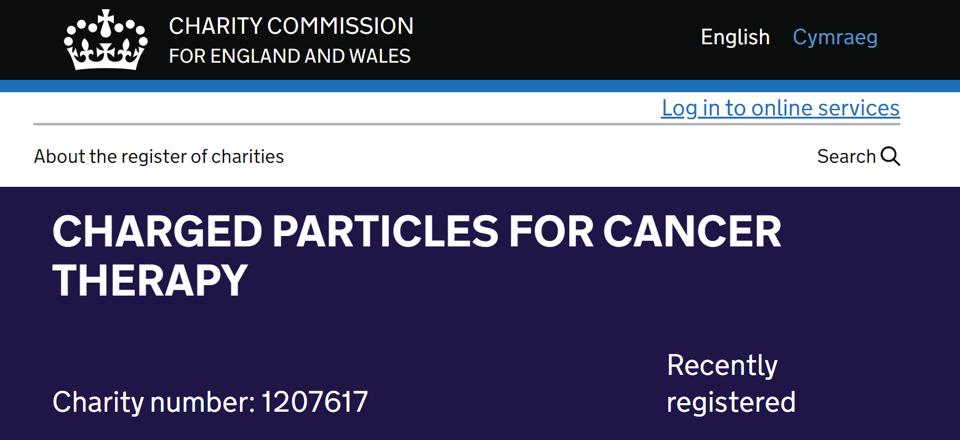
Charged Particles for Cancer Therapy CP4CT
Objects
The relief of sickness and the preservation of health of those diagnosed with cancer by:
  Promoting research for the public benefit in aspects of cancer treatment and publishing the useful results;
  Providing grants to support other bodies or to individuals to support the delivery of the organisation's
  purposes.

